Slide 1
Supporting Multi-Classroom Leaders Effectively
Notes:
Estimated Time: 120 minutes
Advance preparation for this session:
Check slides to fill in URLs or other information
Please print out or make electronically available enough copies for each attendee:
Self-Reflection–OC Implementation (Note: It would be helpful to have access to the version principals filled out last session)
Principal Reflection–MCL Support (Note: Principals will need one handout per MCL they have)
Six Steps with Guiding Questions
Six Steps Blank Template
Materials needed:
Sticky notes at each table
Chart paper
Markers

Slide 2
School Excellence Portal
Log on to the OC School Excellence Portal: opportunityculture.org/portal
Having Problems? Let us know here!
Notes:
Facilitator:
Objective of this slide: Introduce the portal, ensure that everyone can access prior to needing for use in session
Estimated time: 5 minutes
Facilitator says:
Today, we’ll be using the OC Portal to access resources and to complete planning that you can easily revisit throughout the year. We’ll also use it to help your school teams collaborate.
Right now, we just want to make sure that you’re able to log in to the OC Portal. Please go to the website listed here at the top, opportunityculture.org/portal, and enter your email and password. If you’ve used the OC Portal already this year, you’ve already set your own password. If this is your first time, you have a paper on your table with your login information. Having trouble? There’s a box in the lower right corner that you can use to let us know, and we’ll help you get on quickly!

Slide 3
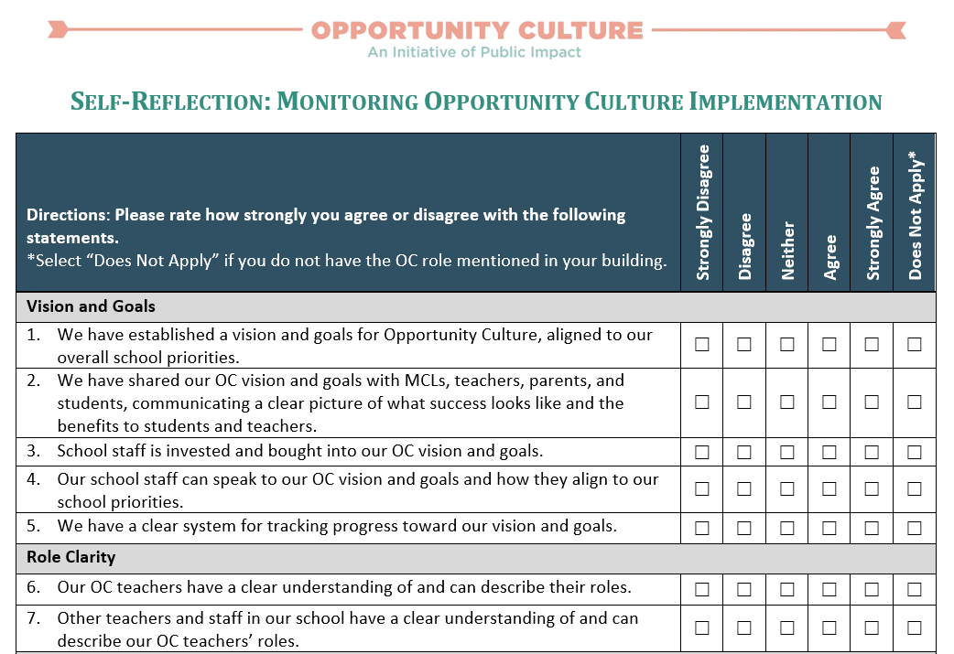
See Handout
Revisit Self-Reflection
Notes:
Facilitator:
Objective: Self-reflect on OC implementation.
Estimated Time: 10 minutes
Facilitator Notes:
Let’s start by reflecting on OC implementation at your own schools. Access your self-reflection on the portal, as pictured on the screen. Take about five minutes to revisit the self-reflection and update any of your ratings. For any statements that are not applicable, you can choose the “Does Not Apply” column.
[After ~5 minutes] Please turn to a partner or your table to share your reflections. Where have you shown the most improvement since our last session?

Slide 4
Handshake Partners
Find a partner you do not interact with often and discuss your self-reflection:
What is going well in the distributed leadership category?
What would you like to improve in the distributed leadership category?
Notes:
Facilitator: PI
Objective: Discuss Opportunity Culture implementation in regards to distributed leadership.
Estimated time: 10 minutes
Facilitator says:
Consider the two questions on the screen:
What is going well in the distributed category?
What would you like to improve in the distributed leadership category.
Take a moment to reflect individually on these two questions.
Now let’s share; find someone with whom you do not interact often, and then discuss the two questions on the screen with that person. Go!
[Optional: If you want to have more interaction, you could do two rounds of this activity, prompting principals to find a new partner.]
Thank you. Please take a seat.
Can I have one volunteer: What is one thing going well with distributed leadership at your school?
[Write response on chart paper. Ask participants to raise their hands or snap if they agree, and then ask for another thing going well. Continue this until there are no new strengths to add to the chart paper. Note that if participation is low, you could do a whip around.]
What about areas of improvement? Can I get a volunteer to share one think you would like to improve on in distributed leadership?
[Write response on chart paper. Ask participants to raise their hands or snap if they agree, and then ask for another area of growth. Continue this until there are no new improvements to add to the chart paper. Note that if participation is low, you could do a whip around.]

Slide 5
Reflect on how each Multi-Classroom Leader is progressing in the elements of instructional leadership.
Review the coaching cycle and discuss how it can be adapted to support Multi-Classroom Leaders.
Begin planning the meeting and next coaching cycle for each Multi-Classroom Leader.
Notes:
Facilitator: PI
Objective: Introduce the session’s purpose and objectives.
Estimated time: 1 minute
Facilitator says:
Thank you for sharing your reflections. We hope to provide ample work time today for you to make plans to tackle these areas of growth and discuss strengths resources with your colleagues.
Our main objectives are to:
Reflect on how each multi-classroom leader is progressing in the elements of instructional leadership.
Review the coaching cycle and discuss how it can be adapted to support multi-classroom leaders.
Begin planning the meeting and next coaching cycle for each multi-classroom leader.

Slide 6
Why is this important?
Principal Actions
MCL Actions
Teacher Actions
Student Achievement
Notes:
Facilitator:
Objective of this slide: To frame the need to track progress
Estimated time: 3 minutes
Facilitator says:
Each role has a responsibility in affecting student achievement.
But in order to know whether or not adult actions are leading to the intended output of student achievement, you as principals must take into account how your actions affect your MCLs and teachers in an OC school.
In most cases, we are accustomed to tracking student progress, but what about the actions of you, your MCLs, and your teachers? How do you have an impact on each? Let's take a few minutes to reflect and talk with your colleagues about the systems you currently have in place to track how feedback and coaching make a difference on teacher practice and student learning.
Today, we’re really going to focus on the MCL actions.

Slide 7
See Handout
How are your MCLs doing?
Launch and Lead
Build Team Cohesion
Lead Instructional Excellence
Support and Develop Individuals
Manage Yourself
Establish leadership by ensuring the right people are on the team and clarifying the team’s vision, goals, roles, and process for collaborating to achieve excellence.
Build team spirit and help your team collaborate productively to achieve your common goal of teaching and learning excellence.
Lead others openly and rapidly to implement the specific elements of instructional excellence and achieve high-standards, high-growth learning.
Provide support and development to each educator, through co-planning, co-teaching or co-leading, modeling, observing and providing feedback, and coaching.
Take care of yourself and improve your leadership and professional skills and competencies to achieve consistent performance.
Notes:
Note: If a principal only has one MCL, it may not take the whole 20 minutes. You could choose to give less time during this work block if there are several principals in this boat, and instead add on time to the work block at the end of the session. Or, if two principals end early, you could have them pair up to share with each other while other principals finish. For principals who have several MCLs, they may not finish within 30 minutes—that is fine. Assure them they will have more time at the end of the session.
Facilitator:
Objective: Reflect on MCLs’ strengths and areas of growth.
Estimated time: 20 minutes
Facilitator says:
Before you can figure out how to better support each of your MCLs, you will need to determine where each MCL actually needs support. To do this, we recommend considering all aspects of instructional leadership.
Public Impact’s Instructional Leadership framework can help do this. It consists of five elements:
First, launching and leading a team. Successful MCLs clarify the team’s vision, goals, roles, and process for collaborating to achieve excellence.
Once they have a team and structures in place to lead successfully, next comes building team cohesion. MCLs should build team spirit and help their team collaborate productively to achieve their common goal of teaching and learning excellence.
Next is leading instructional excellence. MCLs lead others openly and rapidly to implement the specific elements of instructional excellence and achieve high-standards, high-growth learning.
To do this, they’ll need to support and developing the teachers on their team. MCLs provide support and development to each educator, through co-planning, co-teaching or co-leading, modeling, observing and providing feedback, and coaching
And MCLs must make sure to manage themselves, meaning they need to take care of themselves and improve their leadership and professional skills and competencies to achieve consistent performance in a sustainable way.
Please take out the Principal Reflection: MCL Support handout. You will need one handout for each MCL you have at your school.
Take the next 30 minutes to fill out one of these documents for each MCL. You’ll first walk through the five elements of instructional leadership, checking the box that most accurately describes the MCL. The on the second page, you’ll summarize your findings by listing the MCL’s biggest strengths and areas of growth. Then choose which area of growth to prioritize in upcoming meetings with your MCL and start brainstorming how you can best support him or her.
Does anyone have any questions?

Slide 8
The Coaching Cycle
Build relationship, set vision, and norm on roles and expectations
Observe teaching, looking for implementation of action steps
Facilitate debrief conversation to deliver feedback and identify action step(s)
Provide interventions, as needed (such as model lesson, co-teach, etc.)
Notes:
Facilitator:
Objective: Review the coaching cycle MCLs learned over the summer.
Estimated time: 5 minutes
Facilitator says:
As we talk about how to best support your MCLs, let’s do it in the context of a coaching cycle. Are any of you doing consistent coaching cycles with your MCLs?
Over the summer, your MCLs learned about the coaching cycle, and they are doing adaptations of it with their team teachers every week or every other week. Just as they are doing coaching cycles with their teachers, you can be modeling coaching cycles by doing them with your MCLs.
Before we get into how to use it, let’s remind ourselves how MCLs are using it.
[Click] First, you see that in any strong coaching relationship, there must first be a relationship built with a mutual respect, a clear vision, and normed roles and expectations. Of course, this relationship will continue to grow and evolve with time.
[Click] The cycle portion can begin with an informal observation. Observations referred to in this coaching cycle are all considered to be informal and not to be confused with formal observations done by the principal to evaluate a teacher.
[Click] The observation is followed by a debrief conversation, in which the MCL provides the teacher with feedback and then, together, the MCL and teacher identify action steps to improve instruction.
[Click] Depending on the skill level of the teacher, he or she may be able to leave the coaching conversation and implement the action steps right away. Other times, however, the MCL may need to provide interventions, such as modeling a lesson in front of the teacher’s students or co-teaching with the teacher.
[Click] Once a teacher is expected to have implemented the action step, the MCL then observes again, looking specifically for the action step discussed and then eventually for new areas to continue to improve instruction.
Let’s take the cycle one by one, starting with observations, to think about how to use it with MCLs.

Slide 9
Pair-Share
STEP 1: “Observe teaching, looking for implementation of action steps”
How could this step apply to supporting Multi-Classroom Leaders?
Examples:
Observe or record a debrief conversation between an MCL and team teacher
Observe or record a PLC
Review coaching tracker to monitor teacher and student actions in each classroom
Notes:
Facilitator:
Objective: Discuss how coaching cycle could apply to teacher leaders.
Estimated time: 10 minutes
Facilitator says:
The first step in the coaching cycle is the observation. If MCLs do not observe their teachers teaching, how would they ever truly understand their teachers strengths and areas of growth? It would be impossible to support them effectively. Similarly, without a line of sight into your MCLs’ daily work, how will you every truly know their strengths and areas of growth?
Turn to a partner and discuss with each other: How could observations apply to supporting MCLs? What should principals observe their MCLs doing?
[After about 5 minutes, ask the participants to share some ideas with the full group. After the group has shared, click to display some examples on the screen.]

Slide 10
Pair-Share
STEP 2: “Facilitate debrief conversation to deliver feedback and identify action step(s)”
How could this step apply to supporting Multi-Classroom Leaders?
Examples:
Meet regularly to discuss team teachers and MCL’s development
Give clear action steps to improve leadership
Review coaching tracker to monitor action steps MCLs are giving
Notes:
Facilitator:
Objective: Discuss how coaching cycle could apply to MCLs.
Estimated time: 10 minutes
Facilitator says:
The next step in the coaching cycle is the debrief conversation. This is where MCLs give their teachers feedback, ask probing questions, identify an action step, and practice this action step together.
Turn to a partner and discuss with each other: How could this step apply to supporting MCLs?
[After about 5 minutes, ask the participants to share some ideas with the full group. After the group has shared, click to display some examples on the screen.]

Slide 11
Pair-Share
STEP 3: “Provide interventions, as needed (i.e. model lesson, co-teach, etc.)”
How could this step apply to supporting Multi-Classroom Leaders?
Examples:
Model a debrief conversation
Co-facilitate a team meeting
Co-plan a team meeting agenda
Observe a team teacher together and debrief
Role play a difficult conversation
Observe another MCL in action
Read a book or article
Notes:
Facilitator:
Objective: Discuss how coaching cycle could apply to teacher leaders.
Estimated time: 10 minutes
Facilitator says:
The last step in the coaching cycle is the intervention piece. This is where MCLs provide supports like co-teaching, modeling a lesson, co-planning, and more.
Turn to a partner and discuss with each other: How could this step apply to supporting MCLs? What types of hands-on interventions could principals provide?
[After about 5 minutes, ask the participants to share some ideas with the full group. After the group has shared, click to display some examples on the screen.]

Slide 12
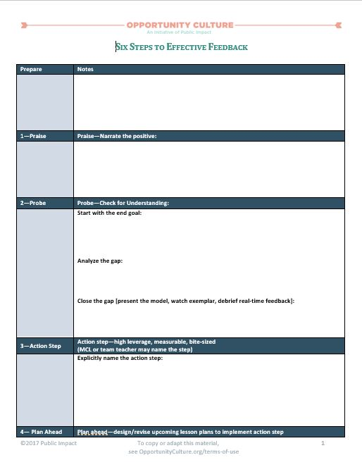
See Handout
Work Time
Begin planning your next meeting and coaching cycle with each of your MCLs.
Optional resources:
Six Steps with Guiding Questions
Six Steps Blank Template
Notes:
Facilitator: PI
Objective: Plan next meeting and coaching cycle with each of your MCLs.
Estimated time: 40 minutes (30 minutes of work time, 10 minutes to share in partners)
Facilitator says:
For the remainder of our time today, we want to give you some open planning time to prepare for your next meeting and coaching cycle for each of your MCLs.
If helpful, we have provided copies of the Six Steps for Effective Feedback—the framework introduced to you and MCLs during summer training. However, feel free to use whatever planning tool or framework you prefer!
At the end of this work time, you will have a chance to share what you developed with a partner and get feedback.
[With about 10 minutes left in this work block, prompt principals to turn to a partner to share what they drafted, give feedback, and brainstorm new ideas.]

Slide 13
Action Items
Write down 2-3 action items you commit to incorporating into your work based on your takeaways from this session. For example:
Action Item | People | Timeline | Status | Notes
Plan next meeting and coaching cycle for each MCL | Me | 12/10 | Not complete
Conduct next meeting for each MCL | Me and MCLs | 12/17 | Not complete
Notes:
Facilitator: PI
Objective: Write down action items participants are taking away from this session.
Estimated time: 5 minutes
Facilitator says:
I know, as well as you know, that if we don’t write down specific next steps after a PD, then we might not actually do them! Please take the next few minutes to write down any action items you commit to incorporating into your work based on your takeaways from this session. [Walk through examples on the screen.]

Slide 14
Thank you for your engagement and participation.
Please complete the exit slip to provide feedback on this session prior to leaving.
Notes:
Facilitator: PI
Objective: Provide feedback on the session.
Facilitator says:
[Thank participants for coming and prompt them to take the exit slip survey before they leave.]

Slide 15
Follow Us!
Keep up to date on Opportunity Culture with resources and research from Public Impact by following:
@PublicImpact
@OppCulture
Facebook.com/PublicImpact
Facebook.com/OpportunityCulture
LinkedIn.com/company/public-impact---chapel-hill-nc
Subscribe to the quarterly Opportunity Culture newsletters, with content by and for Opportunity Culture educators, and sign up to get Remind messages for them:
OpportunityCulture.org/mailing-list/
Remind.com/join/ocnew

