Slide 1
Multi-Classroom Leadership
Coaching Part 3: Practicing What and How to Coach
Notes:
Estimated Time: 70 minutes
Materials needed:
Please print out or make electronically available for each participant:
Handout—Six Steps Template​ Blank
Internet, speakers:
https://www.youtube.com/watch?v=DQ9eyaHH8R8, stop at 15:00

Slide 2
Observe a teacher and identify the highest-leverage teacher action step.
Plan for and practice a coaching conversation with that teacher.
Notes:
Facilitator:
Objective of this slide: to introduce the objectives for the session
Estimated time: <1 minute
Facilitator says (throughout the slides, put this in your own words):
Yesterday, we talked a lot about what to coach and how to coach. Today, we will build on that as we dive into other types of supports you will provide your team as an MCL. Before we move on from coaching, let’s begin today by bringing together everything we discussed yesterday. In this last coaching session, we will:
Observe a different teacher and identify the highest-leverage teacher action step.
Plan for and practice a coaching conversation with this teacher.

Slide 3
Observe and Take Notes
Notes:
Video link:, stop at 15:00
Facilitator:
Objective of this slide: Participants observe teacher, take notes on lesson, and identify teacher action step.
Estimated time: 20 minutes
Facilitator says:
Here is some background context for the video: This is a second-grade class, and you will see part of the English language arts lesson. The teacher told you that the lesson objective is to increase knowledge of comprehension through visualization and vocabulary, with an emphasis on adjectives. You can pretend this is the first time you are observing this teacher, so you are going into this classroom with an open mind and looking to see which direction you want to first push this teacher.
We’ll make this observation a bit longer and will end at the 15-minute mark (the video is a bit shaky at the beginning).
As you take notes, be sure they’re evidence-based so you have specific information to guide your coaching conversation. Feel free to use any note-taking technique you want. Please take a moment to pull out your writing utensil and to set up whatever document you would like to take notes on.
[Play video]

Slide 4
Identify Action Step
Directions:
2 minutes: Review your notes and determine what you think is the highest-leverage action step.
5 minutes: With a partner, discuss the action step you identified; provide evidence to support.
Time for this activity: 7 minutes
Notes:
Facilitator:
Objective of this slide: Participants independently identify action step, then discuss with a partner, then discuss whole group.
Estimated time: 7 minutes
Facilitator says:
Take two minutes to look over your notes, organize your thoughts, and determine what you think is the highest-leverage action step for this teacher to work on to improve. You may use the instructional excellence resources to help you.
[After two minutes] Now, with a partner, discuss the action step you identified and provide evidence for why you think those are the best skills for the teacher to focus on.
[If time, have a volunteer or two share their action step.]
[Listen for:
(1) Strategies to keep students on task rather than disruptive talking—set behavior expectations for carpet time to feel the object, noise level
(2) Probing questions to students that are higher-level to get at the correct answer from an individual student rather than moving to another student to answer the question
(3) Directions for turn and talk need more clarity (do students understand how to compare?)
(4) Introduce a framework for thinking about adjectives (color, smell, texture, etc.)]

Slide 5
Coaching Conversation Protocol
See it
Name it
Praise
Probe
Action Step
Practice
Plan Ahead
Follow-up
Do it
Bambrick-Santoyo, Paul (2012). Leverage Leadership: A Practical Guide to Building Exceptional Schools. San Francisco: Jossey-Bass.
Notes:
Facilitator:
Objective of this slide: Participants briefly review coaching conversation protocol.
Estimated time: 5 minutes
Facilitator says:
In the session on how to coach yesterday, we introduced a coaching conversation protocol. Does anyone remember what the first step was? [Pause for audience participation. Ask for a volunteer to explain what you do during this step. Then move on to the next step, putting the thinking on the participants.]

Slide 6
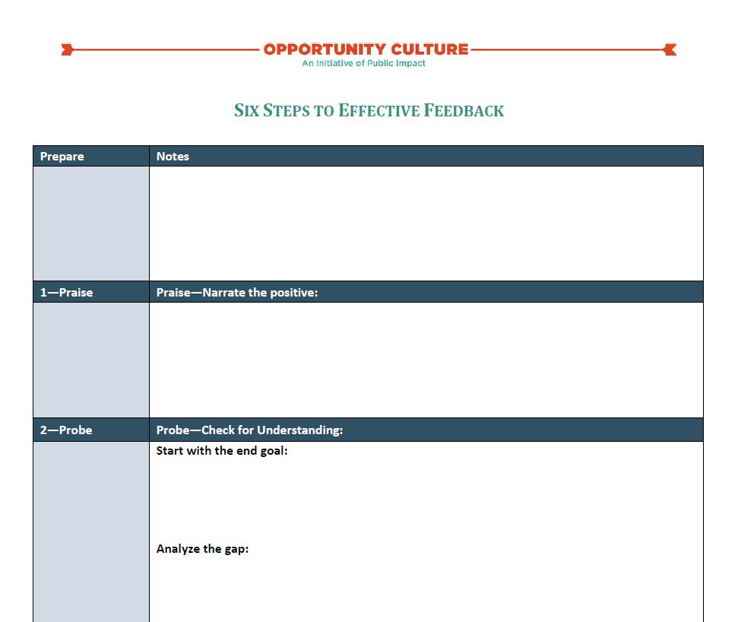
See Handout
Prepare Coaching Conversation
Directions: Prep your coaching conversation using the blank template.
Time for this activity: 10 minutes
Notes:
Facilitator:
Objective of this slide: Participants prepare for coaching conversation.
Estimated time: 10 minutes
Facilitator says:
Take the next 10 minutes to prepare for your upcoming coaching conversation with the teacher from the video. [Facilitators should circulate to support and brainstorm with MCLs as they prep.]

Slide 7
Practice!
Time Allotted | Activity
8 minutes | Role-play the coaching conversation. Partner 1 is MCL. Partner 2 is team teacher.
4 minutes | Debrief the conversation: What was strong about your partner’s facilitation of the coaching conversation? What improvement would you suggest? What are you taking away from this role play to implement in your own coaching practice?
—Switch roles—
Notes:
Facilitator:
Objective of this slide: Participants role-play their coaching conversation with a partner and discuss strengths, areas for improvement, and takeaways.
Estimated time: 25 minutes
Facilitator says:
As before, you will role-play the coaching conversation you prepared. For the first role-play, one person will play the MCL and one person will play the teacher we observed in the video. Then you will switch roles. Choose a different partner than the last time.
You will spend eight minutes in character, which is a little longer than the last role play. [Walk through protocol.]
It can be tempting to say things like, “And then I would say….” If you find yourself slipping out of character, I encourage you to get back in for the entire time. I will keep time upfront and prompt you when to move to the conversation debrief or switch roles.
[As you transition to the next slide, ask participants how it went this time. Was it easier or harder than the last role play? What parts of the coaching conversation are most difficult?]

Slide 8
Action Steps
Write down and share a few next steps you commit to incorporating into your work based on your takeaways from this session.
Next Steps | People | Timeline | Notes
Notes:
Facilitator:
Objective: Set action steps
Estimated Time: 3 minutes
Facilitator says:
At the end of each of our sessions together, we will encourage you to set some actions steps for yourselves based on what you learned during the session. We will always provide some examples. You will learn and experience a lot over the course of our training, so we want to help you ensure that you take note of actionable next steps after each session so you have a plan of attack to prepare for the first day of school.

Slide 9
Follow Us!
Keep up to date on Opportunity Culture with resources and research from Public Impact by following:
@PublicImpact
@OppCulture
Facebook.com/PublicImpact
Facebook.com/OpportunityCulture
LinkedIn.com/company/public-impact---chapel-hill-nc
Subscribe to the quarterly Opportunity Culture newsletters, with content by and for Opportunity Culture educators, and sign up to get Remind messages for them:
OpportunityCulture.org/mailing-list/
Remind.com/join/ocnew

