Slide 1
Personal Development:
Beginning of Year
Notes:
Estimated Time: 40 minutes
Materials Needed:
Handouts:
Competency self-assessments for appropriate role. NOTE: Update generic self-assessments if your district edited which competencies were used to select OC teachers.
Personal Development Plan

Slide 2
Icebreaker: Connections!
Person #1 says his or her name and begins sharing personal facts.
The first person in the group who can make a connection to something Person #1 says stands to interrupt Person #1 and then introduces him or herself.
Continue until every person has participated. Participants cannot stand for more than one connection and no one can use the same connection twice.
Notes:
Facilitator: PI
Objective of this slide: Build comradery among OC teachers.
Estimated time: 5 minutes
Facilitator says:
As you know, one of our main PD goals throughout the year is to build relationships among your cohort, creating a camaraderie where you are comfortable with each other and turn to each other for ideas, resources, and feedback. To create that environment, we need to make sure everyone continues to get to know each other, so let’s do an ice breaker!
This icebreaker is called connections.
The person who starts will say his or her name and begins sharing personal facts. S/he continues sharing facts until someone in the crowd can make a connection. (e.g., “My name is Cameron… I was born in North Carolina… I like to go camping…”)
Then the first person in the group who can make a connection to something Person #1 says stands to interrupt Person #1 and then introduces him or herself. (I.e. “My name is Jennifer… I am going camping this weekend at the lake, and I love walking my dog…”)
We will continue until every person has participated. However, participants cannot stand for more than one connection and no one can use the same connection twice.

Slide 3
Self-assess the extent to which you use the critical competencies for your role.
Create a personal development plan that leverages strengths and improves areas of growth.
Notes:
Facilitator: PI
Objective of this slide: Describe the learning objectives for the session.
Estimated time: 1 minute
Facilitator says:
During today’s sessions, we’ll be asking you to:
Self-assess the extent to which you use the critical competencies for your role.
Create a personal development plan that leverages strengths and improves areas of growth.

Slide 4
Competencies
What is a competency?
A pattern of thinking, feeling, acting or speaking that causes a person to be successful in a job or role.
Competencies can be the focus of professional development and are powerful for selecting people who are already a good fit for a job.
Notes:
Facilitator: PI
Objective of this slide: Understand the concept of competencies.
Estimated time: 2 minutes
Facilitator says:
In addition to the professional skills you have, chances are you also have underlying traits—or competencies—that have helped you see some successes in your role so far. You may remember briefly talking about competencies during summer training. Here is a quick recap.
[click to animate] Competencies are patterns of thinking, feeling, acting, or speaking. They are the underlying traits that make a person more or less effective in their work. Examples include persistence or self-confidence. We don’t use competency-based hiring and development practices often in education, but they are ubiquitous in other sectors, both for-profit and nonprofit, where companies have invested significant resources to develop competency models that are specific to their jobs, and use them strategically for hiring, placement, evaluation, and development.
[click to animate] Competencies are not static. They are developed over a lifetime of experience and can be intentionally developed. A person’s awareness of competencies can be a critical first step in professional and personal growth, which is one reason we are going to explore them now.
Competencies are also very effective for selecting individuals who are most likely to be successful in a role. In fact, many of you were selected in part because you demonstrated critical competencies that are essential for roles in Opportunity Culture schools.

Slide 5
The Iceberg Model
Qualifications:
Certification
Degrees
Knowledge & skills:
Classroom practices
Competencies:
Recurring patterns of thought and action
Example:
Achievement Drive
Adapted from “The Iceberg Model” in Spencer & Spencer, Competence at Work, p. 11.
Notes:
Facilitator: PI
Objective of this slide: Introduce skills versus competencies.
Estimated time: 1 minute
Facilitator says:
We showed this iceberg in summer training because it is a helpful way to visualize how competencies are different from skills and qualifications.
[click to animate] On the surface are easy things to identify – a teacher’s qualifications, including his certification and degrees. If we look a little more closely we can also see his knowledge and skills – the types of courses he’s taken, the subjects he’s really good in. And we can observe his practices, as a teacher or a teacher-leader.
[click to animate] But underneath the surface is what’s really difficult to see – and this is where the competencies lie. These are recurring patterns of thought and action – the underlying characteristics that have made a teacher’s outward achievements possible, such as his fundamental beliefs or achievement drive.

Slide 6
Competencies by OC Role
Principal | MCL | DRT | RA
Achievement | Achievement | Achievement | Achievement
Impact & Influence | Impact & Influence | Impact & Influence | Impact & Influence
Cultural Engagement | Cultural Engagement | Cultural Engagement | Cultural Engagement
Planning Ahead | Planning Ahead | Planning Ahead | Concern for Order
Developing Others | Developing Others | Developing Others | Serving Others
Team Leadership | Team Leadership | Teamwork
Initiative & Persistence | Initiative & Persistence
Monitoring & Directiveness | Monitoring & Directiveness
Analytical Thinking | Belief in Learning Potential
Conceptual Thinking | Flexibility
Self-Confidence
Notes:
Facilitator: PI
Objective of this slide: Remind attendees of the critical competencies for their role.
Estimated time: 5 minutes
Facilitator says:
Each of the four OC roles has specific competencies that are most critical for success in that role. You were hired because you already exhibit many of these competencies.
While the list does vary across roles, you will notice some similarities. Going all the way back to Public Impact’s initial research in 2008, two competencies continued to show up among top performers in many different sectors: Achievement and Impact and Influence. Strong competence in cultural engagement is also critical in any school setting, regardless of role. You will see these three competencies appear across all roles in red.
Principals, MCLs, and DRTs have two other competencies in common—planning ahead and developing others—both of which you can imagine are critical in all three roles.
Please take the next two minutes to read through your role’s critical competencies, which you can find on the first column of the self-assessment handout. Please do not start filling out the self-assessment yet.

Slide 7
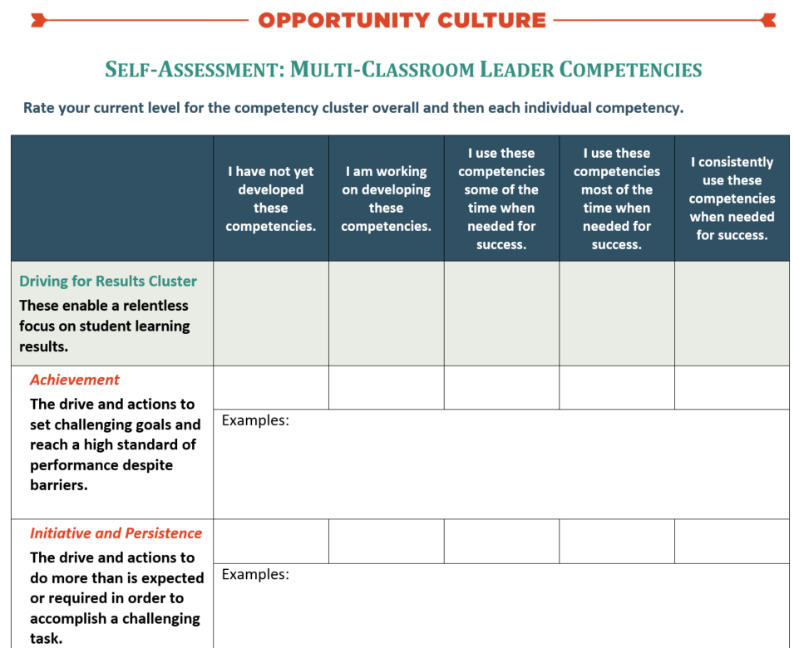
See Handout
Self-Assessment
Notes:
Facilitator: PI
Objective of this slide: Self-assess participants’ use of competencies in their OC roles.
Estimated time: 10 minutes
Facilitator says:
Please take the next 10 minutes to start this self-assessment which is based on the critical competencies of your role. Note that each competency is listed under a cluster. For example, on the screen you see the MCL self-assessment. In the first row, you see the Driving for Results Cluster. That means each of the competencies that follow are all under the same category—Driving for Results. These competencies center around a relentless focus on student learning results. As you take the self-assessment, begin with the competencies themselves, reflecting on the extent to which you use this competency and providing specific examples for how you use this competency. After you complete every competency in the cluster, go back to the shaded row within the cluster and give yourself a rough average of all the related competencies. This will give you a sense overall how strong you are in that cluster.

Slide 8
Discussion
Partner A shares strengths and areas of growth from the self-assessment.
Out of Partner A’s strongest competencies, Partner B chooses one of them to explore further.
Partner B seeks advice from Partner A on how to improve in that competency. For example:
What have you done in your role to be strong in X?
Where should I begin to improve in Y?
Switch roles after 5 minutes.
Notes:
Facilitator: PI
Objective of this slide: Share strengths and areas of growth with a peer.
Estimated time: 10 minutes
Facilitator says:
Please turn to a partner and discuss your strengths and areas of growth on the self-assessment. Choose one person to be Partner A and one person to be Partner B. Partner A will go first.
Partner A shares strengths and areas of growth from the self-assessment.
Out of Partner A’s strongest competencies, Partner B chooses one of them to explore further—ideally a competency that is an area of growth for Partner B.
Partner B then seeks advice from Partner A on how to improve in that competency. For example:
What have you done in your role to be strong in X?
Where should I begin to improve in Y?
After five minutes, you will switch roles.

Slide 9
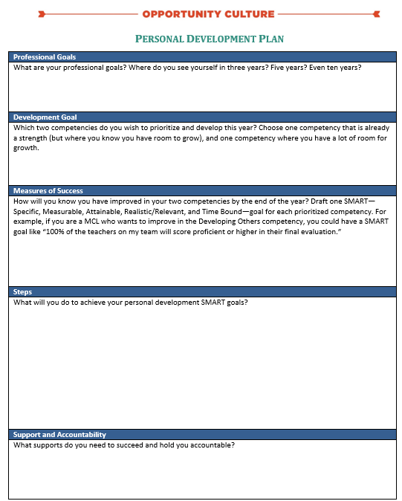
See Handout
Work Time
Draft your Personal Development Plan:
What do you aspire to be doing professionally in five to ten years?
Which competencies will you prioritize this year in order to reach those goals?
What does success look like if you improve in your chosen competencies this year?
What steps will you take?
What supports do you need to succeed and hold you accountable?
Notes:
Facilitator: PI
Objective of this slide: Draft a personal development plan.
Estimated time: 12 minutes
Facilitator says:
Over the summer, MCLs and DRTs set goals to measure success this year. These goals are absolutely critical to ensure that you are improving your and others’ teacher practice and ultimately, seeing gains in student learning and growth.
In addition to thinking about teacher skills and student outcomes, it is important for you all to be thinking about your own personal development, and how that will lead to your ultimate professional plans. It’s not often that we get a chance to step back and think about our five or ten year plan, but we are going to get a chance to do that today and then follow up at the end of this year.
Please take out your handout titled “Personal Development Plan.”
[Walk through the template, sharing any examples or extra details in the handout.]
What do you aspire to be doing professionally in five to ten years?
Which competencies will you prioritize this year in order to reach those goals?
What does success look like if you improve in your chosen competencies this year?
What steps will you take?
What supports do you need to succeed and hold you accountable?
Take the next 15 minutes to begin working on this development plan. However, don’t worry if you can’t finish it today—you may need more time to truly reflect and finish this plan.

Slide 10
Action Items
Write down action items you commit to incorporating into your work based on your takeaways from this session.
Action Item | People | Timeline | Status | Notes
Finish personal development plan | Me | End of the week | Not complete
Meet with supervisor to norm on competency self-assessment and discuss personal development plan | Me, supervisor | End of next week | Not complete | Email supervisor copies of my self-assessment and LDP
Notes:
Facilitator: PI
Objective: Write down action items participants are taking away from this session.
Time: 2 minutes
Facilitator Notes:
We all know that if we don’t write down our next steps, then we may not actually do anything as a result of this session. Don’t let that be you! You will be glad later if you take the time now to plan your next steps. Please take the next few minutes to write down the next steps on the screen, as well as any other action items you commit to incorporating into your work based on your takeaways from this session. [Give participants some time to actually do this before transition to the next session.]

Slide 11
Follow Us!
Keep up to date on Opportunity Culture with resources and research from Public Impact by following:
@PublicImpact
@OppCulture
Facebook.com/PublicImpact
Facebook.com/OpportunityCulture
LinkedIn.com/company/public-impact---chapel-hill-nc
Subscribe to the quarterly Opportunity Culture newsletters, with content by and for Opportunity Culture educators, and sign up to get Remind messages for them:
OpportunityCulture.org/mailing-list/
Remind.com/join/ocnew

