Slide 1
Principals: Launching an
Instructional Team of Leaders
Notes:
Estimated Time: 90 minutes
Materials:
Upload examples of tracking documents into the Portal.
Chart paper, markers, and sticky notes—one for each principal.
Hanouts used during this session: Standing Agendas for Leading Instructional Team of Leaders

Slide 2
Do Now
Write down each of the instructional leadership tasks you currently execute as the school leader. Use a separate sticky note for each task.
Observation/ coaching/PD
Observation and feedback
Instructional coaching
Professional development
Evaluation
Evaluating teacher performance
80% of principals indicate they are responsible for all of these activities for the ~40 teachers they lead
Talent management
Attracting and hiring talent
Teacher retention
Taking action with teachers who perform poorly
Other
Implementing school’s instructional approach
Facilitating teacher collaboration
Building a culture of high expectations
Source: Bain Distributed Leadership Study 2015; Bain Organization practice
Notes:
Facilitator:
Objective of this slide: To have principals reflect on all of the instructional leadership tasks that they execute
Estimated time: 4 minutes
Materials: sticky notes
Facilitator says (throughout the slides, put this in your own words):
In our first session, we saw this graphic that outlined the instructional leadership activities that most principals are responsible for.
I bet that this list is not comprehensive. So, take three minutes to write down each of the instructional leadership tasks that you currently execute as the school leader.
Be sure to include only instructional leadership tasks that directly affect teaching and learning.
Also, it helps to be specific as possible—so, for example, instead of writing “monitor student achievement,” write “conduct quarterly data analysis meetings.”
Write each task on a separate sticky note.
[After three minutes] OK, put those to the side, and we will come back to them soon.

Slide 3
Apply distributed leadership practices to your instructional team of leaders.
Define each Opportunity Culture team member’s role and responsibilities and how they contribute to achieving school vision and goals.
Examine structures for Opportunity Culture teacher collaboration.
Notes:
Facilitator:
Objective of this slide: Introduce session objectives
Estimated time: 2 minutes
Facilitator says:
During this session, we will be discussing how your role will be different next year leading a team of leaders, who in turn lead teams of teachers.
Here are our objectives:
Apply distributed leadership practices to your instructional team of leaders.
Define each Opportunity Culture team member’s role and responsibilities and how they contribute to achieving school vision and goals.
Examine structures for OC teacher collaboration.

Slide 4
Leading a Team
Launch and Lead
Build Team Cohesion
Support and Develop Individuals
Manage Yourself
Lead Instructional Excellence
Establish leadership by ensuring the right people are on the team and clarifying the team’s vision, goals, roles, and process for collaborating to achieve excellence.
Build team spirit and help your team collaborate productively to achieve your common goal of teaching and learning excellence.
Provide support and development to each educator, through co-planning, co-teaching or co-leading, modeling, observing and providing feedback, and coaching.
Take care of yourself and improve your leadership and professional skills and competencies to achieve consistent performance.
Lead others openly and rapidly to implement the specific elements of instructional excellence and achieve high-standards, high-growth learning.
Notes:
Facilitator:
Objective of this slide: To reorient principals to the Leading a Team section of the Principal Action Planner
Estimated time: 1 minutes
Facilitator says:
During an earlier session, we mentioned that over the next few days we planned to focus on one strand of the Principal Action Planner—Leading a Team.

Slide 5
Leading a Team: Launch and Lead
Why are you making changes in your school?
What is your vision for how students will benefit from changes to your school?
What is your vision for how teachers will benefit from changes to your school?
What are your school’s big goals for the next 3 years?
Theory of Action & Measures of Success
Who is on your Instructional Team of Leaders?
What is each team member’s purpose, role, and responsibility to help achieve the vision and reach common goals?
What role will you play?
Roles & Responsibilities
Process for Collaborating
How will your team work together—who makes decisions, when will you meet, what will you do together and independently?
Notes:
Facilitator:
Objective of this slide: To share the key questions that principals must answer in preparation to “Launch and Lead”
Estimated time: 2 minutes
Facilitator says:
As you recall, during the last session you had a chance to revise your school's Theory of Action and Measures of Success. Now, we will shift our focus to revisiting the roles and responsibilities of the people on your instructional team of leaders.
Can someone read the three questions related to the roles and responsibilities of the people on your leadership team?
We are going to talk more about what we mean by the term “instructional team of leaders” in a moment, but for now let’s focus on the big picture of how a principal’s mindset changes in a school that moves to true distributed leadership.

Slide 6
Distributed Leadership Mindset Shifts
Move from doing the work to leading the work.
Give leadership team members the autonomy to do tasks effectively.
Commit to developing your leaders and differentiating your leadership style to meet the needs of each team member.
Monitor key inputs of the work and intervene as necessary.
Notes:
Facilitator:
Objective of this slide: To highlight mindset shifts for distributing leadership
Estimated time: 2 minutes
Facilitator says:
Let’s start by anchoring ourselves back in distributed leadership. Earlier you all shared some of your hopes and fears related to distributed leadership in an Opportunity Culture, and here we can see some key mindset shifts for principals to consider.
Principals from other OC schools have identified some keys to this.
First is accepting that your role as the principal will change in some ways. In many cases, this means that instead of your doing the work, you are leading and guiding the work.
Next is to actually give leadership team members the autonomy to do tasks effectively. A common pitfall some leaders have when implementing Opportunity Culture is telling people that they have responsibilities, but in reality, the leader is still making decisions and pulling the strings from the background. It will be important to truly give your MCLs autonomy to do their jobs and do them well.
Just like your MCLs are committed to developing their teachers and have to differentiate their coaching, you as the principal will need to do the same. As you release leadership to other team members, you will need to commit to developing your leaders and differentiating your leadership style to meet the needs of each team member.
And finally, there will need to be a clear system in place to monitor the work. Since your MCLs are closer to the work and know the intricate details, you as the principal will need to create a system to track leadership team members’ progress to know whether or not your school is on track for success. The most successful OC principals create a shared tracking document that all MCLs can update when they see their teachers. We’ll share some examples with you later today.
As each of you considers how you will make the key decisions you need to lead an effective OC school, keep these mindset shifts in mind.

Slide 7
Instructional Team of Leaders
Instructional Leadership Team Meeting
Provide information on curriculum changes Update on facilities Provide attendance and discipline data Remind teachers of due dates Discuss parent engagement Provide testing information Discuss school programs
Instructional Team of Leaders Meeting
Review data from previous assessment MCLs report on successes and challenges with teachers and students Discuss new instructional strategies, updates to curriculum
Notes:
Facilitator:
Objective of this slide: To define instructional team of leaders
Estimated time: 3 minutes
Facilitator says:
Assuming that most, if not all, of you have an instructional leadership team or ILT, what are some topics covered currently during these meetings? [Listen for operations, discipline, school activities, instruction.. How long do these meetings typically last? [Listen for short periods of time.] Do you feel you’re able to achieve school goals and drive change when you try to cover so much in a short period of time?
[Click] All of the things we cover in ILT meetings are important, but when they try to cover so much in a short meeting, principals report that they do not have the opportunity to really dig into teacher's instructional needs. That limits their ability to quickly increase teacher efficacy and student outcomes. One of the most critical decisions that you will make as a principal in an OC school is to think through how your new OC teacher-leaders—your MCLs and possibly your TRTs—will be incorporated into your instructional team of leaders.
[Click] Looking at the data on OC schools that are able to quickly and significantly improve teacher practice and student outcomes, one factor that stands out is that principals shift their focus to what we call an “instructional team of leaders.” This team is made up of the leaders in the building who are accountable for student outcomes and the growth of all instructional staff. The team usually involves the principal, APs, MCLs, and in some cases TRTs.
In these successful Opportunity Culture schools, leaders shift from trying to cover several topics during one hectic ILT meeting to making sure that the time they have together is laser-focused on monitoring progress toward schoolwide teacher and student goals and making adjustments if needed.
For distributed leadership to work in your school, your MCLs will need this focused time to discuss data, report on successes and challenges they are having with teachers and students, discuss new instructional strategies and curriculum updates, and reflect upon their own practice and ensure that their actions are aligned to your vision and goals as a leader. As you saw from the articles in the previous session, Opportunity Culture principals use this time to lead teachers as well as keep a pulse on the support MCLs provide to teachers.

Slide 8
Instructional Team of Leaders
How is this definition of an Instructional Team of Leaders similar to or different from your current conception of an Instructional Leadership Team?
Definition: The leaders in the school who are accountable for student outcomes and the growth of all instructional staff.
Notes:
Facilitator:
Objective of this slide: To reflect on how an instructional team of leaders is similar to and different from current conceptions of an ILT
Estimated time: 7 minutes
Facilitator says:
Take a moment to silently reflect on the question, "How is this definition of an instructional team of leaders similar to or different from your conception of your Instructional Leadership team?" In other words, to what extent does this definition align to your current ILT? If it doesn’t, do you have any hesitations about moving to this structure?
[Give participants 2 minutes]
Now, share your thoughts with a partner.
[Give 3 minutes]
In a moment, we will be diving deep into the roles and responsibilities of each of the accountable leaders in your building. In order to do so, it would help to have clarity and some agreement on the purpose of the group we are calling an instructional team of leaders, so I am particularly interested in hearing from those of you who would have to make significant changes to your ILT if you shift to this definition, and who have some hesitation about making this move. What are your thoughts and concerns?

Slide 9
Instructional Team of Leaders’ Roles
On your chart paper, draw an organizational chart to show: Who is on your Instructional Team of Leaders?
Include role, name, grade level(s) and subject(s)
Write OC roles in red and non-OC roles in green
Principal: (name)
AP: (name) Enrichment
MCL: (name)
5-8 ELA
MCL: (name)
5-8 Math
TRT: (name)
5-8 Math
Notes:
Facilitator:
Objective of this slide: To identify who is on the instructional team of leaders (OC and non-OC) and to identify the number of students that each OC team member is responsible for
Estimated time: 10 minutes
Facilitator says:
Now that we understand what it means to have an instructional focus through the instructional team of leaders, it is now time to identify whom we will have on this team.
During design sessions, you drafted an OC role clarity document and shared it with your school teams. Let’s build off that and get really concrete. Here, we are specifically talking about the teacher-leaders in your building who will coach and support instruction and who will make up your instructional team of leaders. The example on the screen is of a small school, where the instructional team of leaders consists of the AP, who is not in an OC role, two multi-classroom leaders, and a team reach teacher. A larger school may have a principal managing a group of APs, who then manage the MCLs, who manage the rest of the instructional staff.
For each role, I have identified the content or grade level that they are leading.
Please choose a chart paper posted around the room and move to that spot. When you get there, start drafting your org chart, making sure to answer all three questions on the screen.
[Give principals 5 minutes to draw org charts. Move about the room and ask the questions posted on the slide to ensure that this information is captured.]

Slide 10
Instructional Team of Leaders’ Roles
Now, add: Who is each accountable leader leading and how many teachers and students are they affecting?
For OC roles, ​indicate the # of students who will be reached based on your latest enrollment data (try to get within a +/- 5 students; this data will be updated through the year)​
Principal: (name)
450 s
AP: (name) Enrichment
MCL: (name)
5-8 ELA
MCL: (name)
5-8 Math
8 K-4 teachers (names)
100 S
150 S
10 special-area teachers (names)
4 ELA teachers (names)
2 special education teachers (names)
3 math teachers (names)
2 special education teachers (names)
TRT: (name)
5-8 Math
Notes:
Facilitator:
Objective of this slide: To identify who and how many teachers each person on the instructional team of leaders leads
Estimated time: 10 minutes
Facilitator says:
Now that you've posted who is on your instructional team of leaders, let's move to whom they directly lead.
Using our same example, in this school, the AP coaches and supervises all specials teachers. The MCLs will directly manage all 5–8 teachers—one focused on math and the other on ELA. The principal will directly manage the AP, both MCLs, and the PK-4 teachers. It's also important to note that the math MCL in this small school leads a team of regular classroom teachers as well as a team reach teacher.
Again, a larger school may have a principal managing a group of APs, who then manage the MCLs, who manage the rest of the instructional staff.
Take time now to add whom your leaders are leading—include their names, if known—and how many teachers they are leading, with their names listed as well. In the case of a vacancy, this can just say 'Vacant'
[Give principals 3 minutes to complete this task]
Once you have finished adding team members by name, please calculate how many students each MCL will “reach” through their leadership. For this example, I have identified the number of students on my org chart. In this example, you see that the math MCL is also leading a team reach teacher. Since the math MCL and the TRT are reaching the same group of students, there is no need to identify a unique group of students who are being reached by the TRT. Information about the number of students “reached” by the MCL is really important, as we calculate the number of students who are directly affected by Opportunity Culture in your school, so that we can assess whether your MCLs are reaching the goals you have for them.
We know that enrollment changes, so it is completely fine to provide your best estimate as of today.
[Give principals 3 minutes to complete this task]
Now turn to a principal next to you and compare org charts. Learn how they plan to structure their instructional team of leaders, and share any strengths or concerns.
[Give principals 5 minutes to talk in pairs.]
Now, let's take it one step further to articulate the specific responsibilities for each role.

Slide 11
Instructional Team of Leaders’ Roles
Now: Review your sticky notes and begin to place them under the role that will be responsible for executing this task
Feel free to duplicate a sticky note if multiple people will be responsible.
Principal: (name)
450 s
AP: (name) Enrichment
MCL: (name)
5-8 ELA
MCL: (name)
5-8 Math
8 K-4 teachers (names)
100 S
150 S
Instructional Coaching
10 special-area teachers (names)
4 ELA teachers (names)
2 special education teachers (names)
3 math teachers (names)
2 special education teachers (names)
TRT: (name)
5-8 Math
Teacher Evaluation
Instructional Coaching
Instructional Coaching
Instructional Coaching
Data Analysis Meetings
Teacher Evaluation
Professional Development
Professional Development
Notes:
Facilitator: See note at the bottom about documenting org charts in the portal.
Objective of this slide: To match leadership tasks to roles
Estimated time: 10 minutes
Facilitator says:
Now, let's begin to match responsibilities to each role.
Continuing with our example, let's take a look at what responsibilities each of the instructional team of leaders’ members have been assigned. For illustrative purposes, I've only named one or two tasks, but we know that there are many more than this. To begin with, you see that most instructional team of leaders’ members are responsible for instructional coaching for their teachers. Additionally, both MCLs are responsible for designing and leading professional development. The team reach teacher leads data analysis for math in grades 5–8. Only the principal and the assistant principal are responsible for teacher evaluations.
Using the sticky notes you created earlier describing all the instructional tasks you currently handle, think about how you could ask others on the instructional team of leaders to take on some of these tasks. Begin placing sticky notes for these tasks under the appropriate team member. If necessary, duplicate sticky notes and/or create new ones so that you have a clear visual that reflects your current thinking.
Let's start with 10 minutes of work time as you begin to populate your org chart with responsibilities. Remember to only include instructional leadership tasks. Also, if you completed a Roles and Responsibilities document during the design process, now would be a good time to log in to the portal and revisit this, if it would help you with this task. You can also look in the portal to see the job descriptions for the roles in your district as an additional resource.
Once you complete your org chart, you will want to document it for the rest of your team.
Note to PI facilitator: Organizational charts must be recorded during the session. Organizational charts will be used to assist with the fall support visits and with estimating reach. You can take one of two approaches:
1) You, as the facilitator, take pictures of participants org charts using the process described here (https://opportunityculture.schoolexcellenceportal.org/node/5309). In advance, you schedule an analyst to update the org charts from the pictures on the Portal during the session, and have principals review the information (see slide 15)
2) Principal participants enter their information directly into the Organizational Charts, following the directions on slides 12-14.
In either case, the principal will use the time provided in slide 15 to review the updated organizational chart.

Slide 12
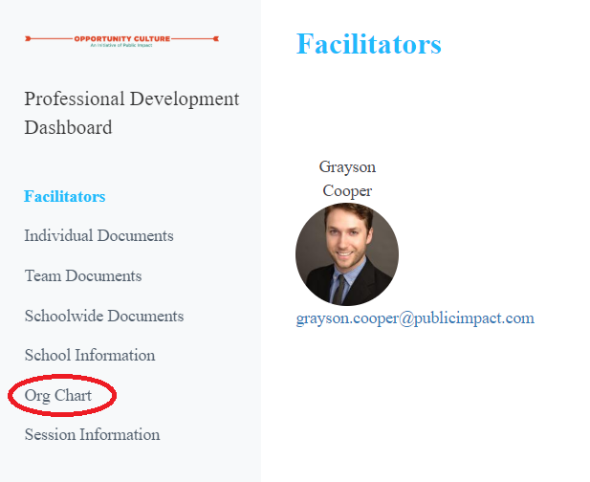
Building Your Organizational Chart in the OC School Excellence Portal
Document your organizational chart in the OC portal.
To edit your org chart:
Click Edit Org Chart to begin editing your Organizational Chart
Notes:
Note: Use slides 12—15 if you are having principals enter organizational chart in the portal themselves. If you are uploading photo and asking a PI analyst to document org chart data during the session, you can hide these slides.
Objective of this slide: To provide time for principals to document their decisions and next steps in the School Excellence Portal
Estimated time: 5 minutes
Facilitator says:
As mentioned earlier, we will be using the School Excellence Portal to document key decisions. Please open the Portal now and navigate to the Organizational Chart.
Please go ahead and take a few minutes to upload your Organizational Chart into the portal so you have a written version that you can share with your staff, following the directions on slides 12 through 15.

Slide 13
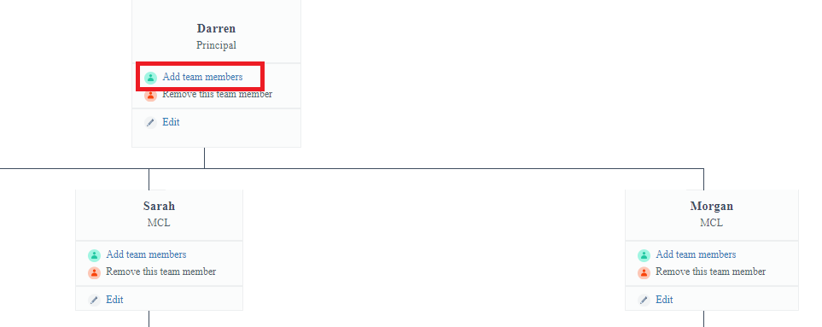
Building Your Organizational Chart in the OC School Excellence Portal
Document your organizational chart in the OC portal.
To update your org chart:
Click Add Team Member to add a new team member to that staff’s team.
Notes:
Note: Use slides 12–15 if you are having principals enter organizational chart in the portal themselves. If you are uploading photo and asking a PI analyst to document org chart data during the session, you can hide these slides.
Objective of this slide: To provide time for principals to document their decisions and next steps in the School Excellence Portal
Estimated time: 5 minutes
Facilitator says: [go through instructions on screen as needed]

Slide 14
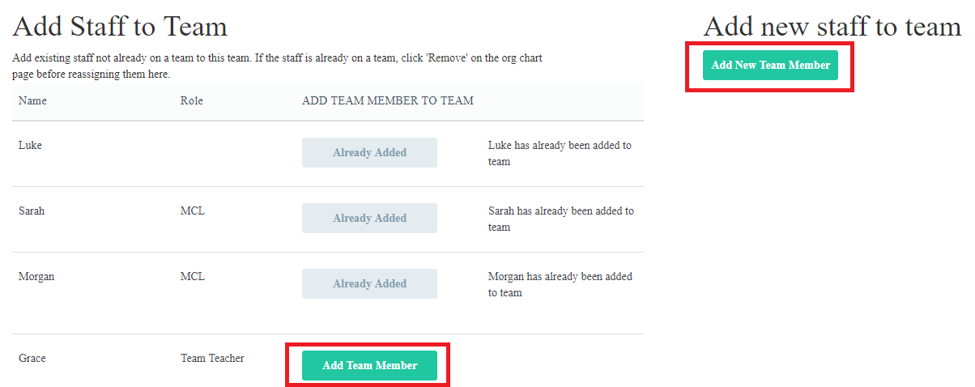
Building Your Organizational Chart in the OC School Excellence Portal
Document your organizational chart in the OC portal.
To update your org chart:
Select the team member from the list
Is the team member not listed? Add a new one!
Notes:
Note: Use slides 12–15 if you are having principals enter organizational chart in the portal themselves. If you are uploading photo and asking a PI analyst to document org chart data during the session, you can hide these slides.
Objective of this slide: To provide time for principals to document their decisions and next steps in the School Excellence Portal
Estimated time: 5 minutes
Facilitator says: [go through instructions on screen as needed]

Slide 15
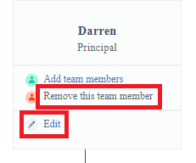
Building Your Organizational Chart in the OC School Excellence Portal
Document your organizational chart in the OC portal.
To update your org chart:
Is there something listed incorrectly? Add or change information about a team member by clicking edit.
Need to add a staff to a different team? Click Remove this Team Member. Then you can add them to a new team!
Notes:
Note: Use slides 12–15 if you are having principals enter org chart in the portal themselves. If you are uploading photo and asking a PI analyst to document org chart data during the session, you can hide these slides.
Objective of this slide: To provide time for principals to document their decisions and next steps in the School Excellence Portal
Estimated time: 5 minutes
Facilitator says: [go through instructions on screen as needed]

Slide 16
Review Your Organizational Chart in the OC School Excellence Portal
Review your organizational chart in the OC portal.
Ensure that your organizational chart includes:
Members of your Instructional Team of Leaders, particularly OC leaders
Names of teachers in each of the MCL, TRT, and RA roles and on an MCL team
The subject, grade, and number of students reached.
To update your org chart:
Click Add Team Member to add a new team member.
Select the team member from the list, or add a new one.
Add or change information about a team member by clicking edit.
Time for activity: 10 minutes
Notes:
Note: Ask all principals to review organizational chart in the portal regardless of how the information was uploaded.
Objective of this slide: To provide time for principals to review their organizational chart in the School Excellence Portal
Estimated time: 10 minutes
Facilitator says:
[if previous slides were hidden] As mentioned earlier, we will be using the School Excellence Portal to document key decisions. Please open the Portal and navigate to the Organizational Chart.
Please take a few minutes to review your Organizational Chart in the portal. Ensure that your organizational chart includes:
Members of your Instructional Team of Leaders, particularly OC leaders
Names of teachers in each of the MCL, TRT, and RA roles and on an MCL team
The subject, grade, and number of students reached.
If you need to make changes to your org chart, now or later:
Click Add Team Member to add a new team member.
Select the team member from the list, or add a new one.
Add or change information about a team member by clicking edit.

Slide 17
Reflection
What sticky notes are left? Who can realistically accomplish those tasks well?
To what extent does your Instructional Team of Leaders have the necessary skills to accomplish the tasks assigned to them currently? How will you maximize strengths? How will you develop areas of growth?
On Day 3, during "Work Time: Scheduling for an Opportunity Culture" you and your team will develop schedules to ensure that your leaders have time in their schedules to accomplish these responsibilities.
Notes:
Facilitator:
Objective of this slide: To reflect on the match between roles and responsibilities
Estimated time: 5 minutes
Facilitator says:
Now, let’s take 5 minutes to reflect on the two questions posted.
As you can see, it's not enough to think about who is being tasked with a particular responsibility.
It is also very important to think about how an individual will grow in executing that skill.

Slide 18
Leading a Team: Launch and Lead
Why are you making changes in your school?
What is your vision for how students will benefit from changes to your school?
What is your vision for how teachers will benefit from changes to your school?
What are your school’s big goals for the next 3 years?
Theory of Action & Measures of Success
Who is on your Team of Leaders?
What is each team member’s purpose, role and responsibility to help achieve the vision and reach common goals?
What role will you play?
Roles & Responsibilities
Process for Collaborating
How will your team work together—who makes decisions, when will you meet, what will you do together and independently?
Notes:
Facilitator:
Objective of this slide: To share the key questions that principals must answer in preparation to Launch and Lead
Estimated time: 2 minutes
Facilitator says:
Next, we are going to take a look at a few tools that we hope will help you establish a strong collaborative culture on your instructional team of leaders. Different from our previous sections, we are not going to take time today for you to answer the question, but we did want to share some tools with you so you can think this through before the school year starts. You learned about some ways principals collaborate in the last session, and now we’d like to provide you with resources to support your collaboration.

Slide 19
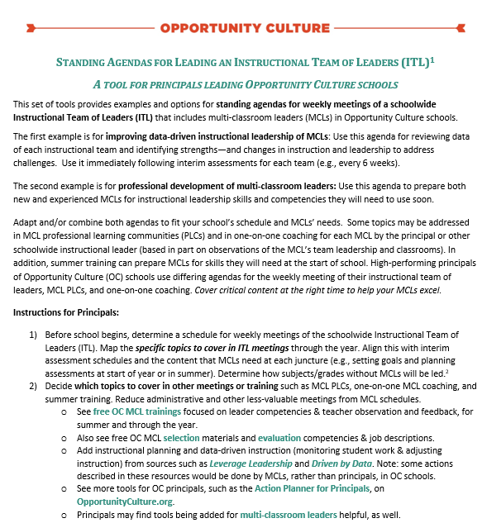
Launch and Lead: Process for Collaborating
Review the Sample Instructional Team of Leaders agenda and consider:
How is the standing agenda similar or different from how you currently collaborate with your ILT?
Which elements of this tool would you like to use in your practice? Why?
Which elements of this tool would you need to adapt to fit your school context? Why?
Notes:
Facilitator:
Objective of this slide: To review a tool to support an instructional team of leaders’ collaboration and reflect on the tool
Estimated time: 10 minutes
Facilitator says:
On the Opportunity Culture website, there are many tools you can use to guide your work. As I navigate to this tool, follow along.
When you go to OpportunityCulture.org you’ll see a top tab called “resources for educators.” In the drop-down menu underneath, you’ll want to explore the first tab on instructional leadership and excellence—it is full of resources, from short videos of Opportunity Culture educators discussing their keys to success, to study guides you can use on your own or with your team of leaders, to a multitude of tools.
Right now, please click on “launch and lead,” and then “learn more.” Now click on “tools for principals and multi-school leaders.” Go to the Standing Agendas for Leading an Instructional Team of Leaders and open it.
Please take 10 minutes to review this tool and reflect on the questions posted on the slide.

Slide 20
Next Steps
Next Steps | By Whom | By When | Notes/ Resources
Share the Roles and Responsibilities Org Chart with your team and seek feedback and clarification. | Principal | Day 3 of OC Summer PD
Use the Roles & Responsibilities Org Chart during the "Scheduling for OC" session to ensure that your leaders have time to execute the tasks assigned. | Instructional Team of Leaders | Before school year starts
Determine a process for collaborating and design a Team of Leaders' scope and sequence for the year, including when the team will meet, and which topics will be covered. | Instructional Team of Leaders | Before school year starts
Begin thinking about which of these next steps you might be able to address with your team during the final “Work Time” on Day 3.
Notes:
Facilitator:
Objective of this slide: To solidify immediate and long-term next steps
Estimated time: 5 minutes
Facilitator says:
To close out this session, we’d like for you to reflect on next steps and record them in the portal.
If you open up the Next Steps Tracker in the portal, you will see that we have gone ahead and pre-populated if with some next steps from this session that we think you will want to record, but of course feel free to edit and delete these and add your own.
Be sure to share leadership and assign tasks to someone other than yourselves!
Consider timelines based on the school year. Do you need to complete this task before school starts? During the first quarter? By the end of first semester?
Finally, make note of any notes or resources that will support you in completing this task.

Slide 21
Follow Us!
Keep up to date on Opportunity Culture with resources and research from Public Impact by following:
@PublicImpact
@OppCulture
Facebook.com/PublicImpact
Facebook.com/OpportunityCulture
LinkedIn.com/company/public-impact---chapel-hill-nc
Subscribe to the quarterly Opportunity Culture newsletters, with content by and for Opportunity Culture educators, and sign up to get Remind messages for them:
OpportunityCulture.org/mailing-list/
Remind.com/join/ocnew

