Slide 1
Multi-Classroom Leadership
Launching a Successful Team
Notes:
Total estimated time: 120 minutes
Activity preparation for this session:
Printing: Please print out the document labeled “NORMal Interactive Activity Cards” and cut the cards out along the lines. There are a few duplicate cards for some of the actions that can easily be “acted out” to demonstrate the need for norms.
Materials needed:
Two flipcharts, one labeled “Hopes” and one labeled “Fears”
Chart paper for setting group norms (one page per table)—Slide 15
Sticky notes, about 10 per person
Writing utensils
Room to move around
Please print out or make electronically available:
Multi-Classroom Leader Team Meeting Sample Agenda—Analyzing Student Work
Multi-Classroom Leader Team Meeting Sample Agenda—Data Analysis
Building Relationships
Examples of Norms
Norms and Responsibilities
Sample MCL Team Meeting Agenda
MCL Action Planner
Please note:
Not all the hopes and fears that participants are likely to bring up in slide 2 will be fully addressed in this session, but many will be addressed over the three-day training series.
Facilitators should feel free to hide examples (such as behavior norm slides) based on group needs/ time.
Facilitator says (throughout the slides, put this in your own words):
Before we get started on the topic of Launching Leadership, I’d like to get a better understanding of how you all are feeling about becoming a Multi-Classroom Leader.
You should all have some sticky notes on your table, and a writing utensil.

Slide 2
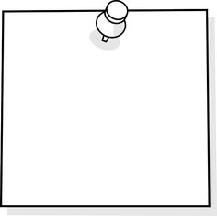
Hopes and Fears
Directions: Respond to the following questions on a sticky note. Please use one sticky note per answer.
What do you hope will happen when you start leading your team?
What is your biggest fear about leading a team?
Time for this activity: 2 minutes
Notes:
Facilitator:
Objectives of this slide:
For participants to be able to voice their fears, and know that they are not alone.
For the facilitator to better understand the hopes and fears in the room and be able to address many of them throughout this session and the training series.
Estimated total time: 5 minutes
Facilitator says:
Stepping into a new role is often a challenging and slightly scary experience.
Please use the sticky notes to write down the hopes [click for animation] and fears [click for animation] you have about leading a team of your peers.
Please write only one hope or fear per note.
I will give you one minute to complete this activity.
[Click once for green circle timer.]
Call out your hopes and place them on this chart. If anyone in the room has the same hope, they should raise their hand and say, “I’m with you!” We will repeat this process until everyone’s hopes are on the chart.
[Make a mental or written note of the hopes and fears participants mention so you can be sure to address them.]
[Hopes to listen for:
Improve student academic achievement
Successfully change “the way things have always been done”
Foster great teamwork and collaboration
Strengthen skills of novice teachers or teachers in need of improvement]
[Repeat the same activity with the fears.]
[Fears to listen for:
Lack of collaboration and/or teamwork
Inability to influence team members to change
Pushback from team members who doesn’t respect the MCL position
Not knowing the answers to everything
Not able to get everything done]
Now everyone please take a moment to silently reflect on the hopes and fears that you all have expressed. We’ll be revisiting many of these throughout this training.

Slide 3
Discuss strategies for building a successful team.
Draft an agenda for norm-setting meeting with team teachers.
Notes:
Facilitator:
Objective of this slide: provide the objective for the session.
Estimated time: 1 minute
Facilitator says:
Today, our first objective is to review and discuss strategies for launching your teaching team.
Our second objective is to draft a norm-setting meeting agenda that you can use with your team teachers at your first meeting.

Slide 4
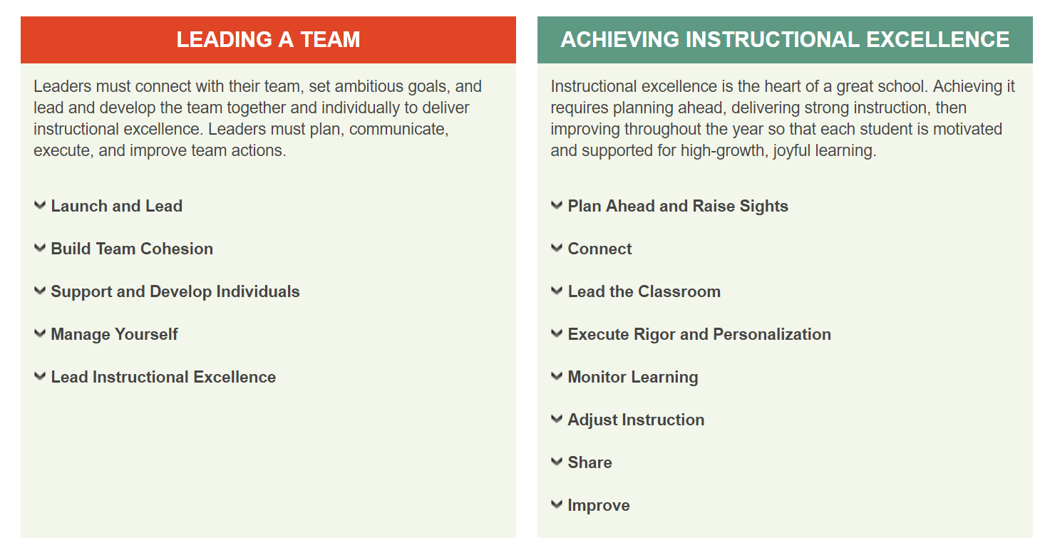
Instructional Leadership and Excellence
Notes:
Facilitator:
Objective of this slide: review ILE framework
Estimated time: <1 minute
Facilitator says:
Today we’re going to focus in on two key elements of the Instructional Leadership and Excellence framework,
[Click] Launching and Leading a Team and Building Team Cohesion

Slide 5
Build Team Cohesion
Build Relationships
Collaborate
Address Challenges
Celebrate Successes
Notes:
Facilitator:
Objective of this slide: To introduce the importance of building team cohesion to help achieve the common goal of teaching and learning excellence.
Estimated time: 1 minute
Facilitator says:
Establishing team cohesion will help you and your team collaborate productively to achieve your teaching and learning goals.
In many ways, this element of leadership can be the most fun, but also one of the most challenging, because it is crucial to start team relationships off on the right foot. Begin early to build positive, supportive, collaborative relationships, so that addressing challenges in the team becomes straightforward, routine, and less emotionally fraught.
Building team cohesion includes planning, communicating, executing, and improving how you will:
[Click] Build relationships
[Click] collaborate
[Click] address challenges
[Click] and celebrate successes

Slide 6
Building Relationships
Tactics for Building Relationships
Vulnerability
Proximity
Presence
Similarity
Safe Space
Notes:
Facilitator:
Objective of this slide: To introduce five tactics for building relationships with team members.
Estimated time: 1 minute
Facilitator says:
We all know it is important to build and maintain strong relationships with our team members.
In the work you are embarking on, trust is very important. You will need to earn your team teachers’ trust that the feedback you are giving them is developmental and not punitive, and that the conversations you are having are confidential. You are working together as a team to improve your students’ learning.
And you are there to help each other. As an MCL, you are working to bring out the best in your team teachers. But at the same time, they are also helping you to become a better MCL. To have a reciprocal relationship like that, you have to have built strong relationships with the teachers on your team.
So you and your team will need to build a common language to ensure common understanding and keep everyone on the same page.
Again—the work you are taking on is not going to be easy. You will have challenging and difficult days. But by building strong connections with your team, you all will be able to work together, help one another out, and increase your ability to handle problems. Essentially, you’ll be increasing your durability.
These five tactics, vulnerability, proximity, presence, similarity, and safe space, can help you build relationships quickly.

Slide 7
Tactics for Building Relationships: Vulnerability
Vulnerability ≠ Weakness
Vulnerability = Relatability
Transactional
Connective
Factual Statements
Gut-Level Statements
Phatic Statements
Evaluative Statements
Peak Statements
Source: Click, by Ori Brafman and Rom Brafman
Notes:
Facilitator:
Objective of this slide: To introduce vulnerability as a tactic for building connections.
Estimated time: 2 minutes
Facilitator says:
What do you all think of when you hear the word “vulnerability”?
[Listen for:
Weakness
Achilles heel]
[Click] But exposing inner fears and weaknesses, or being vulnerable, doesn’t make you look weak. Being vulnerable can actually help other people trust you, because you are putting yourself “out there.”
[Click] It can also make you easier to relate to—you aren’t perfect, you’ve made mistakes, and you have areas for development as well.
Research has shown that when one person in a relationship is vulnerable, the other one is more likely to “lower the wall” and let down their guard as well, which helps build openness and honesty in the relationship.
So how can you work on becoming more open about your challenges, and therefore more approachable? You can shift your conversations from being more transactional to more connective. What do we mean by this?
[Click] We’ve drawn a scale here from most transactional [point towards the left] to most connective [point towards the right]. Statements that are transactional don’t reveal any vulnerability, but connective statements do. To help explain this, here are a few examples.
[Click] Phatic statements are the most basic, transactional statements, often said automatically without thinking, and without revealing any information about yourself. For example, when you first run into someone, you often ask “How are you?” automatically.
[Click] The next set of transactional statements are factual statements. These reveal some information about yourself personally, but usually don’t make you vulnerable. For example, “I’m originally from Long Island,” would be a factual statement.
[Click] Evaluative statements provide opinions or preferences. This is starting to move away from the transactional to the connective. Providing an opinion can potentially be vulnerable if it results in disagreement, but the risks are still very low. For example, “The keynote speaker was very informative” would be an evaluative statement.
[Click] Gut-level statements are statements that reveal feelings. We usually reserve gut-level statements for people we’re closest to. For example, “This is such a great presentation, I really wish you were here to see this” would be considered a gut-level statement.
[Click] Finally, there are peak statements, truly making yourself vulnerable by providing deeply revealing feelings and putting yourself at most risk for how the other person would respond. For example, “A few years ago, I was really struggling with classroom management and had to get a lot of advice from my department chair to get my classroom on track. It felt so awful to not know how to make things better.”

Slide 8
See Handout
Practice: Vulnerability
Directions: With a partner, come up with a gut-level or peak statement that you could use to make yourself more approachable in a conversation with a team teacher about her struggles.
Time for this activity: 3 minutes
Notes:
Facilitator:
Objective of this slide: To practice vulnerability as a tactic for building connections.
Estimated time: 4 minutes
Facilitator says:
Turn to the person on your left. Each of you come up with a gut-level or peak statement that you could use to make yourself more approachable in a conversation with a team teacher about her struggles.

Slide 9
Tactics for Building Relationships: Proximity
Passive Contact
Spontaneous Communication
What are some ways you can use proximity to build connections?
Notes:
Facilitator:
Objective of this slide: To introduce proximity as a tactic for building connections.
Estimated time: 2 minutes
Facilitator says:
Proximity can also be used as a way to build connections.
[Click] Spontaneous communications are unplanned, ordinary conversations and exchanges that occur when people interact just because they happen to be in the same place at the same time; proximity helps increase that likelihood. These are important because the casual conversations and interactions create social glue that eventually enable people to form deeper connections and relationships.
[Click] But don’t feel obligated to engage in conversation every time you run into someone in the hallway or break room (we know we don’t have time for that!) Even passive contact, which increases through proximity, has been shown to build relationships.
[Click] So what are some ways that you can apply proximity to building connections?
[Listen for: Classrooms—are there ways you can arrange your classrooms so that you and your team teachers are close to one another instead of opposite ends of the building?]

Slide 10
Tactics for Building Relationships: Presence
Intentionality
Mutuality
Individuality
Attentiveness
Notes:
Facilitator:
Objective of this slide: To introduce presence as a tactic for building connections.
Estimated time: 2 minutes
Facilitator says:
Being more conscious of your presence can also help you build and strengthen connections. There are four ways that presence can be used.
[Click] Intentionality is entering into interactions with a sense of purpose and awareness, providing undivided attention. For example, if a team teacher is coming to you to express fears or concerns, don’t try to multitask. Really listen. This will help them feel that you value what they are saying, are really listening, and are focused on helping.
[Click] Mutuality is being open and available to meet the other person where they are, focusing on shared aspects instead of always focusing on just giving advice and trying to solve a problem. For example, even if you don’t agree with what the team teacher is saying about parent involvement, hear them out, find the commonalities you do have, and use those as a starting point.
[Click] Individuality is being authentic and aware of your own emotional reactions.
[Click] Attentiveness is care through active involvement, taking intentionality a step further. In addition to listening and providing undivided attention, you can ask for more detail, or share your own reactions, thereby demonstrating that you are not just listening, but also actively participating in the conversation.

Slide 11
Tactics for Building Relationships: Similarity
Quantity over Quality
In-Group
Notes:
Facilitator:
Objective of this slide: To introduce similarity as a tactic for building connections.
Estimated time: 1 minute
Facilitator says:
Another way to help build quick connections is to focus on similarities.
[Click] The more similarities, the faster the bond (and yes, these can be trivial, like the same birthday, from the same home town, same name, similar tastes in music or TV shows). While there are some similarities (and differences) that can’t be changed—your birthday, your favorite color—there are similarities that you can rally your team around. For example, you and your team teachers should be setting common goals around student achievement and school climate.
[Click] Building a sense of belonging, of being part of a group, can also help forge connections. It helps to remind your team teachers that you are all part of the same team, working together.

Slide 12
Tactics for Building Relationships: Supportive Climate
Common Challenges
Welcome to our
Supportive Climate
Framing
What can you do with your team to create a supportive climate?
Notes:
Facilitator:
Objective of this slide: To introduce supportive climates as a tactic for building connections.
Estimated time: 2 minutes
Facilitator says:
An important thing that you will do is to create a supportive climate for your team to work in. Why?
Supportive climates—places where people feel safe—encourage dialogue where the listener genuinely listens. They are problem-oriented atmospheres focused on finding mutual solutions, rather than trying to persuade the other to change their viewpoints and beliefs. Supportive climates also allow for spontaneous communication, expressions of empathy, and expressing respect for another person's opinion, even if you don’t agree. In a supportive climate, there is an atmosphere of equality, a belief that issues are open for debate, and that different and new ideas and suggestions can be considered.
So how do you go about creating a supportive climate?
This sort of safe space has to be created mutually—participation has to be voluntary, with a common understanding and acceptance of ground rules, purpose, and goals.
The leader or mediator—you, the MCL—needs to ensure that there is mutual respect on the team, and shared air time. The topics of discussion need to be relevant to all those involved.
Respect silence. As the MCL/mediator, don’t feel the need to always jump in when there is silence in the group. This can be a sign that people are uncomfortable with speaking or are gathering their thoughts. Some periods of silence are acceptable.
Be vulnerable (going back to the first point). Being vulnerable as the MCL can encourage others to open up as well and see that it is a safe place in which to do so.
You can't create this overnight. It will take time and patience.
In this supportive climate of training sessions, you will come together to work on:
[Click] Common challenges—for example, MCLs and team teachers are working on helping struggling readers.
[Click] Framing—seeing each other in a different light; not just as teachers (Ms. So and So, Mr. So and So) but as individuals who have challenges and successes, both at school and at home.
At your tables, take a minute to discuss what you can do with your team to create a supportive climate.

Slide 13
Build Team Cohesion
Build Relationships
Collaborate
Address Challenges
Celebrate Successes
Notes:
Facilitator:
Objective of this slide: To introduce collaborating as an element in building team cohesion
Estimated time: <1 minute
Facilitator says:
Now let’s talk about how collaborating is essential in building team cohesion.

Slide 14
Collaborate
Establish Common Goals
Be Open to Needs and Concerns
Maintain Authority
Having that open communication to make sure that everyone’s on the same page, that everyone has the same goals, that everyone understands our end goal and making sure everything we do is working towards that end goal is so paramount, because once people don’t feel like they’re included or decisions are being made without them, it can really cause some problems
…that’s why [our] Friday meetings are so imperative for us because it really makes sure we’re all clear on what’s expected, where we’re going, and who is responsible for what so that everyone feels that the whole ship is moving in the right direction.”—MCL Sarah Skopelitis
What are some ways you can establish a collaborative environment with your team teachers?
Notes:
Facilitator:
Objective of this slide: To introduce the importance of collaboration on MCL teams
Estimated time: 5 minutes
Facilitator says:
To be successful as a team leader requires [click] establishing common goals, [click] listening to others on the teaching team by being open to their needs and concerns, and [click] maintaining authority as the leader.
Can I get a volunteer to read the MCL quote on the screen?
Turn to a partner and discuss some ways you can establish a collaborative environment with you team teachers.

Slide 15
Build Team Cohesion
Build Relationships
Collaborate
Address Challenges
Celebrate Successes
Notes:
Facilitator:
Objective of this slide: to introduce addressing challenges as an element of building team cohesion
Estimated time: <1 minute
Facilitator says:
Now let’s discuss some strategies you can use to address team challenges as they arise.

Slide 16
Address Challenges
Keys to addressing challenges with your team:
Keys to handling challenges with your team:
Understand from different perspectives
Empower team members to act independently
Address challenges promptly
Reflect on underlying issues
Keep the focus on students
Notes:
Facilitator:
Objective of this slide: to introduce addressing challenges as an element of building team cohesion
Estimated time: 2 minutes
Facilitator says:
MCLs identify multiple keys to handling challenges within the team: understand what happened from different perspectives; reflect on or seek out possible underlying issues driving a conflict; address challenges promptly; keep the focus on how a challenge is affecting students, backed up with data; and help team members to resolve conflicts on their own.

Slide 17
Build Team Cohesion
Build Relationships
Collaborate
Address Challenges
Celebrate Successes
Notes:
Facilitator:
Objective of this slide: to introduce celebrating success as an element of building team cohesion
Estimated time: <1 minute
Facilitator says:
Now let’s discuss some strategies you can use to celebrate team successes.

Slide 18
Celebrate Successes
Notes:
Video link: https://youtu.be/Q6nXsrdcNK0 (This video should be embedded. If not, open video on You Tube in your browser.)
Facilitator:
Objective of this slide: To show and example of how to create a new culture through launching leadership
Estimated time: 3 minutes
Facilitator says:
First, let’s watch a short video of MCL Molly Whelan on a few ways she celebrates successes and builds team cohesion.

Slide 19
Celebrate Successes
Think-Pair-Share: With a partner, discuss—
How could you communicate successes with your team?
Be prepared to share your responses with the group.
Time for this activity: 2 minutes
Notes:
Facilitator:
Objective of this slide: To show discuss strategies for creating a new culture through launching leadership
Estimated time: 3 minutes
Facilitator says:
Take 2 minutes to discuss your reactions to the video and how you communicate successes with a team.
[Click to begin blue timer]
Could I get a few volunteers to share their ideas?
[Listen for:
Celebratory email or note to team teachers
Shout-outs
Announcement in meetings]

Slide 20
Launch and Lead
Set team vision and goals
Clarify team roles
Organize team work processes
Establish working styles
Notes:
Facilitator:
Objective of this slide: To introduce the importance of establishing leadership to help achieve the common goal of teaching and learning excellence.
Estimated time: 2 minutes
Facilitator says:
Much like building team cohesion, MCLs should establish their leadership to ensure the success of the team.
This includes assessing each team member’s strengths to assign the right roles to each teaching team member, then setting the tone and expectations for team members to ensure that all feel supported and clear about the work to come.
Launching and leading a team includes planning, communicating, executing, and improving these actions:
[Click] Set team vision and goals
[Click] Clarify team roles
[Click] Organize team work process
[Click] Establish team working styles

Slide 21
Set Team Vision and Goals
Success
Actions
Goals
What are some preliminary goals you plan to set for your teaching team?
How can you ensure that your team buys into the goals you’ve set?
Vision
Notes:
Facilitator:
Objective of this slide: to introduce the importance of setting team vision and goals.
Estimated time: 3 minutes
Facilitator says:
For all teaching team leaders, setting and communicating a positive, clear vision and high but reachable goals must be a first step.
Teaching team leaders understand the power of working toward common goals.
MCLs note that this element goes hand-in-hand with that of building team cohesion. Team leaders should guide but not fully dictate their team’s formulation of a vision and goals. Collaborating on these helps build team cohesion. Goals should always meet the team leader’s standard.
What are some preliminary goals you plan to set for your teaching team?
How can you ensure that your team buys into the goals you’ve set?

Slide 22
Launch and Lead
Set team vision and goals
Clarify team roles
Organize team work processes
Establish working styles
Notes:
Facilitator:
Objective of this slide: to introduce the importance of clarifying team roles
Estimated time: 1 minute
Facilitator says:
Now let’s discuss the importance of clarifying team roles and expectations.

Slide 23
Clarify Team Roles
Team Roles & Responsibilities
MCL Expectations As the MCL, I commit to… | Team Teacher Expectations As a Teaching Team, we commit to…
Prioritize student and teacher needs. Provide timely feedback on teacher practice in ways that align with the content and needs of the individual teacher. Lead team meetings and use time efficiently, always focusing on student needs and teacher support. Develop relationships with students so I can provide the most helpful support to my team teachers. | Prioritize and advocate for our students. Actively seek feedback and support to improve our teaching. Understand that feedback isn’t criticism, but an opportunity to get better for kids. Participate in team meetings, value time with colleagues, and focus on student needs.
When you think about MCL and Team Teacher responsibilities, what comes to mind for each role?
Notes:
Facilitator:
Objective of this slide: to show participants example MCL and team teacher roles and responsibilities
Estimated time: 4 minutes
Facilitator says:
An essential part of leading a teaching team is ensuring that each role has a clear understanding of their role and responsibilities
Here is an example of both MCL and team teacher responsibilities {\[read a couple of examples from each column]
When you think about MCL and team teacher responsibilities, what comes to mind for each role? [ask for volunteers to answer, or have guest facilitators share personal example of team responsibilities]

Slide 24
Agreeing on Expectations
Meet with your team teachers to:
Ask about previous experiences with observation.
Clarify overall purpose for MCL observations: SUPPORT!
Discuss your observation style and expectations:
How will you move around the room?
How will you engage with students?
How will you jump in if you see an opportunity for support or clarification?
Plan for how you will tell students about what’s happening when MCL visits.
Notes:
Facilitator:
Objective of this slide: Describe how MCLs can agree on expectations for the observation with the team teacher.
Estimated time: 1 minute
Facilitator says:
At the beginning of the year, this an important component to relationship-building with your teacher. Many of the most successful MCLs perform very high-touch observations, including walking around the room, talking to students, working with small groups, jumping in to co-teach, if appropriate, and providing real-time feedback.
This is a very different experience than what many are used to! Teachers have had varying experiences with being observed and may be used to only intimidating formal observations, where a principal is sitting in the back of the room furiously taking notes. As an MCL, you are working to change the coaching culture of a school, so be mindful of previous coaching experiences and discuss them openly.
To agree on what your team teachers should expect when you visit their classrooms, meet with them to:
Ask about previous experiences with observation.
Clarify overall purpose for MCL observations: SUPPORT!
Discuss your observation style and expectations:
How will you move around the room?
How will you engage with students?
How will you jump in if you see an opportunity for support or clarification?
Plan for how you will tell students about what’s happening when MCL visits.

Slide 25
Launch and Lead
Set team vision and goals
Clarify team roles
Organize team work processes
Establish working styles
Notes:
Facilitator:
Objective of this slide: to introduce the importance of organizing team work processes
Estimated time: 1 minute
Facilitator says:
Now let’s discuss the importance of creating working structures for your team, which includes setting norms and expectations for working relationships.

Slide 26
Organize Team Work Processes
Directions: Imagine you are at a dinner party. Interact and get to know everyone while following the directions on your card.
Time for this activity: 5 minutes
Notes:
Facilitator:
Objectives of this slide: For participants to experience the need for norms through an activity.
Estimated time activity: 5 minutes
Activity
Facilitator says:
Before we talk about how to organize your team work processes, let’s try something.
[Presenter will pass out one card to each participant from the NORMal Interactive Activity, for a “not-so-NORMal meet-and-greet”.]
Keeping your card private, take a moment to read the directions on it.
Now imagine you are all at a dinner party. Interact and get to know everyone while following the directions on your card. This might not be how you usually interact with others, but maintain your role for the next few minutes.
Thank you, please return to your seats.

Slide 27
Debrief
What problems did you run into as you were mingling with other guests?
How would your interactions have been different if your norms were written on your shirt?
Notes:
Facilitator:
Objective of this slide:
To reflect on the activity and understand the need for norms.
Ideally, participants will have interacted with someone who had the behavior that was the opposite of theirs, causing a lot of tension. Each would have been following what was determined for them as “normal” behavior, but did not work with the others. This will help participants see why norms should be established so that everyone is on the same page, no guesswork needed.
Estimated time: 3 minutes
Facilitator says:
What problems did you run into as you were mingling with other guests?
[Listen for: My norms conflicted with the norms of others in the room.]
How would your interactions have been different if your norms were written on your shirt?
[Listen for: It would have made interactions easier or less awkward.]
As an MCL, you are going to have to set norms with your team that will set the tone for how the group will operate.
To understand how this is done, let’s examine this and see some examples.

Slide 28
What is a Norm?
Norms are shared expectations regarding:
Logistics | Roles and Responsibilities | Behavior
Meeting times and frequency Record-keeping Means of communication Reporting Summarizing | Roles during meetings Roles outside of meetings Roles related to instructional practices | Team member interactions
Notes:
Facilitator:
Objective of this slide: To provide a brief overview of the three categories of norms (will go deeper into each in subsequent slides).
Estimated time: 2 minutes
Facilitator says:
[Click]
Norms are shared expectations for all team members.
Norms should be positive and general enough to cover a range of behaviors.
Norms create clear expectations for how logistics, roles and responsibilities, and behavior will be handled.
Many of you have set norms in the context of a PLC, but setting norms as an MCL is a bit different, because you will establish norms that define a wider array of team behaviors, and you’ll need to set accountability measures that create a sense of urgency.
There are three categories of norms that are recommended [click for animation]
Logistic norms can include:
Meeting times and frequency
Record-keeping
Means of communication
Reporting
Summarizing
Roles and responsibilities norms can include:
Roles during meetings such as timekeeper, facilitator, process observer, and note-taker
Roles outside of meetings such as data analysis, reporting, researching, communicating
Roles related to instructional practice such as observer, co-planner, co-teacher]
The majority of the norms you will create will focus on behavior. [click for animation] Let’s take a deeper look at the various types of behavioral norms that you are likely to establish with your teams.

Slide 29
Five Types of Behavior Norms
Norms help leaders navigate group dynamics:
Norms help leaders navigate group dynamics:
Communication
Participation
Relationships
Challenges & Disagreements
Celebrations
How will your team communicate with one another?
What does active and engaging participation look like?
How will your team build and maintain strong relationships?
How will your team address challenges and disagreements when they arise?
How will your team celebrate accomplishments throughout the year?
Notes:
Facilitator:
Objective of this slide: To introduce the participants to five types of behavior norms (will dig deeper into each of them in subsequent slides).
Estimated time: 1 minute
Facilitator says:
These norms help leaders navigate group dynamics.
Behavior norms concentrate on five areas:
[click for animation] communication
[click for animation] participation
[click for animation] relationships
[click for animation] challenges/disagreements
[click for animation] and celebrations.
Let’s go through each, and as we do, please share your ideas for additional norms.

Slide 30
Norms for Behavior
Communication norm examples:
Listen without interrupting
Empathize with the speaker
Ask questions to gain understanding
Limit sidebar conversations
Ensure cell phones are on silent
Additional examples?
Notes:
Facilitator:
Objective of this slide: To present the audience with examples of communication norms they should consider establishing with their teams.
Estimated time: 2 minutes
Facilitator says:
Communication norms address how team members speak to one another, share, and solve problems.
Here are some examples of communication norms.
What other norms have you set for communication? [Facilitator jots down any others that participants mention]

Slide 31
Norms for Behavior
Participation norm examples:
All opinions are heard
Speak up!
Invite the contributions of every team member
Participation is a right and a responsibility
Check your own airtime
Additional examples?
Notes:
Facilitator:
Objective of this slide: To present the audience with examples of behavior norms they should consider establishing with their teams.
Estimated time: 2 minutes
Facilitator says:
Norms for participation define participation levels/expectations for your team teachers.
Here are some examples of participation norms.
Take 30 seconds at your table to discuss how you set participation norms in groups that you have led or participated in, and then we’ll share.
[After the 30 seconds are up, ask participants to list their ideas. Then go through the ones on this list and note those that no one mentioned]

Slide 32
Norms for Behavior
Relationship norm examples:
Trust and encourage one another
Practice humility
Confront others when they do not adhere to group norms
Be friendly and collegial
Use humor to lighten the mood
Assume positive intent
Additional examples?
Notes:
Facilitator:
Objective of this slide: To present the audience with examples of relationship norms they should consider establishing with their teams.
Estimated time: 3 minutes
Facilitator says:
These norms define how team members treat one another.
Here are a few examples of relationship norms [click for each animation].
Please take a minute to discuss at your table additional ways you believe members of effective groups should treat one another.
What other norms have you set for relationships? [Facilitator jots down any others that participants mention]

Slide 33
Norms for Behavior
Challenges or disagreements norm examples:
Maintain confidentiality
Be transparent
Speak the truth
Be open-minded
Assume best intentions
Develop alternative solutions to problems
Offer solutions when presenting a problem
Additional examples?
Notes:
Facilitator:
Objective of this slide: To present the audience with examples of norms to address challenges and disagreements they should consider establishing with their teams.
Estimated time: 2 minutes
Facilitator says:
All teams will be forced to make difficult decisions or will disagree at some point.
Here are a few examples of norms which give teams guidelines for behavior when faced with challenges or disagreements. [Click once to animate all]
What other norms have you set for handling challenges/disagreements? [Facilitator jots down any others that participants mention]

Slide 34
Norms for Behavior
Celebration norm examples:
Celebrate accomplishments big and small
Recognize the contributions of others
Welcome different viewpoints
Do everything with enthusiasm
Additional examples?
Notes:
Facilitator:
Objective of this slide: To present the audience with examples of celebration they should consider establishing with their teams.
Estimated time: 2 minutes
Facilitator says:
The work we’re going to do as MCLs and teams is hard—how do we also keep it fun?
Team norms not only address problems, but also encourage team members to celebrate one another and the group.
Here are a few ideas for how you can make sure you take time to celebrate success with your team.
[Facilitator quickly reads list].
Raise your hand if you have a creative way to celebrate team success that isn’t listed here. [Call on people to share their thoughts.]

Slide 35
Launch and Lead
Set team vision and goals
Clarify team roles
Organize team work processes
Establish working styles
Notes:
Facilitator:
Objective of this slide: to introduce the importance of establishing team working styles
Estimated time: 1 minute
Facilitator says:
Now let’s discuss the importance of determining how your team teachers work best—this includes learning about your team teachers’ likes, dislikes, and work quirks.

Slide 36
Establish Working Styles
Take time to learn as much as possible about how your team members work best.
At the beginning of the year, I met with each one of my teachers one-on-one to figure out what kind of coaching style works best for them.
“Some teachers like to receive immediate feedback by a sticky note on their keyboard; some teachers like me to come up to them and talk to them before I leave to get that confirmation that things are going well. Some teachers would rather an email so that they can get it later on. So just figuring out how they like to be communicated with, how they like to work with other people were some of the key things I did.” – MCL Adrienne Ciccarello
What would you want to learn
about your team teachers’ working styles?
Notes:
Facilitator:
Objective of this slide: To provide MCLs with strategies for establishing team teacher working styles.
Estimated time: 2 minutes
Facilitator says:
Veteran MCLs agree that learning as much as possible about how team members work best is an essential part of launching and leading their teams.
Can I get a volunteer to read the MCL quote on the screen?
What would you want to learn about your team teachers’ working styles?

Slide 37
Hopes and Fears Reflection
Recall: What is your biggest fear about leading a team?
Reflect on the fears that you raised at the beginning of the session.
Have any of these fears have been addressed by the eight steps?
Notes:
Facilitator:
Objectives of this slide: For participants to reflect on which fears have been addressed after learning about the eight steps to launching leadership.
Estimated total time: 3 minutes
Facilitator says:
Now that we’ve completed the eight steps to launching leadership, let’s go back to the fears that you raised at the beginning of the session and see how some of these fears have been addressed by the eight steps.
[Presenter will refer to the notes from the “Hopes and Fears” activity and ask participants which fears have been addressed by the session.
Listen for:
Team not focused on success
Team not focused on goals
Team giving up
Team members not taking ownership of goals or acting to create success]
If you would like to create a written plan for implementing these eight steps, please refer to the “Eight Steps to Launch Leadership” handout.

Slide 38
See Handout
Example of Team Norms
Notes:
Facilitator:
Objective of this slide: to prepare the group for individual work time
Estimated time: 1 minute
Facilitator says:
We’re getting ready to transition to individual work time, but before we do that, we want to share a few resources with you to help you get the most out of this work time.
Building Team Cohesion and Launching a Team are connected to some of the summer actions suggested in your action planner.
Specifically, take a look at the summer communication and the teaching team leadership next steps :
Prepare written materials/talking points for the team to understand team structure and roles, vision, and goals.
Establish weekly schedule for meeting(s) with your whole team and each team teacher; clarify purpose for each
Create standing agendas for meetings with whole team and each team teacher, and norms
[Show participants two sample team meeting agendas—one for analyzing student work and one for analyzing data.]

Slide 39
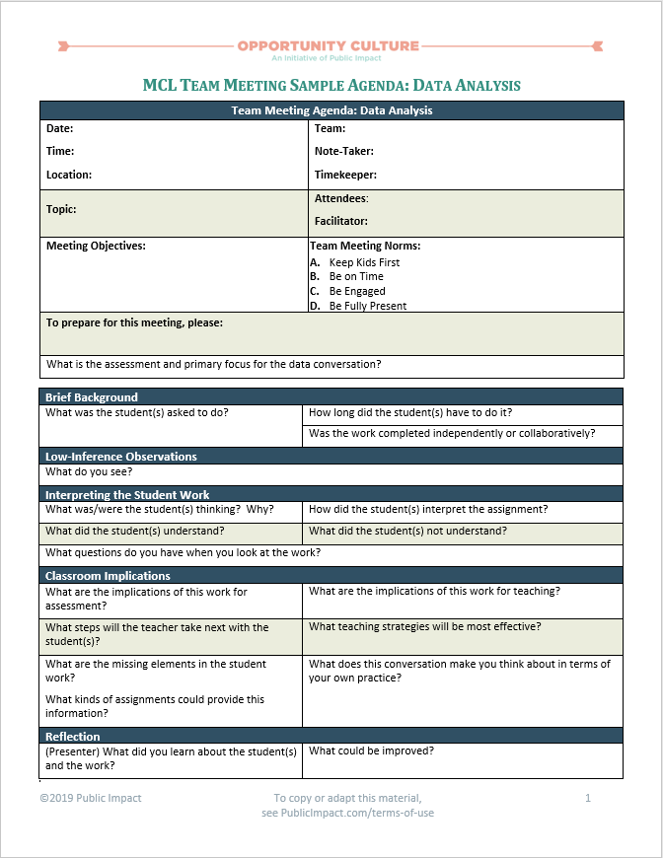
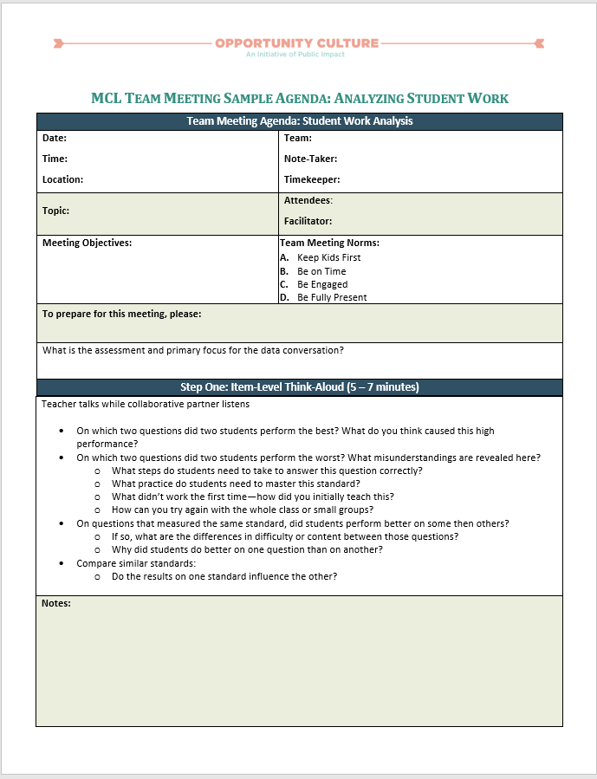
See Handouts
Example Team Meeting Agenda
Data Analysis
Analyzing Student Work
Notes:
Facilitator:
Objective of this slide: to prepare the group for individual work time
Estimated time: 1 minute
Facilitator says:
These eight steps are connected to some of the summer actions suggested in your action planner.
Specifically, take a look at the summer communication and the teaching team leadership next steps on page 3:
Prepare written materials/talking points for the team to understand team structure and roles, vision, and goals.
Establish weekly schedule for meeting(s) with your whole team and each team teacher; clarify purpose for each
Create standing agendas for meetings with whole team and each team teacher—and norms
[Show participants two sample team meeting agendas—one for analyzing student work and one for analyzing data.]

Slide 40
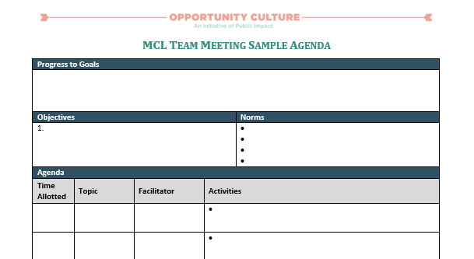
See Handout
Work Time
Directions: Draft an agenda for your first norm-setting meeting with your team teachers.
Notes:
Facilitator:
Objective of this slide: to prepare the group for individual work time
Estimated time: 60 minutes

Slide 41
Action Steps
Write down and share a few next steps you commit to incorporating into your work based on your takeaways from this session.
Next Steps | People | Timeline | Notes
Create agenda for norm-setting meeting with team teachers. | Team teachers | Before first day of school
Notes:
Facilitator:
Objective of this slide: Set action steps
Estimated time: 3 minutes
Facilitator says:
At the end of each of our sessions together, we will encourage you to set some actions steps for yourselves based on what you learned during the session. We will always provide some examples. You will learn and experience a lot over the course of our training, so we want to help you ensure that you take note of actionable next steps after each session so you have a plan of attack to prepare for the first day of school.

Slide 42
Sources
Our Iceberg Is Melting: Changing and Succeeding Under Any Conditions by John Kotter
Click, by Ori Brafman and Rom Brafman
Creating Safe Spaces for Communication, by Julia Chaitin, retrievable at http://www.beyondintractability.org/essay/safe-spaces
Richardson, Joan (1999). Norms put the ‘Golden Rule’ into Practice for Groups. National Staff Development Council. Retrieved from http://learningforward.org/docs/tools-for-learning-schools/tools8-99.pdf?sfvrsn
Warnock, Jim (2008). Norm Development Handbook. Retrieved from http://www.data4ss.org/downloads/conditions_for_professional_learning/norms.pdf
Heathfield, Suzanne. Team Norms Sample. Retrieved from http://humanresources.about.com/od/teambuilding/qt/norms_sample.htm.

Slide 43
Connect with Other Multi-Classroom Leaders!
Interested in collaborating with multi-classroom leaders across the country? Join the Facebook group:
Facebook.com/groups/OpportunityCultureMCLs/
This is a private group open only to multi-classroom leaders, to connect MCLs across districts and states—a place to share advice and materials, collaborate, discuss education topics, and share experiences.

Slide 44
Follow Us!
Keep up to date on Opportunity Culture with resources and research from Public Impact by following:
@PublicImpact
@OppCulture
Facebook.com/PublicImpact
Facebook.com/OpportunityCulture
LinkedIn.com/company/public-impact---chapel-hill-nc
Subscribe to the quarterly Opportunity Culture newsletters, with content by and for Opportunity Culture educators, and sign up to get Remind messages for them:
OpportunityCulture.org/mailing-list/
Remind.com/join/ocnew

