Slide 1
Principals:
Effective OC Implementation
Notes:
Estimated time: 60 minutes
Advance preparation for this session:
Please print out or make electronically available enough copies for each attendee:
Lessons Learned Worksheet
School Implementation Review (2 copies per participant—one for self assessment, one for support visit activity)
Elementary Support Visit Feedback Memo
Secondary Support Visit Feedback Memo
Annual OC School Climate Survey Sample Report
Materials needed:
Sticky notes at each table

Slide 2
Review characteristics of strong Opportunity Culture design and implementation
Anticipate and plan for common implementation challenges
Learn how support visits, data collection, redesign session, and professional development support Opportunity Culture implementation
Notes:
Facilitator:
Objective of this slide: Introduce objectives of the session
Estimated time: 1 minute
Facilitator says (throughout the slides, put this in your own words):
Our objectives for this session are to prepare you for implementation and to introduce you to the supports provided to make implementation a success.

Slide 3
Notes:
Facilitator:
Objective of this slide: Emphasize OC principles and reinforce how important to they are to the success of Opportunity Culture in the schools
Estimated time: 2 minutes
Facilitator says:
As you recall, the five Opportunity Culture Principles are the foundation of success for Opportunity Culture.
As we plan for implementation, it’s important to continually reflect on how well we are adhering to the principles. The support you will receive as outlined in this session is designed to provide you with the information, tools, and support needed to ensure we are adhering to the principles, which will then serve to increase student achievement.

Slide 4
Strong Gains for MCL Teams
Teachers on MCL teams produced gains
equal to top-quartile teachers in math, nearly that in reading.
…and teach this well on MCL teams
Scope of the Study
15,000 students
300 teachers
3 districts, 2-3 years
74% of schools Title I
Team teachers start here on average…
Backes, B., & Hansen, M. (2018). Reaching Further and Learning More? CALDER Center: Washington, DC. Reading range based on 6 of 7 models with statistically significant gains.
Notes:
Facilitator:
Objective of this slide: To review OC results and emphasize the importance of strong implementation that will produce results
Estimated time: 3 minutes
Facilitator says:
A study released by CALDER found strong gains for teachers on MCL teams, as you can see here.
Teachers were on average at the 50th percentile in terms of student learning gains before joining a team led by an MCL.
After joining the teams, they produced:
Learning gains equivalent to teachers from the 66th to 72nd percentile in reading (statistically significant in six of the seven statistical models).
And equivalent to teachers from the 75th to 85th percentile in math (statistically significant across all 7 statistical models used)
[More info to share if needed:
The study covered about 15,000 students and about 300 teachers, looking at two to three years of data for North Carolina’s Charlotte-Mecklenburg Schools and Cabarrus County Schools and New York’s Syracuse City School District. About 90 percent of the students included were in Charlotte-Mecklenburg. In these three districts in 2015–16, 74 percent of Opportunity Culture schools were eligible for Title I based on the percentage of low-income students. ]

Slide 5
Lessons Learned
Aim for 80%–100% reach within three years.
Include TRTs on MCL teams so they also have MCL support.
Maintain MCL teams of six or less.
Build schedules that provide sufficient planning and collaboration time.
Hire early and be selective.
Give everyone the right data to reflect and improve.
Notes:
Facilitator:
Objective of this slide: To provide principals with lessons learned from the CALDER study and our experiences with other schools
Estimated time: 5 minutes
Facilitator says:
From the CALDER study and Public Impact’s experience in the field for the past six years of implementation, we have identified key characteristics of strong Opportunity Culture design that help lead to success.
[Click to animate and read each bullet]
Aim for 80 percent to 100 percent reach within three years. Schools should march rapidly toward MCL coverage schoolwide and districtwide in all core subjects, at minimum. Schools that implemented schoolwide rapidly produced the strongest results.
Provide coaching support to team reach teachers. Ensure that TRTs have ample support and development to provide quality student experiences, both when TRTs are supervising students and when reach associates are. This can be achieved by either placing a TRT on an MCL’s team or creating support structures with the administration.
Maintain MCL teams of 6 or less. MCLs are most successful when they can provide intensive support to their teams, so it’s important to maintain MCL team sizes averaging no more than 5–6 teachers. Among MCL teams in the study, the average team size was 6, the median was 5, and 42 percent of the MCLs had teams of 4 or fewer.
Build schedules that let teams collaborate. Schedule and protect additional in-school time for OC teachers to plan alone and as a team, to review student work, and to improve together during the school year.
Hire early and be selective. Recruit early, advertise widely using multiple methods, make links to Opportunity Culture job openings obvious on the district’s website, and use materials on OpportunityCulture.org to recruit and be selective among candidates.
Give everyone the right data to reflect and improve. Interim and annual data should be collected and reported to match OC roles. It should help teachers improve during the school year and help principals lead well. Consistent interim assessments would help OC teachers.

Slide 6
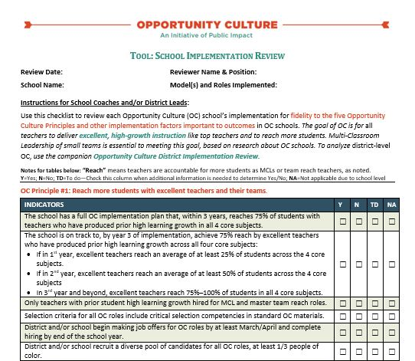
See Handout
School Implementation Review
Notes:
Facilitator:
Objective of this slide: Introduce the school implementation review document
Estimated time: 2 minutes
Facilitator says:
The School Implementation Review document provides schools with guidance on to have strong OC implementation.
Based on the five OC Principles, the indicators in the document outline what strong OC design looks like.
At schools that have had the most success with implementation, which led to higher achievement for schools, these indicators are the common thread among them. You should keep this document in mind as you make future plans and make adjustments throughout the year.

Slide 7
Activity: School Implementation Review
Take a few minutes to reflect on your school’s OC plan and how it measures up to the implementation review. Are you on your way to meeting the indicators?
For the boxes that you marked “To Do” take a moment to record the action steps needed to meet the indicator.
Time for this activity: 10 minutes
Notes:
Facilitator:
Objective of this slide: Principals will use the school plan review document as a self-assessment to identify where their design is strong, and areas they need to work on
Estimated time: 10 minutes
Facilitator says:
Take a few minutes now to assess your school plan using the School Implementation Review document.
Remember, you will not have all indicators met within the first year, but you can use the document to identify where you will make adjustments in your design in the future. For boxes you marked “To Do”, take a moment to record the action steps needed to meet the indicator.

Slide 8
Opportunity Culture Implementation Support
Support Visits
Data Collection
Redesign Session
Professional Development
Notes:
Facilitator:
Objective of this slide: Introduce the various implementation supports
Estimated time: 2 minutes
Facilitator says:
To support your school’s implementation of Opportunity Culture, we provide various supports to assess the strengths and challenges in your design.
These supports are especially critical for the first year of implementation, as there are often challenges that schools face during the first year. These supports allow us to help you identify actionable steps to address challenges and concerns.
[Click] First, we’ll talk about support visits.

Slide 9
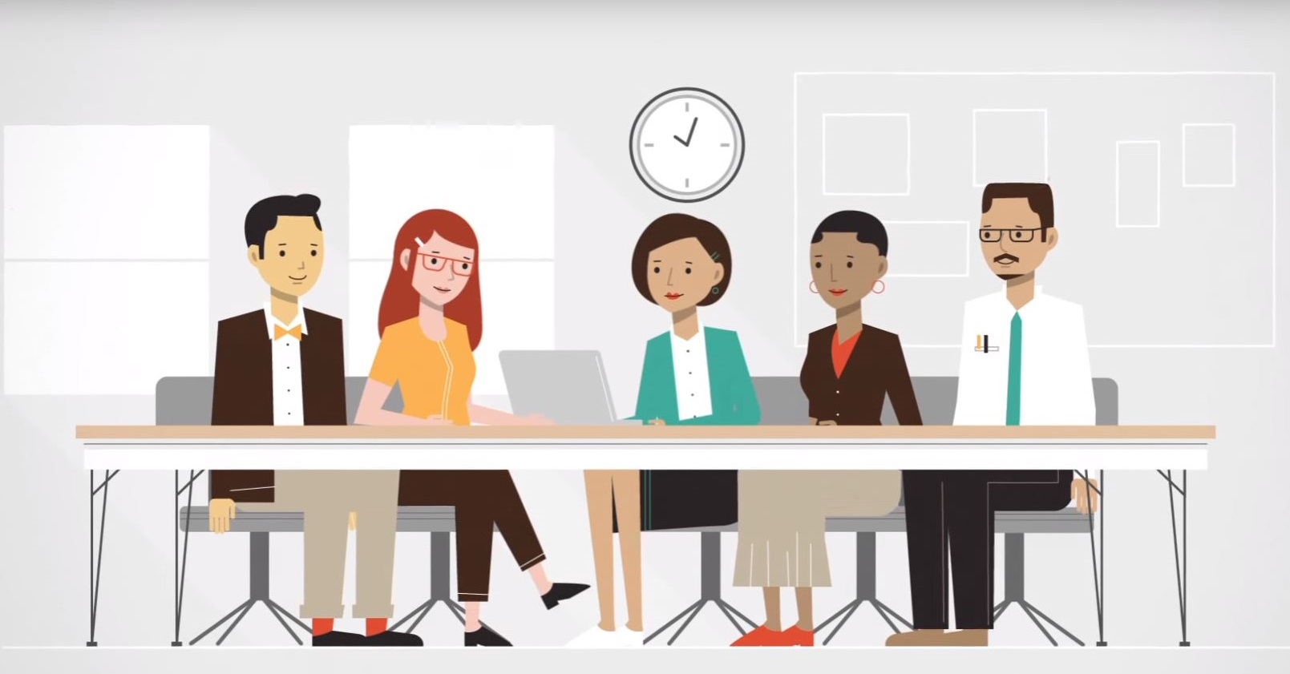
Support Visits
Ensure fidelity to the five Opportunity Culture Principles and district parameters
Identify successes and challenges in implementation
Provide recommendations to address challenges
Notes:
Facilitator:
Objective of this slide: To review the purpose of support visits with principals
Estimated time: 3 minutes
Facilitator says:
Support visits are one of the strongest tools we use to support schools. The focus of the visit is to gather school-level information to highlight successes, identify challenges, and provide recommendations to improve implementation.
All of this will help us ensure fidelity to the five OC Principles and the district parameters, such as the MCL team size and the reach of team reach teachers.
The process is non-evaluative—it is only to provide support. The visit will include interviews with everyone involved in OC, including the principal and teachers on MCL teams and teachers who are not directly reached by OC.
We will ask questions about scheduling, how time is used, the support provided for the roles, and communications.

Slide 10
See Handout
Activity: Support Visit Memo
Review the sample memo with a partner.
One partner review principles 1–3
The other partner reviews principles 4 & 5
Complete the corresponding section in the School Implementation Review document
Guiding Questions
Which indicators are current strengths of the school’s implementation?
What are their areas of growth?
For any “no” responses, discuss any additional recommendations you have for how the principal can address challenges.
Time for this activity: 8 minutes
Notes:
Facilitator:
Objective of this slide: Allow principles to review a sample memo and complete the school implementation review document
Estimated time: 15 minutes
Facilitator says:
With a partner, review the sample memo on your table (or in the portal) and complete the corresponding section in the school implementation review document.
After 10 minutes, bring group together to share out recommendations, primary takeaways.
Note: When we make recommendations, we try to make them actionable something principals can do in the short-term. Often these involve making adjustments to the schedule and making it more transparent to staff in the school, having a discussion with staff to get everyone aligned, or providing additional PD support.

Slide 11
Support Visit Process
Timing: October/November and February/March for either a full-day or half-day.
Interviewees: Principal, MCLs, TRTs, RAs, team teachers, and non-OC teachers.
Observations: 15 minute observations of:
MCLs working with team teachers,
TRTs working with RAs,
PLC meetings, etc.
Notes:
Note: Edit this based on your district’s scope of work.
Facilitator:
Objective of this slide: Review the support visit process
Estimated time: 3 minutes
Facilitator says: The support visits are generally held in the fall and spring after schools have been in session for a few weeks. We connect with principals a few weeks beforehand, to provide a schedule template and additional guidance on the visit.

Slide 12
Opportunity Culture Implementation Support
Support Visits
Data Collection
Redesign Session
Professional Development
Notes:
Facilitator:
Objective of this slide: Introduce the data collection process
Estimated time: 1 minute
Facilitator says: Now we’ll discuss another critical piece of implementation [Click]—data collection.

Slide 13
See Handout
Data Collection
OC Survey | Human Resources Analysis
Administered January or February Entire teaching staff Public Impact and TWC questions | Number of applicants per position Previous experience Candidate qualifications
Notes:
Note: Edit this based on your district’s scope of work.
Facilitator:
Objective of this slide: To review the various ways Public Impact collects data
Estimated time: 7 minutes
Facilitator says:
In addition to support visits, we also collect data on staff perceptions of the work, as well as the selectivity of the process you used to choose teachers for OC roles.
The OC survey is a critical tool that helps schools measure how Opportunity Culture has affected culture in the school. In addition to a school report, the district will receive a report, and information will be reported on the OC dashboard. The OC survey is administered in January or February of each year. It includes a combination of questions from the New Teacher Center's Teacher Working Conditions Survey as well as OC-specific questions that Public Impact developed. We ask principals to send it to all teaching staff in the school.
Direct participants to report, describe format, highlight a few example questions.
The HR analysis provides districts and schools with information about candidate experience and qualifications to determine the competitiveness of the positions. We will also ask about retention of teachers.

Slide 14
Opportunity Culture Implementation Support
Support Visits
Data Collection
Redesign Session
Professional Development
Notes:
Facilitator:
Objective of this slide: To introduce Redesign as another piece of implementation support
Estimated time: 1 minute
Facilitator says:
As you work through the school year implementing OC, you will see great things happening in your school, and you will also see changes you want to make.
[Click] The redesign session is designed to give you and your team time to reflect on the current year and plan for the next year of implementation.

Slide 15
Redesign Session
Timing: March/April to begin early recruitment for any new positions
Objectives:
Review school survey data
Review district-wide survey data
Identify success and challenges of implementation
Plan for next school year (additional roles, scheduling, funding)
Bring to the session
Previous full-implementation plan
Schedule
Budget workbook (if available)
Notes:
Facilitator:
Objective of this slide: To review purpose and content for redesign session
Estimated time: 2 minutes
Facilitator says:
In a redesign session, as schools review successes and challenges, your team will review your goals and revise if needed, work on scheduling, and also review the data from the OC survey.
We recommend having this session in March or early April to help with early recruitment for any OC positions you add or want to fill.
We ask schools to bring with them their previous full implementation plan to help identify the next transition year, the schedule they need to revise, and their budget workbooks, if available.

Slide 16
Opportunity Culture Implementation Support
Support Visits
Data Collection
Redesign Session
Professional Development
Notes:
Facilitator:
Objective of this slide: To introduce professional development as another tool to support implementation
Estimated time: 1 minute
Facilitator says:
[Click] The final area we will discuss is professional development. With these roles being so new to the school, it will be important to provide continuous support to the people in the positions so that they can be as successful as possible.

Slide 17
Year 1 Professional Development
MCL | TRT | RA | Principal
Coaching 2.0 | Continuing to Strengthen Working Relationships | Continuing to Strengthen Working Relationships | Monitoring OC Implementation
Leading Difficult Conversations | Difficult Conversations 2.0 | Successful Classroom Management 2.0 | Supporting MCLs Effectively
Midyear Review | Midyear Review | Increasing Student Participation and Thinking | Selection and Hiring
Year in Review | Year in Review | Year in Review | Year in Review
Notes:
Note: Update with site-specific PD. You may have a calendar planned out for PD, in which case you would provide it here.
Facilitator:
Objective of this slide: To review content for professional development
Estimated time: 5 minutes
Facilitator says:
We quickly realized in the early days of Opportunity Culture that additional training and support are necessary for Opportunity Culture teachers and paraprofessionals. We have developed a number of training sessions for each strand of work, including principals, that all came out of a need identified by teachers, principals, and paraprofessionals in these positions and are revised annually based on feedback from participants.

Slide 18
Action Steps
Write down and share a few next steps you commit to incorporating into your work based on your takeaways from this session.
Next Steps | By Whom | By When | Notes/Resources
Schedule support visit
Notes:
Facilitator:
Objective: Set action steps
Estimated time: 3 minutes
Facilitator says:
At the end of each of our sessions together, we will encourage you to set some actions steps for yourselves based on what you learned during the session. We will always provide some examples. You will learn and experience a lot over the course of our training, so we want to help you ensure that you take note of actionable next steps after each session so you have a plan of attack to prepare for the first day of school.

Slide 19
Follow Us!
Keep up to date on Opportunity Culture with resources and research from Public Impact by following:
@PublicImpact
@OppCulture
Facebook.com/PublicImpact
Facebook.com/OpportunityCulture
LinkedIn.com/company/public-impact---chapel-hill-nc
Subscribe to the quarterly Opportunity Culture newsletters, with content by and for Opportunity Culture educators, and sign up to get Remind messages for them:
OpportunityCulture.org/mailing-list/
Remind.com/join/ocnew

