Slide 1
Reach Associates:
Culturally Responsive Classroom
Notes:
Facilitator name:
Advance preparation for this session:​
Please print out or make electronically available enough copies for each attendee:​
Culturally-Responsive ​Self-Assessment
Culturally-Responsive Note Taker
Materials needed:​
Sticky notes at each table​
​
​
Facilitator says (throughout the slides, put this in your own words):​
While we’ll refer in this session to a culturally responsive “classroom,” we know that in your roles as reach associates, you are not always in a classroom setting, but also in computer labs, whole groups, small groups and 1:1.
What we’re considering here: is this question: The student population that we serve continues to become more diverse, but are we doing everything we can to be culturally responsive?

Slide 2
How do you incorporate students’ interests, backgrounds, and experiences into your classroom (or computer lab, small groups, etc.)?
Time for this activity: 2 minutes
Notes:
Facilitator:
Objective of this slide: Provide a do now for participants as they enter into the room
Estimated time: 3 minutes
Facilitator says:
Welcome back! As always, we’re going to start with a Do Now. Take a minute to jot down your thoughts on this question. How do you incorporate students’ interests, backgrounds, and experiences into your classroom?

Slide 3
Why Is This Important?
“The prevailing question, ‘How do I motivate them?’ implies that 'they' are somehow dependent, incapable of self-motivation, and in need of help from a more powerful 'other.' In this sense, the 'at-risk' label acts to heighten our perception of students as motivationally dysfunctional, and increases our tendency not to trust their perspective. The fact that an inordinately high number of 'at-risk' students are poor and people of color should cause us to reflect on how well we understand motivation."
—From "A Framework for Culturally Responsive Teaching" in Educational Leadership
Source: http://www.ascd.org/publications/educational-leadership/sept95/vol53/num01/A-Framework-for-Culturally-Responsive-Teaching.aspx
Notes:
Facilitator:
Objective of this slide: Provide framing as to why we are having this session.
Estimated time: 4 minutes
Facilitator says:
Why is it important that we think about our roles in a culturally responsive classroom?
[click to animate] Can I have a volunteer read this statement?
Thank you. Please take two minutes to talk with a neighbor about your reflections on this statement and how it connects to today’s session.

Slide 4
Define the components of culture
Understand what is and is not cultural responsiveness
Learn strategies for creating and/or supporting a culturally responsive classroom
Create a plan for next steps
Notes:
Facilitator:
Objective of this slide: Provide the objectives of this session
Estimated time: 1 minute
Facilitator says:
In this session, participants will:
Define the components of culture
Understand what is and is not cultural responsiveness
Learn strategies for creating and/or supporting a culturally responsive classroom
Create a plan for next steps

Slide 5
Discussion
How do you incorporate students’ interests, backgrounds, and experiences into your classroom (or computer lab, small groups, etc.)?
Notes:
Facilitator:
Objective of this slide: Debrief the “do now”
Estimated time: 3 minutes
Facilitator says:
Before we get started with our session, we’d love to hear some of the things that you are already doing to incorporate students’ interests, backgrounds, and experiences into your classroom. Could I get a few volunteers to share?
[If participants haven’t worked in a classroom]How might you anticipate doing this?
[facilitator scribe]

Slide 6
What Are the Components of Culture?
Explicit, visible:
Dress
Language
Music
Food
Dance
Careful observation:
Eye contact
Facial expressions
Concept of time
Concept of personal space
Underlying values:
Problem-solving roles
Attitude toward elders
Concept of past and future
Cooperation vs. competition
Source: https://steinhardt.nyu.edu/scmsAdmin/uploads/004/913/PCRE.pdf
Notes:
Facilitator:
Objective of this slide: to describe the different components of culture.
Estimated time: 4 minutes (likely longer, depending on conversation)
Facilitator says:
So what are some of the components of culture?
[click to animate] One way to think about this is as an iceberg.
There are going to be things that are easily seen, sticking out of the water [click to animate], some things that can be seen with careful observation [click to animate], and some things that are not able to been seen, hidden beneath the water [click to animate].
What are some of the components of culture that are explicit and visible? [facilitator scribes some of the ideas that the participants provide, then click to animate the examples]
What are some of the components of culture that are visible with careful observation? [facilitator scribes some of the ideas that the participants provide, then click to animate the examples]
Example for clarification of concept of time, if needed: much of Mexican culture has a more flexible or malleable understanding of time than in the U.S. where "time is money." Mexican culture allows for more spontaneity and less commitment. If you ask for something "now," you may not be understood to mean "at this exact moment." http://www.bbc.com/travel/story/20170725-the-confusing-way-mexicans-tell-time
What are some of the components of culture that are not easily visible, but still important? [facilitator scribes some of the ideas that the participants provide, then click to animate the examples]

Slide 7
What Is It?
Culturally responsive teaching is a pedagogy that recognizes the importance of including students’ cultural references in all aspects of learning.
Culturally responsive pedagogy rests on three criteria:
Students must experience academic success
Students must develop and/or maintain cultural competence
Students must develop a critical consciousness through which they challenge the status quo of the current social order
Sources: The Dreamkeepers (1994) and “That’s Just Good Teaching” (1995), Gloria Ladson-Billings
Notes:
Facilitator:
Objective of this slide: Provide a definition for culturally responsive teaching.
Estimated time: 2 minutes
Facilitator says:
So what is “culturally responsive teaching”?
[click to animate] Accordingly to Gloria Ladson-Billings, an educator and leader in this area, culturally responsive teaching is a pedagogy that recognizes the importance of including students’ cultural references in all aspects of learning.
[click to animate] In order to determine whether culturally responsive teaching is being done successfully, Ladson-Billings has identified three things to look for:
[click to animate] Students must experience academic success
[click to animate] Students must develop and/or maintain cultural competence (students maintain their cultural integrity; don’t feel obligated to adopt the culture of the majority; OK to be who they are; encouraged to incorporate student culture into learning. For example, analyzing the hidden meaning, alliteration, onomatopoeia in rap music; studying the history of a traditional dish and calculating fractions to make it)
[click to animate] Students must develop a critical consciousness through which they challenge the status quo of the current social order (students are able to critique and evaluate social norms and institutions that maintain and encourage social inequities. For example, writing letters to the editor for an article about school funding; studying the history of certain pieces of legislation)

Slide 8
What Is It Not?
You do not need to have the same cultural background as your students to be a culturally responsive teacher and create a culturally responsive classroom.
You do not need to master the details of the cultures of every student in the classroom to be successful.
Students of different races don’t need to be taught differently.
Don’t try too hard (and appear fake).
Sources: http://blog.curry.virginia.edu/2015/10/14/5-tips-for-creating-a-culturally-responsive-classroom/; https://steinhardt.nyu.edu/scmsAdmin/uploads/004/913/PCRE.pdf; http://www.ascd.org/publications/books/111022/chapters/Culturally-Responsive-Instruction.aspx
Notes:
Facilitator:
Objective of this slide: Clarify what culturally responsive teaching is not.
Estimated time: 2 minutes
Facilitator says:
Before we continue, let’s also clarify what culturally responsive teaching is not.
[click to animate] It does not require you to have the same background as your students in order to ensure a culturally responsive classroom.
[click to animate] It does not require you to become experts on the cultures of every student that you work with.
[click to animate] It does not say that students of different races need to be taught differently—the focus is on each individual student and meeting them where they are at.
[click to animate] And you should still be your authentic self—like the things that you like, but also show interest in their interests.

Slide 9
Goals
Establishing inclusion—creating an atmosphere in which students feel respected by and connected to one another.
Developing attitude—creating a favorable disposition toward learning through personal relevance and choice.
Enhancing meaning—creating thoughtful learning experiences that include student perspectives and values.
Engendering competence—understanding that students are effective in learning something they value.
Source: http://www.ascd.org/publications/educational-leadership/sept95/vol53/num01/A-Framework-for-Culturally-Responsive-Teaching.aspx
Notes:
Facilitator:
Objective of this slide: Identify the goals for creating a culturally responsive classroom
Estimated time: 6 minutes
Facilitator says:
There are four main goals for creating a culturally responsive classroom that will drive you toward the three look-fors we described earlier—academic success, cultural competence, and critical consciousness.
[click to animate] Establishing inclusion—creating an atmosphere in which students feel respected by and connected to one another. Why is this important? [whole group discussion]
[click to animate] Developing attitude—creating a favorable disposition toward learning through personal relevance and choice. How will you know if you are reaching this goal? [whole group discussion]
[click to animate] Enhancing meaning—creating thoughtful learning experiences that include student perspectives and values. [Facilitator should try to connect this to any examples that were brought up in the Do Now. If there are none, ask for examples from the group.]
[click to animate] Engendering competence—understanding that students are effective in learning something they value. How does this connect to the earlier statement we discussed around motivation? [whole-group discussion]

Slide 10
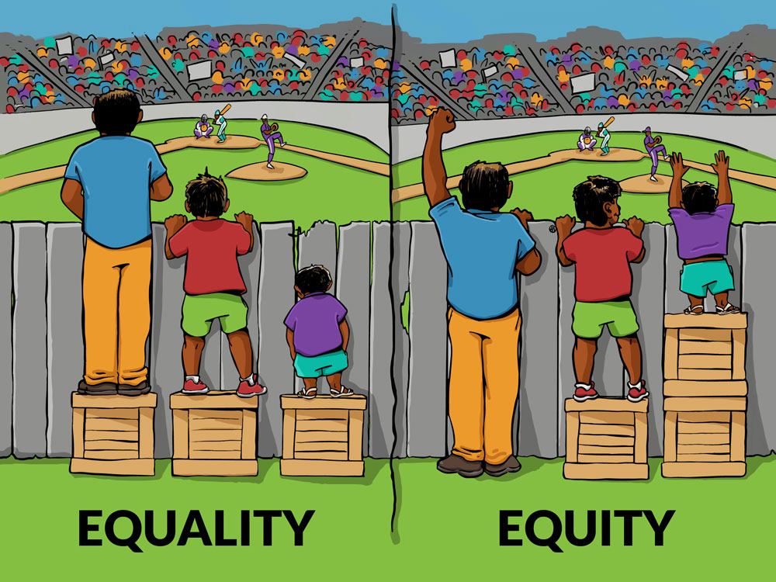
Reflection
“If equality means giving everyone the same resources, equity means giving each student access to the resources they need to learn and thrive.”
- Shane Safir, Founding Co-Principal of June Jordan School for Equity and author of The Listening Leader
Time for this activity: 4 minutes
Notes:
Facilitator:
Objective of this slide: Provide a quote for the participants to reflect upon and connect to the session topic.
Estimated time: 6 minutes
Facilitator says:
Can I have a volunteer read this quote?
Thank you. Now at your tables, please take four minutes to discuss how this quote connects to today’s topic on culturally responsive classrooms. Then we’ll have one person share from each table.
[click to begin timer]
Could I have a volunteer to share your table’s thoughts?

Slide 11
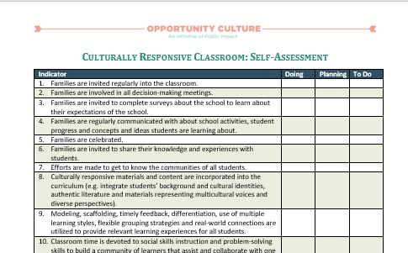
See Handout
Self-Assessment
Time for this activity: 10 minutes
Notes:
Facilitator:
Objective of this slide: Provide work time for the self-assessment.
Estimated time: 12 minutes
Facilitator says:
Before we did into some strategies for creating and supporting a culturally responsive classroom, let’s take 10 minutes to reflect upon our current practices with this self-assessment. For each indicator, note whether you are currently doing the action stated (or not), and whether you’re planning to do it in the future (or not). Don’t worry about filing out the “to do” column just yet; we’ll come back to that a little bit later.
Any questions?
[click to begin timer]
[after time is up] Any surprises or reflections on this self-assessment?
[Encourage conversation by asking participants about their 5-6 highest priority/leverage actions. What will they focus on first? What do they feel is most crucial to creating a culturally responsive classroom?]

Slide 12
Why Reach Associates?
Notes:
Facilitator:
Objective of this slide: Provide a video for participants to watch and connect this session to their role as RAs
Estimated time: 10 minutes (6:45 for video)
Facilitator says:
You may be wondering, why us? Let’s take a few minutes to listen to this video.
[play the video]
[after the video – discussion] So why is this session important for you in your roles? [Connect to the RAs who also grew up in the neighborhood and went to the school, to the ones who have been serving the community for decades, that are raising their children in the community, and the power they all have to make things engaging and connect students to the work]
Video Link: https://www.youtube.com/watch?v=H3ddtbeduoo

Slide 13
See Handout
Strategies to Be Culturally Responsive
Have positive perspectives on parents and families
Communicate high expectations
Learn within the context of culture
Provide student-centered instruction
Provide culturally mediated instruction
Reshape the curriculum
Teach as a facilitator
Adapted from: https://www.brown.edu/academics/education-alliance/teaching-diverse-learners/strategies-0/culturally-responsive-teaching-0
Notes:
Facilitator:
Objective of this slide: Provide a brief overview of the strategies that will be discussed.
Estimated time: 2 minutes
Facilitator says:
There are lots of strategies available, but we’ve picked a few to discuss today that you could implement in your role as a reach associate.
We’ve also provided a notetaker so that you can jot down specific ideas or things you’ve heard from other participants as we go over each of these.
For each strategy, we’ll talk about why it is important to consider this, and what are some of the actions that you could take in support of this strategy.

Slide 14
1. Positive perspectives on parents & families
Why?
School staff can learn more about the students’ background knowledge and abilities, and how they learn best
How?
Seek to understand
Keep families appraised
Gain cross-cultural skills
Notes:
Facilitator:
Objective of this slide: Provide the why and the how for having positive perspectives on parents and families.
Estimated time: 4 minutes
Facilitator says:
Why is it important to have positive perspectives on parents and families? [seek volunteers to provide thoughts, then click to animate]
What are some of the ways in which you could do this? [discuss as a whole group, then provide some of the details below if not already suggested]
[Listen for:
Seek to understand parents' hopes, concerns, and suggestions
Conduct needs assessments and surveys (in the parents' first language) of what parents expect of the school community
Establish parent-teacher organizations or committees to work collaboratively for the benefit of the students
Conduct home visits in which parents are able to speak freely about their expectations and concerns for their children
Keep parents apprised of services offered by the schools
Send weekly/monthly newsletters (in the home language) informing parents of school activities
Conduct monthly meeting at parents' homes or community centers to inform parents of school activities
Host family nights at school to introduce parents to concepts and ideas children are learning in their classes and to share interactive journals
Gain cross-cultural skills necessary for successful exchange and collaboration
Research the cultural background of students' families
Visit local community centers to find out about the cultural activities and beliefs of the students
Tour students' neighborhoods to identify local resources and "funds of knowledge“]
[Note: remind participants to write down ideas they hear in their notetaker]

Slide 15
2. Communication of high expectations
Why?
Effective and consistent communication of high expectations helps students develop a healthy self-concept, provides the structure for intrinsic motivation, and fosters an environment in which students can be successful.
How?
Communicate clear expectations
Create an environment in which there is genuine respect for students and a belief in their capability
Notes:
Facilitator:
Objective of this slide: Provide the why and the how for communication of high expectations.
Estimated time: 3 minutes
Facilitator says:
[click to animate] Why is it important to communicate high expectations?
[look for volunteer, then animate the answer]
[click to animate] What are some ways in which you can do this?
[click to animate] You could communicate clear expectations and [click to animate] Create an environment in which there is genuine respect for students. But what does this look and sound like? Please brainstorm some ideas with a neighbor and then I’ll ask for some volunteers]
[Listen for:
Communicate clear expectations
Be specific in what you expect students to know and be able to do
Create an environment in which there is genuine respect for students and a belief in their capability
Encourage students to meet expectations for a particular task
Offer praise when standards are met]

Slide 16
3. Learning within the context of culture
Why?
Students from minority cultures may feel pressured to disavow themselves of their cultural beliefs and norms to assimilate into the majority culture.
How?
Vary classroom strategies
Bridge cultural differences
Notes:
Facilitator:
Objective of this slide: Provide the why and the how for learning within the context of culture.
Estimated time: 4 minutes
Facilitator says:
[click to animate] Why is this important?
[click to animate] Students from minority cultures may feel pressured to disavow themselves of their cultural beliefs and norms to assimilate into the majority culture.
From your experiences, have any of you seen this happen? What was the situation?
[click to animate] What are some of the things that you can do to support learning within the context of culture?
[click to animate] One thing is to vary teaching strategies. But what does that mean exactly? Does anyone have any examples to share?
[Listen for:
Use cooperative learning especially for material new to the students
Assign independent work after students are familiar with concept
Use role-playing strategies
Assign students research projects that focus on issues or concepts that apply to their own community or cultural group
Provide various options for completing an assignment]
[click to animate] You could also work to bridge cultural differences. What could that look like in your workspace? Each table, please come up with an idea and then we’ll go around and share.
[Listen for:
Teach and talk to students about differences between individuals
Show how differences among the students make for better learning
Attend community events of the students and discuss the events with the students]

Slide 17
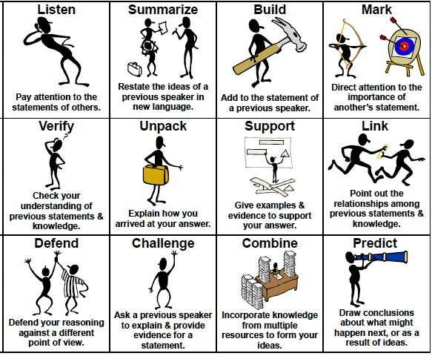
4. Student-centered instruction
Why?
Students develop cognitively by interacting with both adults and more knowledgeable peers.
How?
Promote student engagement
Share responsibility of instruction
Create inquiry-based/discovery-oriented opportunities
Encourage a community of learners
Notes:
Facilitator:
Objective of this slide: Provide the why and how for student-centered instruction
Estimated time: 5 minutes
Facilitator says:
[click to animate] Why is student-centered instruction important?
[click to animate] Can I have a volunteer read this?
In what other session have we talked about the importance of students interacting with peers? [listen for: student-to-student interactions, accountable talk] [click to animate the accountable talk chart]
[click to animate] How can we promote student engagement?
[click to animate] Encourage shared responsibility of instruction
[click to animate] Create inquiry-based/discovery-oriented opportunities?
[click to animate] and encourage a community of learners?
[assign each table one, and then provide work time. Each table will share the ideas for their strategy after 3 minutes]
[Listen for:
Promote student engagement
Have students generate lists of topics they wish to study and/or research
Allow students to select their own reading material
Share responsibility of instruction
Initiate cooperative learning groups
Have students lead discussion groups or reteach concepts
Create inquiry-based/discovery-oriented curriculum
Create classroom projects that involve the community
Encourage a community of learners
Form book clubs or literature for reading discussions
Conduct student-directed sharing time
Use cooperative learning strategies such as Jigsaw ]

Slide 18
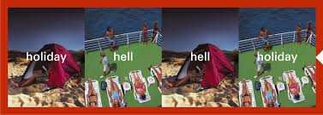
5. Culturally mediated instruction
Why?
Students need to understand that there is more than one way to interpret a statement, event, or action.
How?
Understand student learning style preferences
Involve students in their own goal-setting
Create an environment that encourages and embraces culture
Notes:
Facilitator:
Objective of this slide: Provide the why and how for culturally mediated instruction
Estimated time: 5 minutes
Facilitator says:
What is culturally mediated instruction?
[Listen for: when it incorporates and integrates diverse ways of knowing, understanding, and representing information. Instruction and learning take place in an environment that encourages multicultural viewpoints and allows for inclusion of knowledge that is relevant to the students.]
[click to animate] Why is culturally mediated instruction important?
[click to animate] Students need to understand that there is more than one way to interpret a statement, event, or action. What exactly does that mean? One company that has done a nice job in their advertising campaigns is HSBC. They’ve been able to illustrate how the same thing can be interpreted in different ways.
[click to animate] Here is one example. Going on a holiday (vacation) can look very different in the eyes of the beholder.
[click to animate] So how can you account for this in the time you spend with students?
[click to animate] Understand student learning style preferences. Think back to our session on differentiating instruction. What are some of the things that you would do?
[click to animate] Involve students in their own goal-setting. How many of you already do that now? What does that look and sound like at your school?
[click to animate] Create an environment that encourages and embraces culture. What are some steps that you can take here?
[Listen for:
Employ patterns of management familiar to students
Allow students ample opportunities to share their cultural knowledge
Question and challenge students on their beliefs and actions
Teach students to question and challenge their own beliefs and actions
Provide positive images and representations of cultural diversity.]

Slide 19
6. Reshaping the curriculum
Why?
By using students’ personal experiences to develop new skills and knowledge, teachers make meaningful connections between school and real-life situations
How?
Use resources other than textbooks
Develop learning opportunities that are more reflective of student backgrounds
Notes:
Facilitator:
Objective of this slide: Provide the why and the how for reshaping the curriculum.
Estimated time: 4 minutes
Facilitator says:
[click to animate] We know that as RAs you aren’t writing lesson plans and curriculum at this time, but you are supporting its execution in the classroom in whole group, small group, 1:1, or in a computer lab. You’ll still have opportunities to [click to animate] help use students’ personal experiences to develop new skills and knowledge to help students make meaningful connections between school and real-life situations.
[click to animate] So how could you do this?
[click to animate] You could use resources other than textbooks. For example, have students research aspects of a topic within their community, encourage students to interview members of their community who have knowledge of the topic they are studying, or provide information to the students on alternative viewpoints or beliefs of a topic.
[click to animate] You could also support your MCL or TRT in developing opportunities that are more reflective of student backgrounds and learning styles, such as including cooperative learning strategies or allowing students the choice of working alone or in groups on certain projects.

Slide 20
7. Teacher (and RA) as facilitator
Why should you do this?
Using students’ home cultural experiences as a foundation upon which to develop knowledge and skills allows the content learned to be more significant to students and facilitates the transfer of what is learned from school to real-life situations
How?
Encourage learning about students’ cultures
Use resources in the community
Notes:
Facilitator:
Objective of this slide: Provide the why and the how about the teacher as a facilitator
Estimated time: 4 minutes
Facilitator says:
[click to animate] Finally, it is the job of the MCL, TRT, and you all as RAs to be facilitators in the classroom, small groups, or labs, [click to animate] facilitating the transfer of what is learned from school to real-life situations. You can do that even better when you use the students’ home cultural experiences as a foundation to build upon.
[click to animate] You can help support your MCL or TRT in doing this, or also do it on your own, by [click to animate]: Encouraging learning about the students’ cultures. This could include: having students share artifacts from home that reflect their culture, having students write about traditions shared by their families, or having students research different aspects of their culture.
[click to animate] You could also use community resources, such as having community members speak to students on various subjects, asking them to teach a lesson or give a demonstration (in their field of expertise) to the students, or inviting parents to the classroom to show students alternative ways of approaching a problem (for example, in math: various ways of dividing numbers, naming decimals, etc.)

Slide 21
Action Items
Write down 2–3 action items you commit to incorporating into your work based on your takeaways from this session.
Next Steps | By Whom | By When | Notes/Resources
Meet with MCL/TRT to discuss cultural responsiveness and your class’s curriculum. | MCL, TRT | Before first day of school
Notes:
Objective of this slide: Provide the work-time to plan out some next steps
Estimated time: 5–20 minutes, depending on length of session
Facilitator says:
Based on your self-assessment and what you’ve learned today, what are some next steps that you can take towards creating or supporting a (more) culturally responsive classroom? You’ll have 20 minutes of work time to jot down some ideas and then we’ll ask for a few volunteers to share.
Could I have a few volunteers share some of their takeaways and next steps?

Slide 22
Resources for Additional Learning
The Dreamkeepers: Successful Teachers of African American Children, by Gloria Ladson-Billings
Culturally Responsive Teaching, by Geneva Gay
“But That’s Just Good Teaching! The Case for Culturally Relevant Pedagogy”, by Gloria Ladson-Billings
Create Success! By Kadhir Rajagopal
Notes:
Objective of this slide: Provide resources for additional learning
Estimated time: none – info only.
Facilitator says:
[providing info only]

Slide 23
Follow Us!
Keep up to date on Opportunity Culture with resources and research from Public Impact by following:
@PublicImpact
@OppCulture
Facebook.com/PublicImpact
Facebook.com/OpportunityCulture
LinkedIn.com/company/public-impact---chapel-hill-nc
Subscribe to the quarterly Opportunity Culture newsletters, with content by and for Opportunity Culture educators, and sign up to get Remind messages for them:
OpportunityCulture.org/mailing-list/
Remind.com/join/ocnew

