Slide 1
Coaching Teachers 2.0
Notes:
Estimated time: 120 minutes
Advance preparation:
Fill in URL on last slide
Materials Needed:
Handouts:
MCL Reflection: Instructional Leadership
Six Steps for Effective Feedback (with guiding questions)
Coaching Conversation Sort
Six Steps for Effective Feedback (blank template)
Situational Leadership
Team Teacher Reflection
Four pieces of chart paper, one for each situational leadership quadrant. For each, draw a line mid-way down, splitting the chart paper into a top half and a bottom half. Title as follows:
Coaching
Directing
Delegating
Supporting
Coaching

Slide 2
School Excellence Portal
Log on to the OC School Excellence Portal: opportunityculture.org/portal
Having Problems? Let us know here!
Notes:
Facilitator:
Objective of this slide: Introduce the portal, ensure that everyone can access prior to needing for use in session
Estimated time: 5 minutes
Facilitator says:
Today, we’ll be using the OC Portal to access resources and to complete planning that you can easily revisit throughout the year. We’ll also use it to help your school teams collaborate.
Right now, we just want to make sure that you’re able to log in to the OC Portal. Please go to the website listed here at the top, opportunityculture.org/portal, and enter your email and password. If you’ve used the OC Portal already this year, you’ve already set your own password. If this is your first time, you have a paper on your table with your login information. Having trouble? There’s a box in the lower right corner that you can use to let us know, and we’ll help you get on quickly!

Slide 3
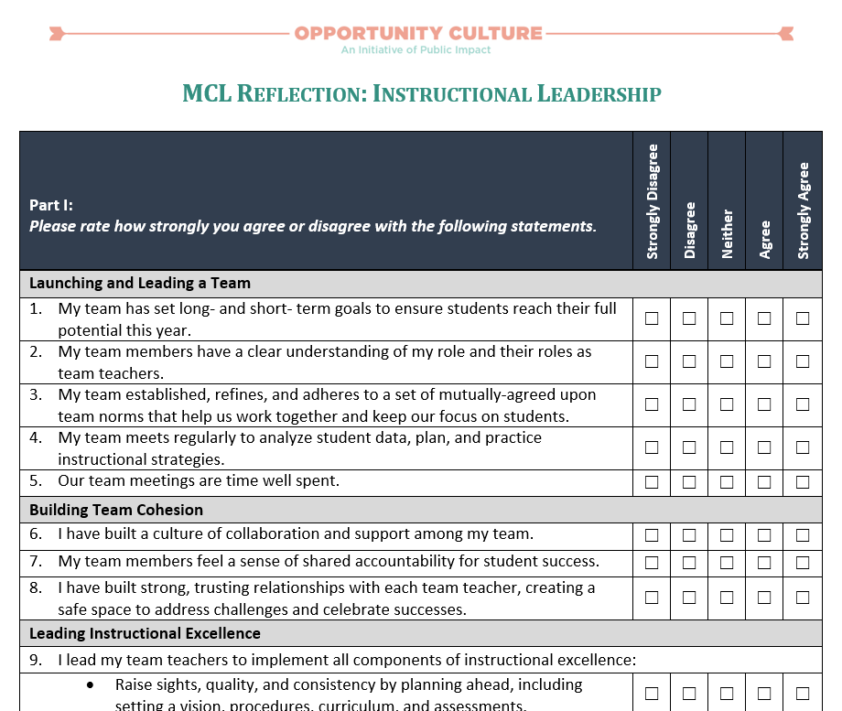
See Handout
Do Now
Time for this activity: 10 minutes
Notes:
Facilitator:
Objective of this slide: MCLs complete self-assessment.
Estimated time: 10 minutes
Facilitator says:
To start this session, let’s first take the time to reflect individually on your own instructional leadership. Let’s log on to the portal (or take out handout). Take about five minutes to fill out this self-reflection.

Slide 4
Handshake Partners
Find a partner you do not interact with often and discuss your self-reflection:
What is going well with your instructional leadership?
What would you like to improve?
Time for this activity: 5 minutes
Notes:
Facilitator:
Objective: Discuss MCL self-assessment.
Estimated time: 10 minutes
Facilitator says:
Consider the two questions on the screen:
What is going well with your instructional leadership?
What would you like to improve?
Take a moment to reflect individually on these two questions.
Now find someone you do not interact with often, and then stand up and discuss the two questions on the screen with that person. Go!
[Optional: If you want to have more interaction, you could do two rounds of this activity, prompting MCLs to find a new partner.]
Thank you. Please take a seat.
I’d like to get a sense of where the room is at in this category. Can I have one volunteer: What is one thing going well with your instructional leadership?
[Write response on chart paper. Ask participants to raise their hands or snap if they agree, and then ask for another thing going well. Continue this until there are no new strengths to add to the chart paper. Note that if participation is low, you could do a whip around.]
What about areas of improvement? Can I get a volunteer to share one think you would like to improve on?
[Write response on chart paper. Ask participants to raise their hands or snap if they agree, and then ask for another area of growth. Continue this until there are no new improvements to add to the chart paper. Note that if participation is low, you could do a whip around.]

Slide 5
Review the Six Steps for Effective Feedback and the Situational Leadership framework.
Discuss how to adapt coaching conversations based on the current skill and will of a particular teacher.
Role play an upcoming coaching conversation with one of your team teachers.
Notes:
Facilitator:
Objective of this slide: Review the objectives for the session
Estimated time: <1 minute
Facilitator says:
In this session, we will build off our what and how to coach sessions from summer training and focus on one teacher you are currently working with. We have three key objectives:
Review the Six Steps for Effective Feedback and the Situational Leadership framework.
Discuss how to adapt coaching conversations based on the current skill and will of a particular teacher.
Role play an upcoming coaching conversation with one of your team teachers.

Slide 6
See Handout
Do Now
Using your Coaching Conversation Sort handout, reorder the quotes so that they are sequenced chronologically for the most effective possible feedback conversation.
Time for this activity: 5 minutes
Notes:
Facilitator:
Objective of this slide: Review the steps of effective coaching conversations.
Estimated time: 5 minutes
Facilitator says:
In your Coaching Conversation Sort handout, you will see seven quotes. These quotes were pulled from a longer, 30-minute coaching conversation between a MCL and a team teacher. However, these quotes are not in the order they appeared in the coaching conversation.
With your table group, read through the quotes and reorder them so that they are sequenced chronologically for the most effective possible feedback conversation.
Write your recommended order in the right-hand column.

Slide 7
See Handout
Coaching Conversation Protocol
G
D, A
E
See it
Name it
Praise
Probe
Action Step
Plan Ahead
Practice
Follow-up
C
F
B
Do it
Bambrick-Santoyo, Paul (2012). Leverage Leadership: A Practical Guide to Building Exceptional Schools. San Francisco: Jossey-Bass.
Notes:
Facilitator:
Objective of this slide: Review the Six Steps for Effective Feedback.
Estimated time: 10 minutes
Facilitator says:
Over the summer, we introduced Leverage Leadership’s Six Steps for Effective Feedback as a strong example of one coaching framework. Of course, there are many coaching frameworks out there that you may use at your school. I’d love to get a sense of what coaching framework your schools decided to use. Can each school share what coaching framework you are using?
For today’s purposes, it is important that we share a common language as we discuss and practice, so we are going to review the Six Steps for Effective Feedback. However, if you use a different framework, please draw connections to your framework and share differences for the full group to create a more robust conversation.
Let’s go back to the Do Now sorting activity:
Which quote do you think appeared first in the full conversation? [Pause for participants to respond. Look for G. Note that throughout this activity, MCLs could make strong arguments for a different order—this is perfectly fine and is dependent on what coaching framework they are using. Encourage disagreement and ask for rationale! Then bring the conversation back to: “In the Six Steps for Effective feedback, we see X step next.”]
[Click] The first step in the Six Steps to provide your team teacher precise praise. This steps establishes a positive tone at the beginning of the meeting, narrates a specific positive you saw during your observation, ideally something you had been working on together in the past, and prompts the teacher to reflect on how they were successful.
Which quote do you think would appear next in the conversation? [Pause for participants to respond. Look for D and A.]
[Click] Once you’ve identified a positive, you should move on to asking probing questions that prompt your teacher to respond to a targeted, open-ended question about their lesson. This step allows you to guide the teacher to reach conclusions about their lesson on their own. The Six Steps handout gives examples of probing questions you could ask.
In the coaching conversation quotes, you see the MCLs is probing the teacher about the exit slip, first asking how students did, why she thought that was the case, and then she started probing with the hope of getting her to realize that the exit slip questions were not aligned to the questions she actually asked the class. She then had the teacher watch the video of her questioning so that the MCL could presumably ask more questions, such as “How are the questions you asked students different than the one in your exit slip?”
What would come next in the conversation? [Pause for participants to respond. Look for E.]
[Click] The next step in the Six Steps is that you and your teacher should identify a concrete, bite-sized action step. There are a few ways to surface this action step, including:
The team teacher self-identifies a problem.
You ask scaffolded questions that lead the teacher to identify a problem.
You share classroom data or specific observations.
You state a problem you observed directly.
In our coaching conversation, the action step is for the teacher to write out all questions and checks for understanding in the lesson plan and ensure they are aligned to the rigor of the exit slip/interim assessment.
What is next? [Pause for participant responses. Look for C.]
[Click] Then, you should help your team teacher to plan ahead and revise an upcoming lesson to implement the action step.
Our MCL does this by asking the teacher to pull out tomorrow’s lesson. This allows them to actually rewrite the questions together.
What should come next in the conversation? [Pause for participant responses. Look for F.]
[Click] The next step is to practice. During this step, you and the team teacher should role play or simulate how the teacher could improve current or future lessons.
In our example, the teacher is going to go back to today’s lesson and practice asking new questions, some that are more aligned to the exit slip.
What is next? [Pause for participant responses. Look for F.]
[Click] Then, you should help your team teacher to plan ahead and revise an upcoming lesson to implement the action step.
Our MCL does this by asking the teacher to pull out tomorrow’s lesson. This allows them to actually rewrite the questions together.
And lastly, which quote should end the conversation? Pause for participant responses. Look for B.]
[Click] Finally, you should set a timeline for follow-up to continue your support and how the teacher accountable for improvement.

Slide 8
Situational Leadership
Directing
Delegating
Low Skill
High Will
High Skill
High Will
Ex: A new teacher who constantly seeks feedback, wants to improve. Could say things like “What should I do?”
Ex: A high-performing teacher who owns her own development.
(Low) <------ Commitment (will) Level -----> (High)
Coaching
Supporting
Low to Mid Skill
Low Will
Mid to High Skill
Low Will
Ex: A teacher not getting results who does not seem invested in wanting to change his practice.
Ex: A teacher who is getting good results, but is not open to changing her curriculum.
(Low) <------ Competency (skill) Level -----> (High)
Adapted from Blanchard, Ken (2003). The One Minute Manager. New York: William Morrow Company.
Notes:
Facilitator:
Objective of this slide: Review Situational Leadership framework.
Estimated time: 5 minutes
Facilitator says:
On the screen, you will see the situational leadership we presented over summer training. [Quickly reorient the group to the four quadrants, going step by step. The facilitator notes from summer training are copied below if needed.]
Think to yourself for a moment: You just reflected on a team teacher. In which quadrant does that team teacher fall on this framework?
Around the room, you will see four pieces of chart paper—one for each of the quadrants on the screen. Please move to the chart paper that corresponds to where you placed your team teacher.
**IF NEEDED, Facilitator Notes from Summer Training:
We all have natural “styles,” both for work and for leading others, but as strong and capable leaders, we need to adapt our leadership style and the type of support we offer to each situation. One size does not fit all (or even most). But how will you know what type of support to offer when?
The Hersey-Blanchard (Paul Hersey and Ken Blanchard) framework pictured here is one way to assess the teachers on your team in terms of what type of support they need at a particular point. Please keep in mind that this is a broad and general framework or guideline—it’s one way of thinking about how you may interact with your team teachers, but also serves as a reminder that we need to continue to adjust our interactions based on changing needs and circumstances—that is, situational adjustments! Also keep in mind that people change in different circumstances so a teacher may be high skill and high will in one situation and have very low will in another situation where they feel defeated.
Let’s first look at diagnosing our team teachers by determining their current levels of competency and commitment (some refer to this as “skill” and “will”). Along the x axis is the competency level, ranging from low to high. And along the y axis is the commitment level, ranging from low to high. So someone in the bottom left quadrant is “low skill and low will” and someone in the top right quadrant is generally high skill and high will.
[Click for next animation] Now let’s talk about four general leadership styles and how you would use them to support all the teachers on your team. First, those who have low competence but high commitment need a lot of direction, so the leadership style that is generally best suited for that quadrant is directing. They will generally do what you suggest, because they want to do well and improve. In this quadrant, the teacher-leader provides specific directions—what to do, how to do it, and when to do it, and closely monitors whether or not a team member accomplishes the task. What type of team teacher might you have in this quadrant? [Answer to look for: novice teacher.]
[Click for next animation] With team teachers who are highly competent and highly committed, delegating is an effective strategy because they don’t need a lot of direction or support. In this case, you as a teacher-leader can even turn over responsibility for decision-making or problem-solving to someone in this quadrant.
[Click for next animation] Those who are generally competent but may be wavering in commitment are particularly challenging. They don’t need a lot of direction, but definitely need supporting—in fact, what they often need is a morale boost. The teacher-leader could handle this by closely monitoring the team teacher’s efforts while also sharing responsibility for decision-making with them. Key to this quadrant is listening, providing support and ongoing encouragement for efforts.
[Click for next animation] Those who are less competent and also have low commitment will need pretty intensive coaching if they are going to become more productive and capable—as a teacher-leader, you will need to provide strong direction as well as ongoing external support and motivation. You will need to closely monitor progress toward goals, but in addition to providing clear direction, you must also explain the decisions, solicit suggestions, and support progress.

Slide 9
Situational Leadership
Why might someone in this quadrant be difficult to coach?
How could you adapt the Six Steps to better align with your teacher’s skill and will?
DIRECTING
Notes:
Facilitator:
Objective of this slide: Brainstorm ways to better “manage” a teacher in this quadrant.
Estimated time: 20 minutes
Facilitator says:
As a group, discuss the two questions on the screen. On the top half of the chart paper, take notes on why someone in this quadrant might be difficult to coach, and on the bottom half, take notes on how you could adapt your “managing style” to better align with the needs of a teacher in this quadrant.
Take seven minutes to fill out your chart paper as a group.
[After 7 minutes] Let’s come back together. Can each group share your responses to both questions? [After each question, see if others in the room have other ideas. Push their thinking by asking how they would prep a Six Steps conversation specifically for a person in this quadrant.]
[Note: If no one chose to go to one of the quadrants, bring this quadrant up at the end and prompt everyone to do a quick turn and talk, discussing the two questions on the screen for the directing quadrant. Then ask for several people to share.]

Slide 10
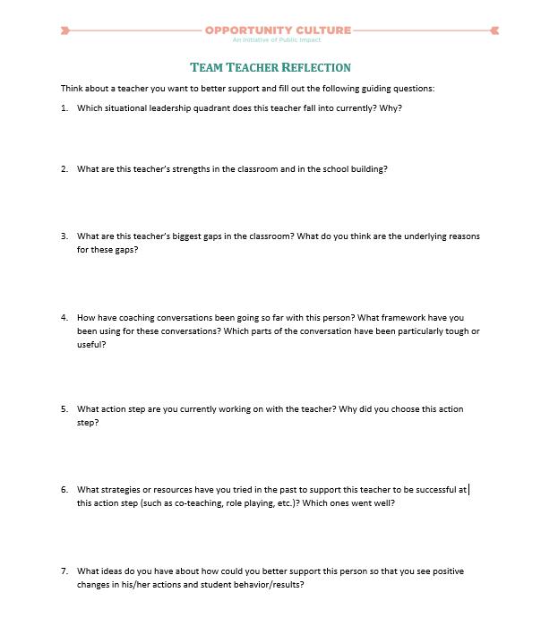
See Handout
Application
Independent Reflection:
Think about a teacher you want to better support.
Complete the Team Teacher Reflection handout.
Notes:
Facilitator:
Objective of this slide: Reflect on a current team teacher, who MCLs want to better support.
Estimated time: 10 minutes
Facilitator says:
By this time in the school year, you have already met with each of your team teachers several times. I would imagine that you have already seen some successes, where teachers has improved their practice as a direct result of your support! I can also imagine that you may be more stuck with other teachers.
Maybe you have a teacher who is really bought into your support, tries everything you tell her, but for some reason, you two just aren’t seeing the changes in student behavior you expected. Or maybe you have a teacher who is flying under the radar. Her management is pretty solid, and because you have had to put out other fires, you just haven’t had time to give her the support she needs to move from good to great. Or, maybe you have a teacher who is not really bought into the whole coaching thing, so you are struggling with how to move forward. Regardless of your exact scenario, you likely have a teacher whom you want to better support, and the best way to is to bounce ideas off of your principal and your peers. That is what today is all about. Of course, we want to maintain anonymity for our teachers, so please don’t use anyone’s real name in the exercises that follow.
Take the next five minutes to think about a teacher you want to better support. Then fill out the Team Teacher Reflection handout. You’ll be using this teacher as the inspiration for a brainstorming discussion and a coaching role play later today.

Slide 11
See Handout
Work Time
Plan a coaching conversation you could have with your team teacher.
Use your preferred coaching framework; a blank Six Steps template is provided.
Use a real action step for this teacher.
Incorporate ideas discussed in your Situational Leadership chart paper group.
Notes:
Facilitator:
Objective of this slide: Plan a coaching conversation with a team teacher.
Estimated time: 10 minutes
Facilitator says:
For the next 10 minutes, you will have time to individually prep for a coaching conversation with your team teacher. We will end today’s session by role playing this conversation with each other.
Feel free to use your preferred coaching framework. A blank Six Steps template is provided if that is the framework you would like to practice with today.
Because this is a real teacher, please choose a real action step that you think will move their practice.
Then incorporate some of the ideas just discussed in your Situational Leadership chart paper group.

Slide 12
Role Play
Time Allotted | Activity
5 minutes | Share background context
5 minutes | Role play the coaching conversation
5 minutes | Debrief the conversation: What was strong about your partner’s facilitation? What improvement would you suggest? What are other ideas for how your partner could better support his or her team teacher?
Notes:
Facilitator:
Objective of this slide: Practice a coaching conversation.
Estimated time: 30 minutes total
Facilitator says:
[Review the role play protocol on the screen]
We will spend 15 minutes for each role play. I’ll keep time for the role play and will let you know when it’s time to move on to the conversation debrief or switch to the next person’s role play.
Please stay in character the entire five minutes of the role play.
[After 15 minutes, prompt participants to switch to role play the other MCL’s scenario.]

Slide 13
Action Items
Write down 2-3 action items you commit to incorporating into your work based on your takeaways from this session. For example:
Action Item | People | Timeline | Status | Notes
Have coaching conversation with team teacher. | Me and teacher | 10/15 | Not complete
Notes:
Facilitator: PI
Objective: Write down action items participants are taking away from this session.
Time: 2 minutes
Facilitator Notes:
I know, as well as you know, that if we don’t write down specific next steps after a PD, then we might not actually do them! Please take the next few minutes to write down any action items you commit to incorporating into your work based on your takeaways from this session. [Review examples on the screen.]

Slide 14
Thank you for your engagement and participation.
Please complete the exit slip to provide feedback on this session prior to leaving.
Notes:
Facilitator:
Objective: Provide feedback on the session.
Facilitator says:
Thank you for coming and don’t forget to take the exit slip survey before you leave.

Slide 15
Follow Us!
Keep up to date on Opportunity Culture with resources and research from Public Impact by following:
@PublicImpact
@OppCulture
Facebook.com/PublicImpact
Facebook.com/OpportunityCulture
LinkedIn.com/company/public-impact---chapel-hill-nc
Subscribe to the quarterly Opportunity Culture newsletters, with content by and for Opportunity Culture educators, and sign up to get Remind messages for them:
OpportunityCulture.org/mailing-list/
Remind.com/join/ocnew

