Slide 1
MCLs & TRTs:
Analyzing Student Data
Notes:
Notes about this session: This session is intended to help TRTs learn about the best practices for data analysis
​
Advance preparation for this session:​
Please print out or make electronically available enough copies for each attendee:​
Analyzing Student Data Note-Taking Template
Action Plan Template
Sample Data Meeting Agenda

Slide 2

Handshake Partners
1. On a scale of 1—10, how comfortable do you currently feel using data in your classroom?
2. How might you use data differently in an Opportunity Culture?
1 = “PLEASE don’t show me a spreadsheet!”
10 = “I track data in my sleep.”
Time for partner activity: 3 minutes
Notes:
Objective of this slide: Kick off the presentation and get folks moving!
Estimated time: 5 minutes
Facilitator says:
Before we hop into the bulk of our session, let’s first get up and get moving!
This session will be all about analyzing student data in your new OC roles, so we are curious what role data already plays in your classrooms/buildings.
When I say GO, stand up and find someone you don’t know. Give them a warm greeting, and discuss the questions on this slide. GO!
[After 2–3 minutes, depending on conversations, invite participants to sit down.] Would any participants like to share highlights from your conversation? What will change in an Opportunity Culture? [Go question by question, inviting sharing with the whole group.]

Slide 3
Session Objectives
Learn about the best practices for data analysis:
  Creating a clear assessment calendar
  Setting ambitious, achievable student goals
  Tracking student progress toward goals
Prepare for new Opportunity Culture roles:
  Scaling data analysis up for a larger student group
  Facilitating data meetings for MCL teams
Notes:
Objective of this slide: Review session objectives
Estimated time: 2 minutes
Facilitator says:
Thanks to everyone for sharing! There is obviously a lot of great data analysis already happening in your buildings. Today, we want to share some best practices and discuss how those practices may change in your new roles.
[Review session objectives] Also, we want to acknowledge that you may already have data analysis practices in place that you prefer. That’s OK! We want to give you some food for thought. We also encourage you to share those existing practices with others in the room.
Today will also include quite a bit of work time, but a heads-up—we won’t get everything done during today’s session.
Let’s jump into it!

Slide 4

“There’s trained, & there’s untrained.”
Notes:
Objective of this slide: Spark conversation re: data analysis
Estimated time: 3 minutes
Facilitator says: [Show video.]
Source:
EngageNY: https://www.engageny.org/file/161/download/teacher-training-workshop.ppt?token=bHFnkAFL
Video link: https://www.youtube.com/watch?v=4WYlRcuLpR4

Slide 5

Turn & Talk
How does this video relate to analyzing student data?
Notes:
Objective of this slide: Have participants reflect on the video clip
Estimated time: 3 minutes
Facilitator says:
Now why have we chosen to kick off our session with this clip, aside from showing you part of what is unquestionably some of Denzel’s greatest work?
Turn and talk to a partner and consider—how does this video relate to analyzing student data?
[Give 3 minutes, then solicit responses] Exactly! Analyzing student data is all about giving students regular feedback, retesting students on the same objectives, and ultimately leading them to reach their goals.
Before we move forward, let’s establish a common definition for data-driven instruction.

Slide 6


Leveraging Leadership & Driven by Data
A framework from Bambrick-Santoyo’s book
Leveraging Leadership.
With components from Bambrick-Santoyo’s book
Driven by Data
Notes:
Facilitator:
Objective of this slide: Acknowledge Leveraging Leadership and Driven by Data as source materials for this session
Estimated time: 15 seconds

Slide 7
Data-Driven Instruction
“Data-driven instruction is the philosophy that schools should constantly focus on one simple question: are our students learning? Using data-based methods, these schools break from the traditional emphasis on what teachers ostensibly taught in favor of a clear-eyed, fact-based focus on what students actually learned. In doing so, they create a powerful paradigm to drive academic excellence.”
-Paul Bambrick-Santoyo, Driven by Data
Notes:
Objective of this slide: Establish common definition of data-driven instruction
Estimated time: 4 minutes
Facilitator says:
Could someone read this definition for us?
What sticks out to you most in this paragraph?
By a show of hands, who in here has been guilty of equating what you taught with what students learned? Can one of you share a bit about your experience?
I know I’ve done this! As you transition into new Opportunity Culture roles, it will be more important than ever to efficiently and effectively gauge whether students are learning, especially with larger student loads and teams to manage.
So, what exactly does it look like to employ effective data-driven instruction?

Slide 8
Components of DDI
Assess Regularly
Assign Clear Goals
Analyze Data
Act Accordingly
1
2
3
4
Bambrick-Santoyo, Paul (2011). Driven by Data: A Practical Guide to Improve Instruction. San Francisco: Jossey-Bass.
Notes:
Objective of this slide: Describe components of data-driven instruction
Estimated time: 2 minutes
Facilitator says:
Think of DDI as a four-step process (the four As)
Assess Regularly:
Before you can really analyze student data, you must first decide where that data will come from! As you’ll see, a high-quality assessment directly informs the type of instruction teachers deliver.
Assign Clear Goals
Once you’ve decided on the type and regularity of assessment, you can begin to set goals for all students based on their prior performance. Thoughtful, clear goals can be a powerful motivator for both students and teachers.
Analyze Data
Next, you can track student data in relation to their respective goals. Students and teachers need to know where they stand, and visually appealing, informative data tracking can be a powerful tool.
Act Accordingly
So you’ve given rigorous assessments, you’ve tracked the data, and you’ve identified the gaps—now what? You have to act by communicating data analysis to your students and teams and creating a game plan for intervention.
We’ll go into each of these components in more detail, starting with #1, Assess Regularly [click for animation].

Slide 9
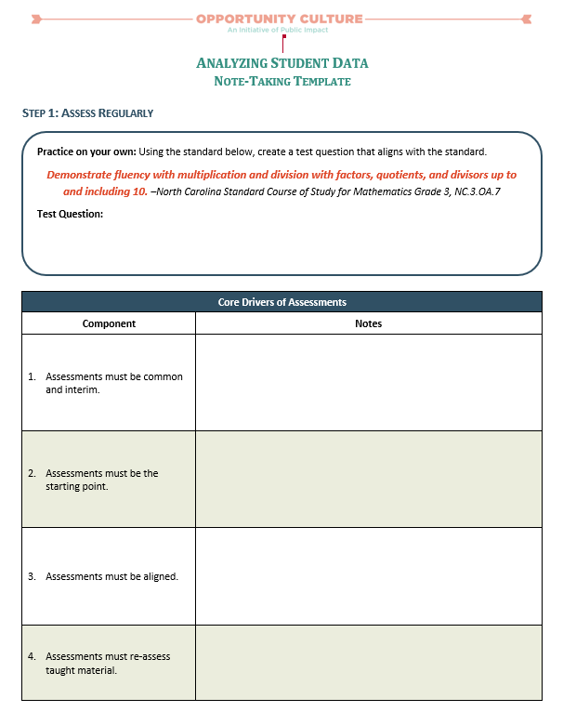
See Handout
Note-Taking Template
Notes:
Objective of this slide: Introduce note-taking template
Estimated time: 1 minute
Facilitator says:
Throughout today’s session, we’ll be using the Analyzing Student Data Note-Taking Template. We’ll direct you to different portions of the template throughout.

Slide 10
See Handout
Assessments = Road Map
Demonstrate fluency with multiplication and division…
–North Carolina Standard Course of Study for Mathematics Grade 3, NC.3.OA.7
Practice on your own!
What test question would you write for this standard?
Time for practice: 4 minutes
Notes:
Objective of this slide: Demonstrate necessity of clear, rigorous, common assessments
Estimated time: 5-7 minutes
Facilitator says:
Consider the following state standard from North Carolina (read standard; standard is intentionally shortened for simplicity; full standard = Demonstrate fluency with multiplication and division with factors, quotients, and divisors up to and including 10 http://www.dpi.state.nc.us/docs/curriculum/mathematics/scos/0617-adopted-k-8-standards.pdf).
Take 4 minutes and write a test question that would assess a student’s mastery of this standard; it’s OK if you aren’t a math person! Try your best.
[After 4 minutes] Now turn to a partner and share your question. Are they similar, are they different, how?

Slide 11
Assessments = Road Map
What is 27 multiplied by 3?
This Halloween, David received 24 mini Kit Kat bars. Unfortunately, his teacher requested he share them with his seven classmates. How many Kit Kats will each student receive?
During the last three games, Damian Lillard made 14 two-pointers and nine three-pointers. Jamal Murray made 11 two-pointers and 12 three-pointers.
  Who had the better PPG, or Points Per Game?
  In the next game, Murray made only five two-pointers while Lillard made eight. Who now has the better PPG?
Notes:
Objective of this slide: Show that standards are not what determine instruction/teachers will come up with different questions!
Estimated time: 3 minutes
Facilitator says:
As you can see, you had different ways of assessing standard mastery [run through different of questions, highlighting that some are more rigorous than others].
Standards, while helpful, can be somewhat vague. Standards are not what determines the rigor and mode of instruction, assessments do!
And if not given high-quality, rigorous assessments as a model, teachers can come up with pretty different methods of approaching the same standard. Teachers want to know what the bar for success is.
We want great assessments, and we want to use them strategically so there can be a consistent level of rigor schoolwide.
([f helpful, from Driven by Data:] “Instead of standards determining the type of assessments used, the type of assessments used actually define the standard that will be reached.”

Slide 12
Core Drivers of Assessment
According to Driven by Data, there are several core drivers to effective assessment:
Assessments must be common and interim
Assessments must be the starting point
Assessments must be aligned
Assessments must reassess taught material
Bambrick-Santoyo, Paul (2011). Driven by Data: A Practical Guide to Improve Instruction. San Francisco: Jossey-Bass.
Notes:
Objective of this slide: Intro Core Drivers of Assessment
Estimated time: 2 minutes
Facilitator says:
According to Driven by Data (which is a great resource you should consider purchasing and a resource we used quite a bit when creating this session), there are several core drivers to effective assessment. They’re the key components that make tests truly useful and data analysis meaningful [read each bullet point].
We’ll walk through each of these in more detail. As we walk through each, we encourage you to take notes in your note-taking template.

Slide 13
Common & Interim
Teachers in the same grade level and content should use the same interim assessments.
Interim assessments should be administered every six to eight weeks.
Turn & Talk
Why is it important to issue interim assessments that are common across teams?
Notes:
Objective of this slide: Explain why assessments must be common & interim
Estimated time: 3 minutes
Facilitator says:
Assessments should be common across teachers in the same content/grade levels. For those MCLs in the room, that likely means all of your team members should be using the same interim assessments.
Those interim assessments should be administered every six to eight weeks.
Question for the group—why is it important to have common, regular interim assessments? [encourage participants to turn to a partner, discuss, and jot down their ideas]
Exactly! Common interim assessments ensure that all teachers are accountable for the same material, that teachers can more easily compare data during team meetings, and that teachers have regular data points to track progress, not just one high-stakes test.
[Optional follow-up questions] How do you all feel about regular, common interim assessments? Are there any concerns, considerations? Does anyone already employ a similar system, and how has it been received?

Slide 14
Regular Formative Assessments
Exit Slips
Weekly Quizzes
Unit Tests
Turn & Talk
Should these assessments be common among team members?
How long should each of these assessments last?
Notes:
Objective of this slide: Note that assessment should also happen more regularly
Estimated time: 3 minutes
Facilitator says:
Obviously, assessment often happens more regularly than just interim assessments every six to eight weeks.
It occurs on a daily basis, with exit slips monitoring whether students mastered the standard for the day.
It occurs with weekly quizzes, assessing whether students understood the week’s material.
And it occurs with unit tests, issued at the end of an instructional period.
Turn to a partner and quickly discuss—do you think these assessments should be common among team members? Should teachers use all of these? How long should each of these assessments last?
Teachers often think that assessment takes up an inordinate amount of time, and they have a point, if assessment isn’t done right. Exit slips should take no more than 3 to 4 minutes, and weekly quizzes should be as short as 15 to 20 minutes.

Slide 15
The Starting Point
Interim assessments should be created before teaching begins, not after teaching has occurred.
Assessments should be transparent—teachers, students, and other stakeholders know exactly what skills will be tested.
Discuss
How can teachers ensure transparency with assessment?
Notes:
Objective of this slide: Explain why assessments should be the starting point
Estimated time: 3 minutes
Facilitator says:
People often think of assessment in reverse—you teach material, then you create a test that determines whether students learned the material.
Actually, assessment should be the opposite. The assessment determines how a teacher will teach the material—the rigor of the assessment drives the rigor of what is taught.
In addition, assessment should be transparent. There should be no surprises—teachers, students, parents, school leaders, etc., should know what is being assessed on every test.
[Quick question] How might we ensure transparency in our assessment? How have you in the past?
[Optional question] How many of you already plan instruction around interim assessments? Does this strike anyone as odd or backwards?

Slide 16
Alignment
Assessments should be aligned with:
  High-stakes district or state exams
  College- and career-readiness standards
  School expectations for specific grade levels and content
Turn & Talk
Why should assessments be aligned with college- and career-readiness standards, and not just district/state exams?
Notes:
Objective of this slide: Explain why assessments should be aligned
Estimated time: 3 minutes
Facilitator says:
It also goes without saying that assessments should always be aligned. Aligned with what? Well…[run through bullets—college/career readiness standards could include SAT/IB/AP exams, or other levels of college readiness as determined by researchers]
Why should assessments be aligned with college- and career-readiness standards, and not just district or state exams? Talk briefly with a partner about this. [Listen for: “existing exams are helpful, but sometimes aren’t rigorous enough to ensure students meet the bar for postsecondary success/true mastery of the material”].

Slide 17
Reassessment
Interim assessments should occasionally reassess previous material, which will:
  Provide students extra practice to retain material
  Inform teachers whether reteaching was successful
Show of Hands
Who has forgotten to reteach previously taught material?
HINT: USUALLY EVERYONE
Notes:
Objective of this slide: Explain why assessments should re-assess prior material
Estimated time: 2 minutes
Facilitator says:
Lastly, interim assessments should reassess previously taught material to
Provide students an extra opportunity to demonstrate mastery, and
Inform teachers whether students actually mastered/retained the material
Show of hands—who has worked through the curriculum, forgetting to reteach previous material? We all have. Reassessment is often what teachers forget most, but it is incredibly important.

Slide 18
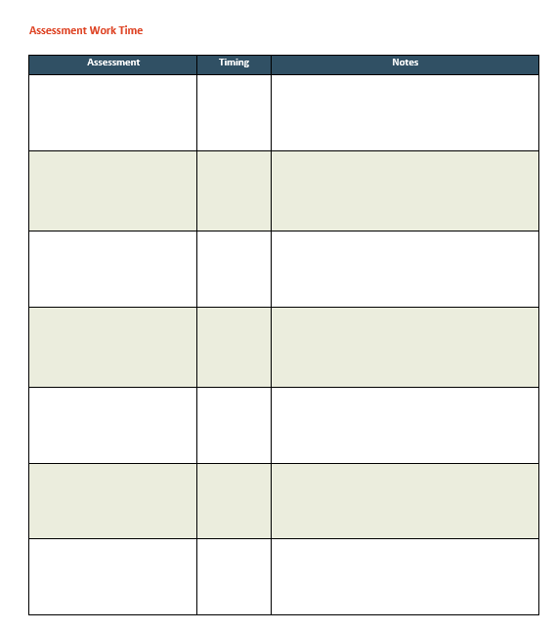
Assessment Work Time
What is your primary summative assessment?
Do you already have regular interim assessments? If not, what will you need to create and when?
When will you issue interim assessments throughout the year?
What other assessments will remain common among your team?
Notes:
Objective of this slide: Transition to assessment work time.
Estimated time: 10 minutes
Facilitator says:
Given what assessment should look like, let’s move to assessment work time
Ideally, you’ll begin the year with a clear assessment calendar, outlining each interim assessment you’ll give, when you’ll give it, and what it will cover. This is a great time for MCLs and TRTs to work together.
Given our timing, we won’t be able to get all of that done today. However, we can begin to answer some preliminary questions.
Consider the following questions [review questions].
You may also begin creating your assessment calendar, if you feel ready. We’ve provided an example for your benefit [Share example]

Slide 19
Components of DDI
Assess Regularly
Assign Clear Goals
Analyze Data
Act Accordingly
1
2
3
4
Bambrick-Santoyo, Paul (2011). Driven by Data: A Practical Guide to Improve Instruction. San Francisco: Jossey-Bass.
Notes:
Objective of this slide: Transition to setting student goals
Estimated time: 5 minutes
Facilitator says:
Now that you’ve thought through assessment for next year, let’s chat a bit about assigning clear goals for students.
As mentioned, it’s important that you are able to analyze student results in context—every student has his or her unique strengths and challenges, and teachers should take those into account.
So, how does one go about setting student goals?

Slide 20

Stop & Jot
What was your overall goal last year?
Time for Stop & Jot: 2 minutes
Notes:
Objective of this slide: Kick off student goals time
Estimated time: 2 minutes
Facilitator says:
Think back to this most recent school year. What was your overall goal last year? Jot down your answers.
[After 2 minutes] Now turn to a partner and share your goals, and then share with the group—what is different/similar in the overall goal you chose?
[Listen for some identifying proficiency while others focus on growth]

Slide 21
Create Goals & Break Them Down
Proficiency
  40% of students will be proficient on the biology EOY test
  40% of 394 biology students = 158 students are proficient
  Proficiency for biology EOY test is 65% or higher
  …we need 158 students to score 65% or higher on assessments regularly & cumulatively
Growth
  80% of students will exceed projected growth
  315 of the 394 students must exceed their predicted score on assessments regularly & cumulatively
Notes:
Objective of this slide: Encourage participants to create goals and break them down
Estimated time: 3 minutes
Facilitator says:
As you can see, people had different approaches to their overall school goal, but typically those goals took the form of overall class/subject proficiency or growth targets.
That makes sense, as these are the metrics that district/state/federal governments set for schools.
However, teachers and leaders often do not break these large percentages down further. You’ll want more specific targets to give you something to aim for every day.
[Review examples, noting that these came from a biology MCL] Show of hands—is this something you already do in your schools/classrooms?

Slide 22
Break Them Down Even More!
Within a class, look at each student’s data. For example:
Student A
  Predicted to fall in the 30th percentile in the state
  30th percentile in the state correlated with a 62/D on last year’s EOC
  Student A’s goal is to score at least a 62/D or higher on every assessment
Student B
  Predicted to fall in the 74th percentile in the state
  74th percentile in the state correlated with a 87/B on last year’s EOC
  Student B’s goal is to score at least an 87/B on every assessment
Notes:
Objective of this slide: Encourage participants to break it down even more
Estimated time: 3 minutes
Facilitator says:
You can even break it down further [review example, drilling down to the student level]
[Note: this example is from NC, so percentiles and their relationship to proficiency + growth may differ. The point to emphasize, regardless, is to figure out what each student is expected to score/what they need to score to exceed expectations. Set that as the baseline for all regular assessments.]

Slide 23
Set Teacher-Level Goals
For example:
  158 students need to be proficient →
  4 teachers teaching 6 sections/classes each →
  24 sections/classes total →
  …approximately 7 students per class should be proficient to reach the goal, given an average class size of 16 students.
Other factors to consider:
  Does one teacher or class have primarily honors, ELL, EC/SPED, or some other enrollment stipulation impacting the course?
  How many students on the roster are entering on grade level? Proficiency score should be at least that percent or higher.
  Note: Honors classes should have a higher proficiency goal. ELL or SPED may have a lower proficiency goal. But, growth goals stay constant because we want to grow every student in every class!
Notes:
Objective of this slide: Encourage MCLs to work with their teachers to set teacher-level goals
Estimated time: 2 minutes
Facilitator says:
For the MCLs in the room—you may consider setting teacher-level/class-level goals. What does each of your teachers need to accomplish to meet the overall grade/subject area goal?
However, not every teacher teaches the same students [review other factors to consider].

Slide 24

Break Goals Down by Teacher
Teacher | Goal proficient | Predicted proficient** | Interim 1 | Interim 2 | Interim 3
 | No. of Students
Teacher Smith | 31 | 11 | 31 | 24 | 23
Teacher Jones | 27 | 21 | 28 | 35 | 31
Teacher Anderson | 4 | 1 | 14 | 9 | 13
Teacher Williams | 10 | 4 | 22 | 24 | 25
Teacher Smith’s Proficiency Goal = 31/41 students
Honors Block 1 (26 students)
17/26 proficient on Interim 3 Assessment
23/41 students proficient on Interim 3 Assessment
Block 2 (15 students)
6/15 proficient on Interim 3 Assessment
Notes:
Objective of this slide: Encourage participants to create teacher-specific goals.
Estimated time: 3 minutes
Facilitator says:
Given that classrooms are different, with their own challenges and opportunities, strong Opportunity Culture schools often set teacher-specific goals based on the predicted scores of the students they teach.
Here’s a real-world example from an OC school in Charlotte. The teacher team consisted of four teachers, each of which had a different student population.
Teacher Smith had only 11 students predicted to pass the exam, but he decided to be extra ambitious and set a goal of 31 proficient. That 31 became the basis for every assessment, especially common interim assessments.
Students hit the mark on interim 1, but scores have consistently fallen short, with only 23 students meeting the goal on the last interim assessment.
Teacher Smith is not meeting his personal goal, but he is exceeding predicted performance.
MCLs should work with their team teachers to set teacher-specific goals related to their individual students’ projected performance.
Any questions?

Slide 25

Goal-Setting Work Time
What types of data do you need?
What data do you currently have?
What do you need to request from the district and/or state?
Work Time: 10 minutes
Notes:
Objective of this slide: Quick work time to take stock of data availability.
Estimated time: 10 minutes
Facilitator says:
We won’t have time today to set student and teacher-level goals. However, we can identify the data you’ll need to start the process (and we will have work time at the end of the day).
Consider and jot down answers to the following questions for the next 10 minutes [review questions]
[After 10 minutes, have some participants share their ideas—note that schools will likely need access to the same data; defer to district staff, if present]

Slide 26
Components of DDI
Assess Regularly
Assign Clear Goals
Analyze Data
Act Accordingly
1
2
3
4
Bambrick-Santoyo, Paul (2011). Driven by Data: A Practical Guide to Improve Instruction. San Francisco: Jossey-Bass.
Notes:
Objective of this slide: Transition to analyzing data
Estimated time: 3 minutes
Facilitator says:
Now that we’ve briefly discussed setting student goals, you’ll have a comparison point when analyzing and tracking student data.
What exactly does effective data analysis look like?

Slide 27
Core Drivers of Analysis
Analysis should be:
  User-friendly
  Conducted with test in hand
  Deep
  Quick
Notes:
Objective of this slide: Describe core drivers of effective data analysis
Estimated time: 2 minutes
Facilitator says:
Thankfully, Driven by Data has also given this some thought.
Similar to Assessment, there are several core drivers of data analysis [read through bullet points].
We’ll go through each of these in more detail.

Slide 28
User-Friendly Reports
Data is useless unless it’s in an easily digestible form
Reports should be a maximum of one page per class
Reports should allow for analysis at four levels:
    Question Level
    Standard Level
    Individual Student Level
    Whole-Class Level
Notes:
Objective of this slide: Emphasize that data analysis should be user-friendly
Estimated time: 2 minutes
Facilitator says:
First, data is useless if it is not in an easily digestible form. Both teachers and students are more likely to value data analysis if it’s in a user-friendly package.
For example, a good rule of thumb is:
Provide data reports that are a maximum one page per class. Teachers and students should not need to flip through multiple pages of a Word document or multiple tabs in a spreadsheet.
Data reports should also allow for analysis at four different levels [read through levels].
Let’s look at an example together.

Slide 29
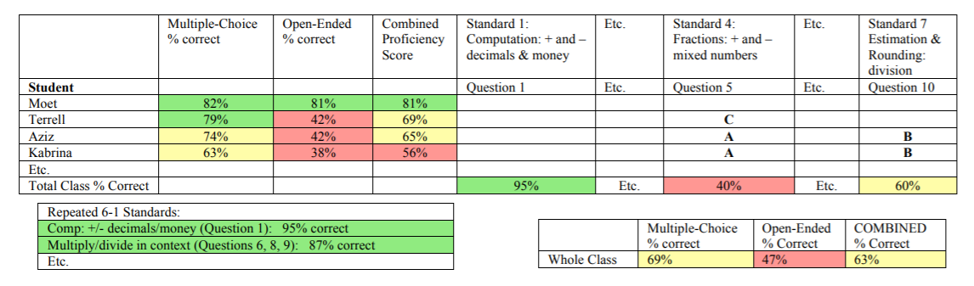
Data Report Example
For a quick tutorial on how to make a student data analysis spreadsheet, check out this link:
https://bit.ly/2WOGMzN
Notes:
Objective of this slide: Emphasize that data analysis should be user-friendly
Estimated time: 3 minutes
Facilitator says:
[Walk through example, noting how it provides for analysis at the four levels:]
Here’s a simple, condensed version of a data tracker for an interim assessment.
[Orient participants to the tracker] The tracker gives the overall percentage correct for each student, with conditional formatting (75% + = green, 60% - 74% = yellow, and 60 below = red); the conditional formatting makes it much easier to see data trends.
Most important, the tracker includes [click to animate] questions aligned to each standard, [click] individual student results, [click] and whole-class results.

Slide 30
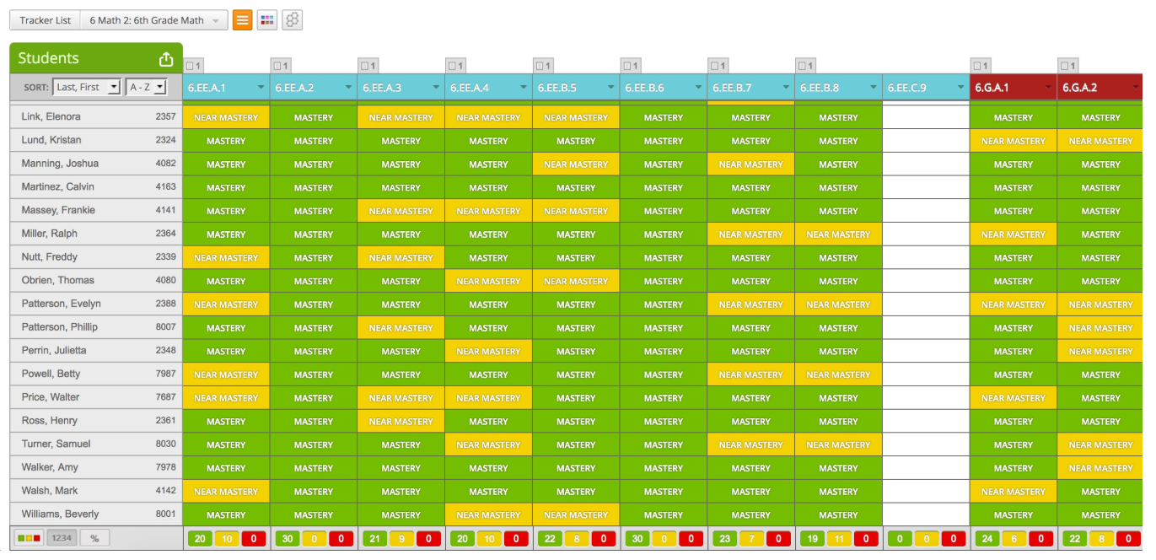
Online Options
Notes:
Objective of this slide: Emphasize that data analysis should be user-friendly
Estimated time: 1 minute
Facilitator says:
Your school may already use an online option such as MasteryConnect or Summit Learning, which already provides visually appealing data reports.

Slide 31
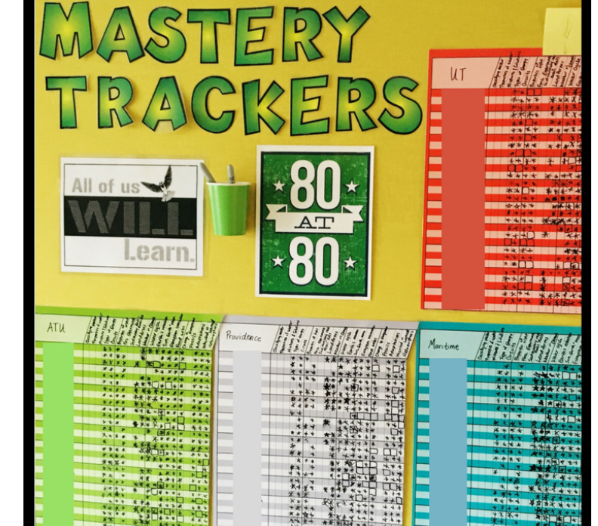
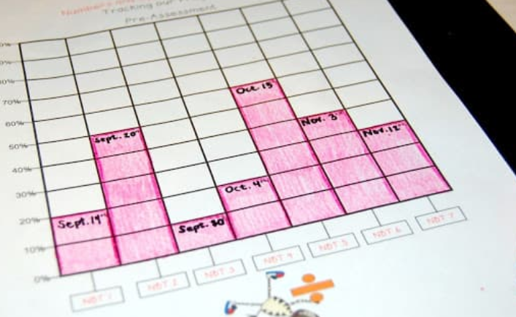
Paper Options
Notes:
Objective of this slide: Emphasize that data analysis should be user-friendly
Estimated time: 1 minute
Facilitator says:
And you may also choose to go with a more pen-and-paper method, which can still be powerful.

Slide 32
Stop & Jot
Do you currently track data this way?
How comfortable would you feel tracking data this way?
Time for Stop & Jot: 3 minutes
Notes:
Objective of this slide: Assess participant comfort with tracking data
Estimated time: 5 minutes
Facilitator says:
[Introduce Stop & Jot; direct participants to note-taking template; give them 3 minutes to jot, 2 minutes to share with the whole group)
Even if you’re already comfortable tracking data, you may need to find a quicker way to break down data (for TRTs especially) and to help implement a consistent data tracking system across your team (for MCLs).

Slide 33
Test in Hand
It doesn’t make sense to look at a data report in isolation.
Always conduct data analysis with the test in hand for a clear reference point.
Otherwise, you are a coach reading about his team’s performance in the newspaper, and not checking the tape!
Notes:
Objective of this slide: Emphasize that data analysis should be done with the test in hand
Estimated time: 2 minutes
Facilitator says:
In addition to making the report user-friendly, data analysis should be done with the test in hand.
Data reports mean little without simultaneously looking at the assessment. You want to know exactly what students got wrong. As we mentioned earlier, a standard can look a lot different question to question or teacher to teacher. Looking at an individual question is the only real way to see what students got wrong.
[Mention coach example on the slide]

Slide 34
Deep Analysis
Don’t focus on WHAT students got wrong, focus on WHY they got it wrong.
Turn & Talk
On your last assessment, students scored a 70% on your multiplication/division question.
What does this indicate?
Notes:
Objective of this slide: Emphasize that data analysis should be deep
Estimated time: 2 minutes
Facilitator says:
Once you have the test in hand, you can perform truly deep data analysis, during which you determine why students got something wrong, not what they got it wrong.
Let’s pretend your students take an assessment and they score 70% overall on your multiplication/division question. What does this indicate?
[Have participants turn and talk, then share thoughts with the whole group. Expect participants to say “a majority of my students seem to have mastered the standard” or “I need to reteach the standard to 30% of students”)

Slide 35
Question + Standard Analysis
34% Correct
15. Troy drove 36 miles in an hour. At this rate, how far would he travel in 2 ^{¼} hours?
A. 72 miles B. 80 miles C. 81 miles D. 90 miles
82% Correct
30. If a machine can fill 40 bottles in 6 seconds, how many bottles can it fill in 18 seconds?
A. 24 B. 12 C. 8. D. 7
Notes:
Objective of this slide: Provide example of deep analysis
Estimated time: 3 minutes
Facilitator says:
However, sometimes things aren’t exactly what they seem. That’s why it’s crucial to conduct question-level analysis and standard-level analysis side by side.
Take the following example—a math teacher issues an assessment. When asked about ratios and proportions, only 34% of students got question 15 right.
The teacher may think, “Well, only 34% of kids mastered the material, or I need to reteach to 66% of the class.”
[Click] After looking more closely at the assessment as a whole, however, the teacher discovers that 82% of students got question 30 correct, which assesses the same standard.
Looking more closely, the teacher realizes that of the students who got question 15 wrong, almost all of them chose choice A [click]. The teacher realizes that students understand rates and proportions, but they are actually having trouble multiplying mixed numbers. They put 36*2 instead of 36*2 ¼.
The teacher realizes she should reteach multiplying fractions/mixed numbers.
Deep analysis allowed the teacher to get at the root of the problem.

Slide 36
Other Deep Analysis Strategies
Search by Separators
Find questions where stronger students outperform their peers; helps to highlight small-group + pullout instruction.
Scan by Student
Look beyond the aggregate data. Individual results may highlight trends or misconceptions for low-performing students.
Question | 1 | 2 | 3 | 4 | 5 | 6 | 7 | 8 | 9 | 10 | 11 | 12 | 13 | 14 | 15 | 16 | 17 | 18
Chandler |  |  |  | B |  |  |  |  |  | A | B | C | A | A | D | C | B | D
Notes:
Objective of this slide: Outline other deep analysis strategies
Estimated time: 3 minutes
Facilitator says:
Two other deep-analysis strategies include “Search by Separators” and “Scan by Student.”
With “Search by Separators,” teachers find questions where stronger students outperform their peers. This analysis can highlight where certain groups of students would benefit from more targeted instruction. The teacher could reteach the standard while giving stronger students reach assignments to further sharpen their skills.
With “Scan by Student,” teachers look beyond the class-level data and focus on individual students. This often highlights misconceptions one might have missed.
Take Chandler, for example [click], who scored the lowest in the class on your last weekly assessment. You may think, “Chandler simply didn’t master the material.” However, when you drill down, you realize Chandler did great on the first half of the assessment. It could be that she ran out of time or fell asleep, not that she didn’t know the material.
Are there other successful analysis strategies you’ve used in the past?

Slide 37
Quick Results
Results from assessment and analysis should be turned around as soon as possible.
Put systems in place to grade and analyze assessments quickly
For example:
  Use software programs that automatically grade assessments
  Work with your RA to tag-team grading
  Schedule time after assessments solely dedicated to grading and analysis
Notes:
Objective of this slide: Describe importance of quick results
Estimated time: 3 minutes
Facilitator says:
Last, analysis should be quick! Results from assessment and analysis aren’t useful unless we can get them in the hands of students/teachers as quickly as possible.
This might include putting systems in place to grade and analyze assessments quickly (especially important if you’re a TRT and taking on an even larger student load).
Some strategies might include [review bullets].
Are there any other methods you’ve used to quickly grade and analyze data?

Slide 38
Analyze Data Work Time
What tracker will your team use next school year?
How can you improve speed of grading/analysis?
What guidance will you provide to team teachers?
When will you meet with team teachers to discuss?
Notes:
Objective of this slide: Transition to work time.
Estimated time: 10-15 minutes
Facilitator says:
Now, let’s transition to Analyze Data work time. Obviously, you don’t have a data set to start analyzing today, but it’s helpful to start thinking about what systems you might employ to grade, analyze, and track your student data.
MCLs, keep in mind that you may want these systems to be consistent across your team members.
MCLs and TRTs will work together during this work time; MCLs/TRTs can make joint decisions for their teams.
During work time, consider the following:
What tracker will your team use next school year?
How can you improve speed of grading/analysis?
What guidance will you provide to team teachers?
When will you meet with team teachers to discuss?

Slide 39
Components of DDI
Assess Regularly
Assign Clear Goals
Analyze Data
Act Accordingly
1
2
3
4
Bambrick-Santoyo, Paul (2011). Driven by Data: A Practical Guide to Improve Instruction. San Francisco: Jossey-Bass.
Notes:
Objective of this slide: Transition to Act Accordingly
Estimated time: 3 minutes
Facilitator says:
Once you’ve analyzed data, you have to act on that data analysis and address the gaps you’ve uncovered.
“Act Accordingly” will look a bit different from role to role:
TRTs, you’ll want to consider how to create a clear action plan for reteaching standards, spiral standards into parts of your lesson plan (Do Now, CFUs, Homework), and provide more targeted interventions.
MCLs, you’ll want to implement a consistent action plan template across your team, communicate expectations, and facilitate effective data meetings.

Slide 40
Post-Assessment Cycle
Teacher analyzes data to understand WHY teachers did not master material
Teacher completes an action plan based on data analysis results
Teacher shares assessment results and action plan with MCL
MCL reviews assessment results to prepare for data meeting
MCL facilitates team data meeting
MCL reviews teacher action plan, provides feedback
Notes:
Objective of this slide: Outline post-assessment cycle
Estimated time: 5 minutes
Facilitator says:
There should be a set protocol after every assessment.
Immediately after an assessment….[describe each step of the cycle; pink indicates teacher/TRT actions, green indicates MCL/admin actions]
[Pause for questions]

Slide 41
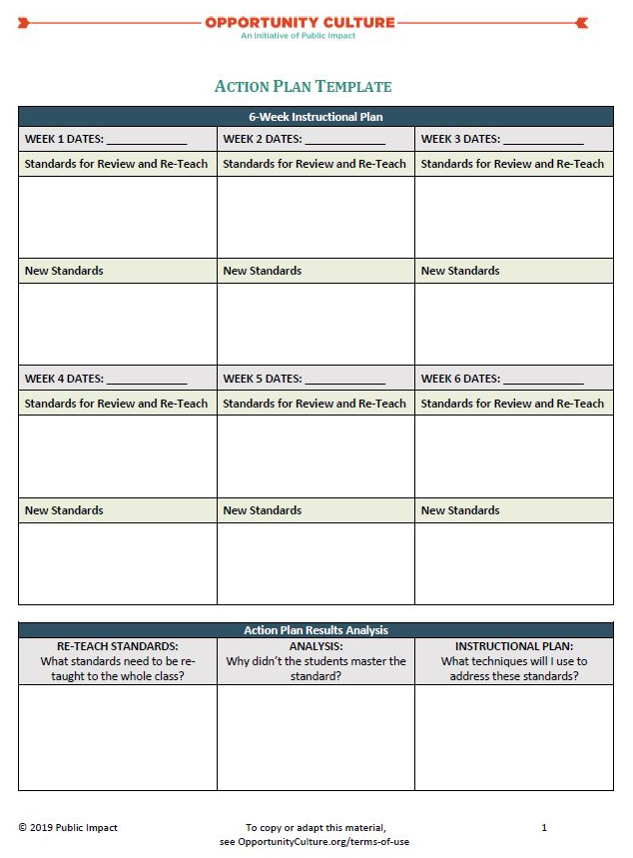
See Handout
Action Plan Example
Notes:
Objective of this slide: Describe purpose and format of the action plan
Estimated time: 5 minutes
Facilitator says:
When we say “Create an Action Plan,” you may think it is a complicated process—but it doesn’t have to be.
An Action Plan can be fairly simple, and at its core, the Action Plan answers three questions:
What standards need to be retaught to the entire class?
Why didn’t the students learn it?
What techniques will you use to address these standards?
An Action Plan is often structured like a calendar—outlining what new standards the teacher will teach and which he/she will spiral back to [walk participants through very simple example action plan].
Often, teachers go into more detail (after becoming more comfortable) planning exactly how they’ll teach each new or repeat standard each day, using, for example,
CFUs
Weekly Assessments
Do Nows/Exit Slips
MCLs and TRTs should work together to define the use of an action plan like this and its format.

Slide 42
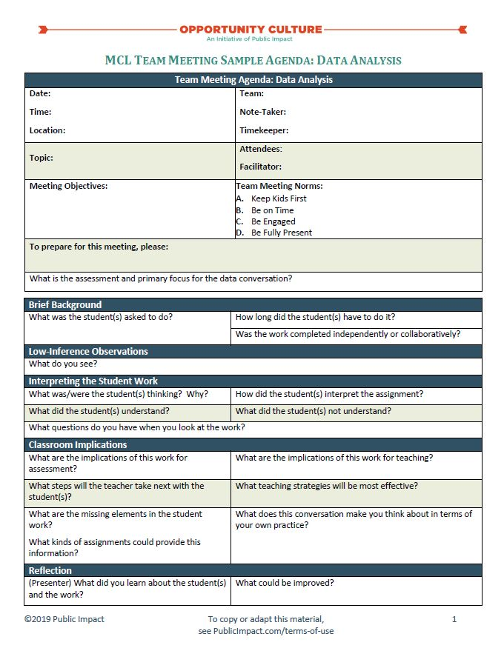
See Handout
Leading an Effective Data Meeting
When leading a data meeting, remember:
Let the Data Do the Talking
Let the Teacher Do the Talking
Go Back to Specific Test Questions
Know the Data Yourself
Notes:
Objective of this slide: Briefly intro instructional strategies
Estimated time: 5 minutes
Facilitator says:
When it comes to running a successful data meeting, whether with a whole MCL team or one-on-one, there are a few helpful tips to keep in mind.
Let the Data/Teacher Do the Talking:
Don’t just tell teachers what to do. Point to the data and have them arrive at the answer—great for buy-in and truly internalizing
Go Back to Specific Test Questions
Remember, data analysis/convos always happen with the test in hand
Know the Data Yourself
While you want teachers to arrive at the answer, it helps to know what to highlight/provide guidance along the way.
The regularity of your data meetings is really at your or your admin’s discretion, but our most successful MCLs try to meet weekly to discuss quiz data and meet about every 6 weeks for a longer meeting in which they discuss interim assessment data.
Data meetings can look pretty different place to place, but the most important thing is to have a consistent agenda and stick to it!
In addition, less is more. Consider focusing on only one or two standards that students struggled with across classrooms. You can have a deeper, richer conversation and feel less rushed.
Public Impact has provided a sample agenda you can use and adapt for your data meetings [direct participants to agenda]
[If there is time (likely not), have MCLs and TRTs begin crafting a standing agenda for their data analysis meetings.]

Slide 43
Action Steps
Write down and share a few next steps you commit to incorporating into your work based on your takeaways from this session.
Next Steps | By Whom | By When | Notes/Resources
Create assessment calendar for upcoming school year. | Team teachers | Before first day of school
Notes:
Facilitator:
Objective: Set action steps
Estimated Time: 3 minutes
Facilitator says:
At the end of each of our sessions together, we will encourage you to set some actions steps for yourselves based on what you learned during the session. We will always provide some examples. You will learn and experience a lot over the course of our training, so we want to help you ensure that you take note of actionable next steps after each session so you have a plan of attack to prepare for the first day of school.

Slide 44





Follow Us!
Keep up to date on Opportunity Culture with
resources and research from Public Impact by following:
@PublicImpact
@OppCulture
Facebook.com/PublicImpact
Facebook.com/OpportunityCulture
LinkedIn.com/company/public-impact---chapel-hill-nc
Subscribe to the quarterly Opportunity Culture newsletters, with content by and for Opportunity Culture educators, and sign up to get Remind messages for them:
OpportunityCulture.org/mailing-list/
Remind.com/join/ocnew

